Slide 1

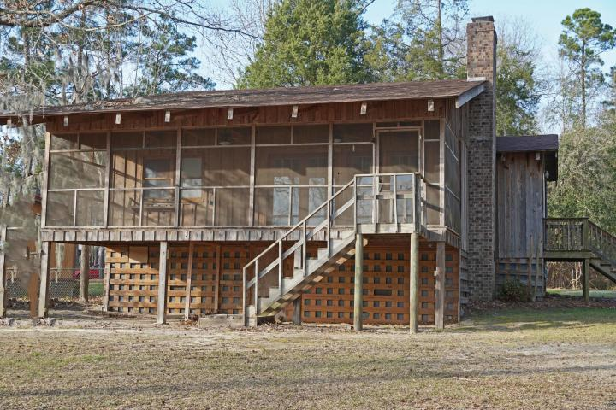
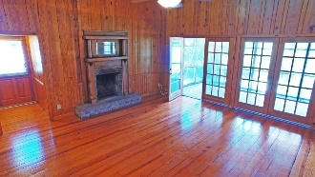
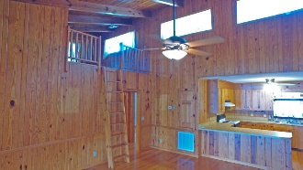
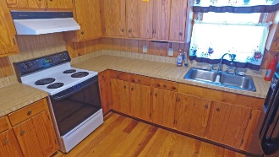
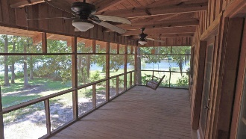
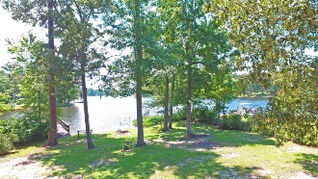
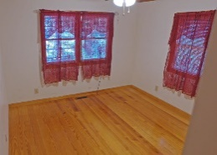
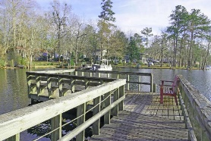
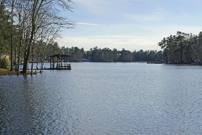
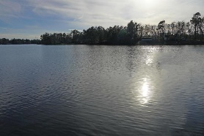
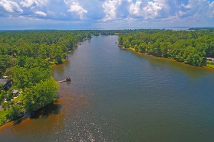

Cabin on the Lake
2110 Stukes Road
Manning, SC 29102
MLS# 18022004
$199,000
2 Bed | 1 Bath | 1,302sf
Enjoy sunrises and coffee overlooking the water. This home offers room enough for full time living or just a retreat from urban life. Sitting on the Church Branch inlet with over 60 ac of boatable water. Bring the family and make new traditions on the lake. This home has wonderful wood work and beautiful fireplace. Screened in porch for outdoor living. Don't miss this one!!!
Lake Homes Realty, LLC
Elloree, SC 29047
www.SCLakeLife.com
Kristie Anderson
(803) 387-9459
kristie@sclakelife.com

