Slide 1
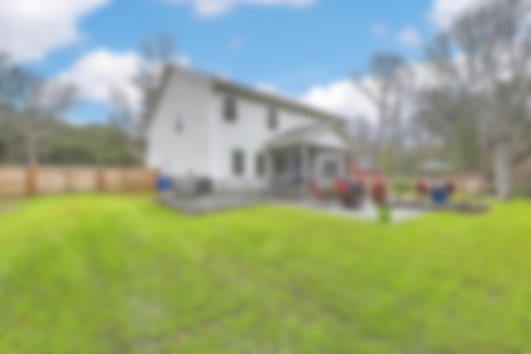
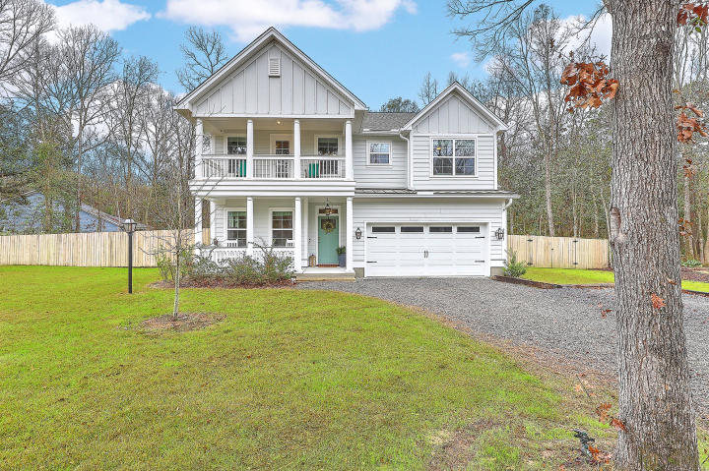
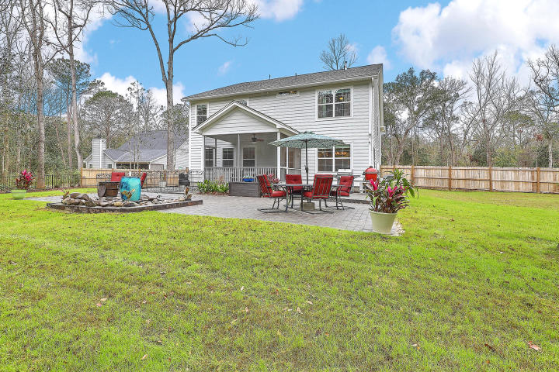
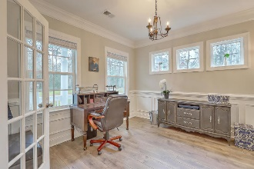
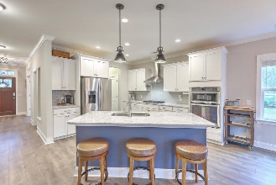
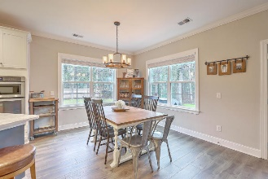
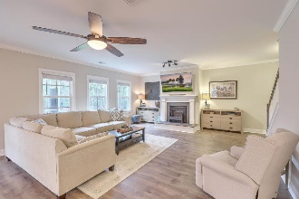
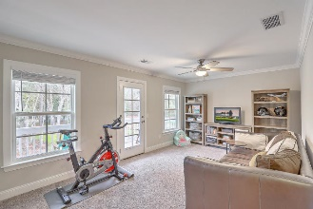
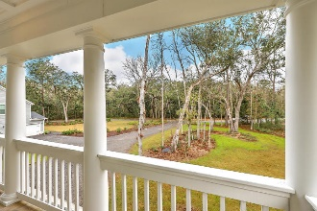
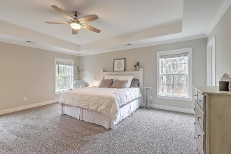
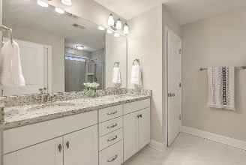
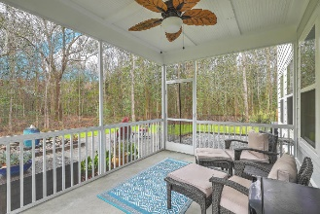
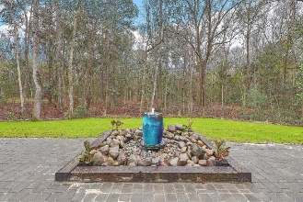


Just Listed In Waterloo Estates Open House this Saturday from 1 - 3
2111 Pecorino Lane
Waterloo Estates | Johns Island, SC 29455 | MLS# 20002740 | $534,975
Better than new, there is no need to wait for new construction with this gorgeous Charleston-single style home! Tucked away on a .6 acre lot which backs up to a natural preserve, you will instantly feel welcomed by the spacious front porch enhanced with gas lanterns. The wide foyer leads to an office with french doors which can double as a formal dining room. You will head into a cook's dream kitchen complete w/plentiful storage & workspace, marble counters, 5-burner gas cooktop, wall oven combo, walk in pantry & large center island w/seating. The open kitchen flows perfectly into the dining/family area ideal for entertaining. And on those chilly nights, you can sit by the cozy gas fireplace with a glass of wine and relax. Upstairs you will find the large Master en suite with tray ceiling, large, tiled walk-in shower and dual sinks. Three more nicely sized bedrooms with two full baths and a spacious Bonus Room with access to the top porch rounds off the top floor. The outside is an absolute private oasis with screened porch and huge patio with beautiful water feature - what a perfect way to end your crazy day by sitting out in your lounge chairs, enjoying the serenity! Waterloo Estates offers wonderful oak lined lots with walking trails and ponds to enjoy nature at its best. This location and neighborhood can't be beat! Wonderful restaurants are nearby, shopping just minutes away and the beach is an easy 20 minute drive. Waterloo is also a convenient drive to downtown Charleston and major highways. Pack your bags as this beautiful home is ready to go!
Desiree Maurer Office - (843) 416-2000
Mobile - (843) 327-9010 desiree.maurer1@gmail.com
www.yourcharlestonhousesearch.com
Keller Williams Realty 496 Bramson Ct Ste 200 Mt. Pleasant, SC 29464

