Slide 1
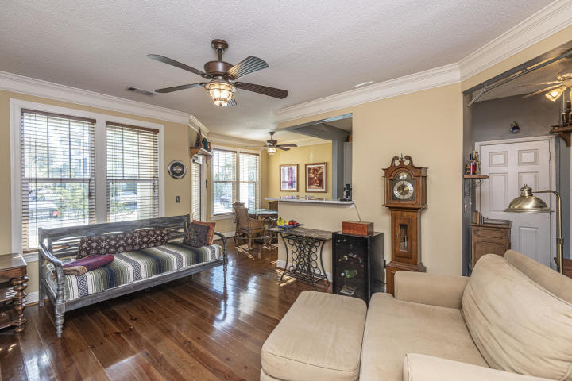
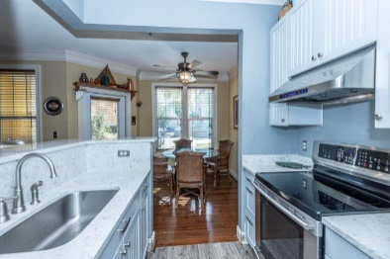
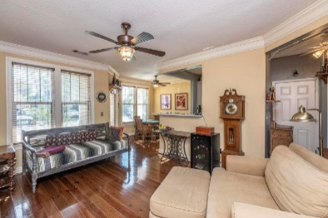
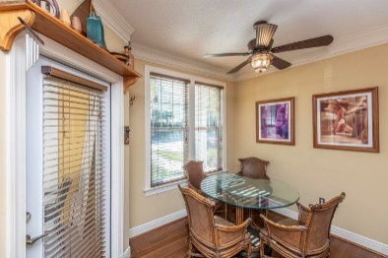
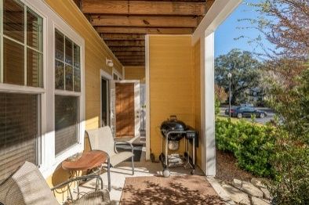
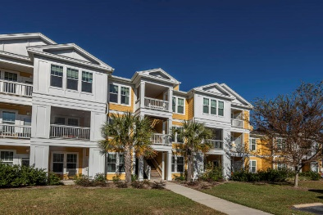
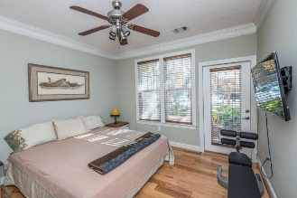
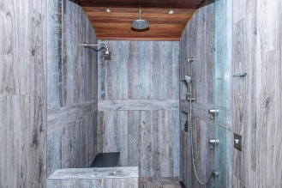
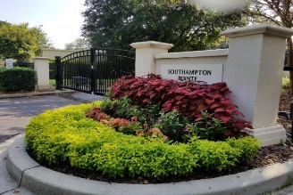
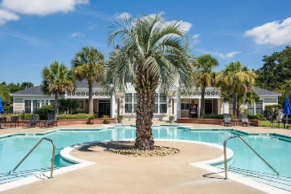
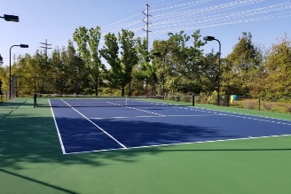


2112 Chatelain Way Southampton Pointe | Mount Pleasant, SC 29464 | MLS# 19033194 | $215,000
Condo With Great Amenities!
RENOVATED GROUND FLOOR CONDO in gated community of Southampton Pointe! Awesome location. New heart pine floors in living area, luxury vinyl plank floors in foyer and kitchen. Quartz countertops, new stainless appliances, 42'' domestic solid wood cabinets with soft/self closing hinges. Totally renovated bath with step-in shower, rain showerhead + 2 additional heads, granite bench, ceramic floors, Ipe barrell ceiling and halogen lighting. New vanity with granite top. Separate laundry room off bathroom. Engineered hickory floors in bedroom with walk-in closet. Bedroom also accesses patio. All new ceiling fans and 3-pc crown moulding throughout.
Great amenities in Southampton! Check out the photos!
Barbara Walker
REALTOR
O (843) 886-8110 | M (843) 906-5404
bwalker@carolinaone.com
www.barbarawalkerrealtor.com
Carolina One Real Estate
1503 Palm Blvd
Isle of Palms, SC 29451-2280

