Slide 1
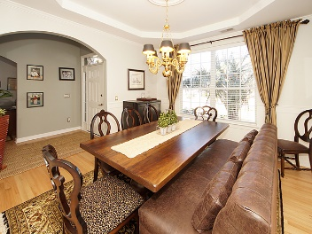
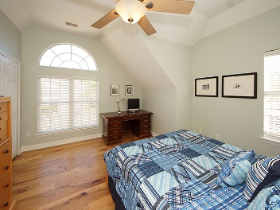
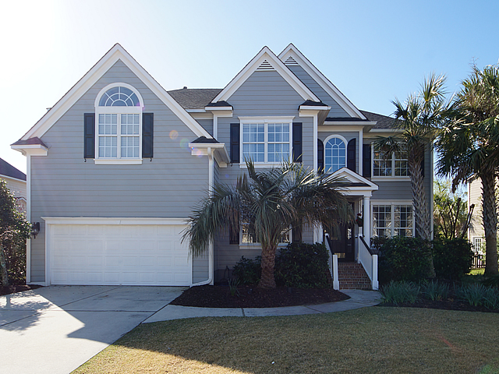
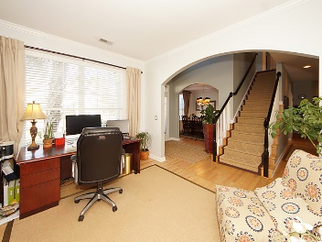
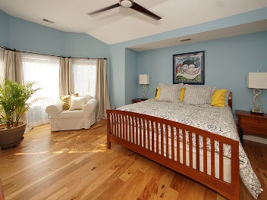
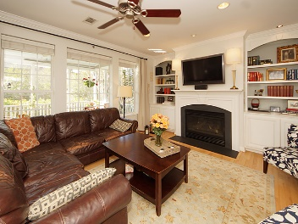
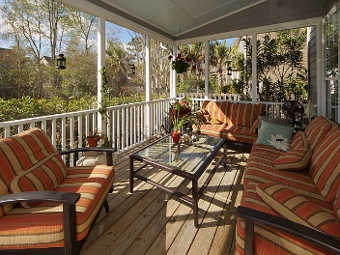
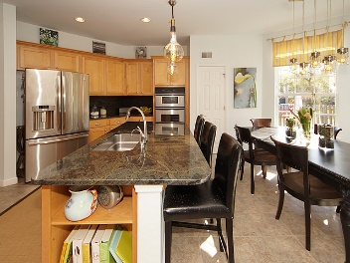
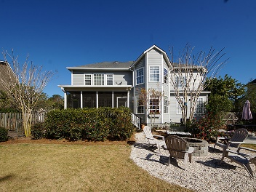


2112 Short Grass Court
Dunes West ~ Mount Pleasant, SC 29466
MLS# 17008422 ~ $534,900
Agent Luncheon Open House ~ May 2nd 11-1
$50 gas card drawing
Great floor plan and too many upgrades to list make this 6 bedroom 3 bath home a must seethe main living area includes family room, dining room, guest bedroom and a chef’s kitchen with granite counters, Wolf range, stainless steel appliances, Delta touchless faucet, hot water dispenser, under/over cabinet lighting, and more. Upstairs is the Owners suite,3 bedrooms, laundry room and large flex space that can also serve as either a 6th bedroom or rec room. Upgrades include: Nest thermostats, recessed lighting, dimmers throughout, beautiful hardwood floors, built in speakers in the owners suite, porch and family room wired for 7.1 surround. The yard is fenced and professionally landscaped for privacy and includes landscape lighting, large tabby patio, fire pit, Zoysia turf and full irrigation system. Set the mood with dimmers located in all public rooms including remote controlled dimmers in the Master Bedroom, and Family Room. Switches and outlets all upgrades to Decora (paddle) style, with metal plates. Comfort height toilets throughout. Floating plug in the family room floor, hardwood and ceramic tiled floors throughout, and tray ceiling in the master suite. The main floor includes the formal dining room and office or formal living room plus a guestroom with full bath on the main floor offering guests privacy. Enjoy the open floor plan with the cook's kitchen. The kitchen is a "wow" with granite counters, Wolf range, vented hood to the outside, Bosch dishwasher, oversized kitchen sink with Delta touchless faucet, hot water dispenser, under/over cabinet switched lighting, and more. This flows into the family room that has a gas log fireplace, custom book cases, and a wall of windows overlooking the screened porch. For movie nights the Family room is wired for 7.1 surround sound. Upstairs is the master suite, with in ceiling speakers, 3 bedrooms, full bath, and the media or playroom with large storage closet. Master bath has dual vanities, jetted tub, separate tiled shower and private commode room plus both upstairs baths are updated with granite counters, undermount sinks and tiled floors. Venturing outside the screened porch includes outdoor speakers. The fire pit and large tabby patio give plenty of space for outdoor entertaining in the private, mature, professionally landscaped for privacy, fenced in yard. The entire property includes irrigation, landscape lighting, and was sodded with Empire Zoysia. Dunes West is Mount Pleasant's premier gated community with membership to the club including Arthur Hills designed golf course, boat launch and storage and state of the art amenities available.
Franne Schwarb
843-270-1207
franne@charlestonfinehomes.com
Chari Karinshak
843-810-8287
Chari@CharlestonFineHomes.com
Coldwell Banker Residential Brokerage, 1127 Queensborough Blvd, Mount Pleasant, SC 29464

