Slide 1
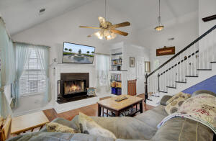
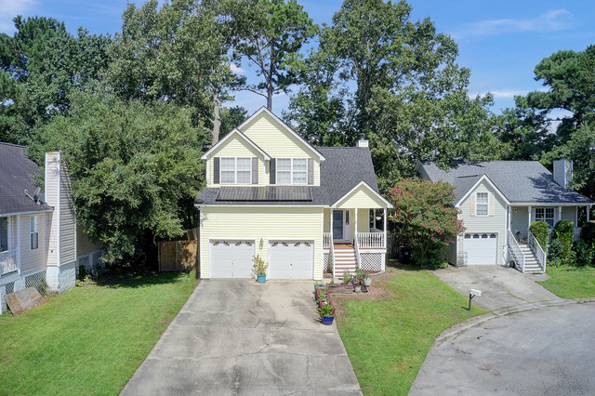
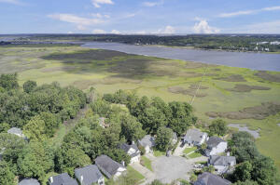
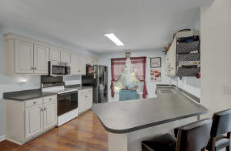
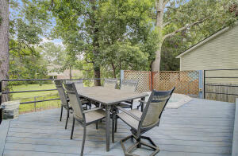
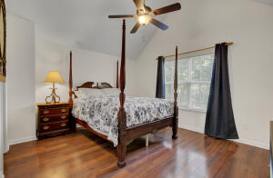
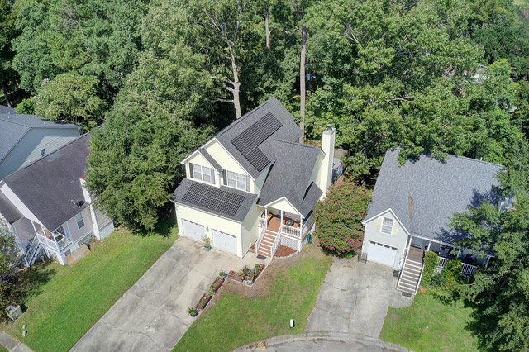


JUST LISTED
Updated 3 Bedroom Home with Water Views
2112 Razorback Lane
Pierpont | Charleston, SC 29414
MLS# 21032882 | $395,000
An amazing home like this rarely becomes available at this price! Sit on the front porch sipping your favorite beverage and take in the views of the Ashley River. The cul de sac location is an added bonus for owners who appreciate peace and quiet. The current owner has enhanced this home in numerous ways. Not only has the roof been replaced, but the HVAC and water heater were, too. New premium solar panels convey and are owned outright! Wood flooring on the main level and carpeting upstairs are also new. The two full bathrooms have been fully renovated. This open concept floor plan is a winner for families and for those who love to entertain! The yard is also a fantastic retreat and perfect for entertaining with a vast deck that includes as built in hot tub! The yard is fully fenced and mature trees add to the charm and privacy while enjoying the great outdoors. The master bedroom is upstairs and has its own fully renovated bath and walk in closet. Two additional bedrooms share the renovated hall bath upstairs as well. Added conveniences include amazing storage in the garage and a driveway large enough to accommodate several vehicles. Numerous stores and restaurants are nearby, and it is a short drive to Historic Downtown Charleston and the Beaches at Folly, Isle of Palms, and Sullivans Island. The Charleston International Airport is within 15 minutes. The new owners can toss their worries to the side knowing that the important and expensive upgrades have been completed. They can sit back and enjoy the benefits of the solar panels and let their cares melt away while relaxing in their hot tub. Don't let this amazing opportunity to pass by- schedule your tour right away!
Take a video tour!
Ellen O'Neil
Broker/Owner, ABR, e-PRO, CNE
Charleston Realtor of Distinction
(843) 300-8530
www.EllenONeilProperties.com

