Slide 1
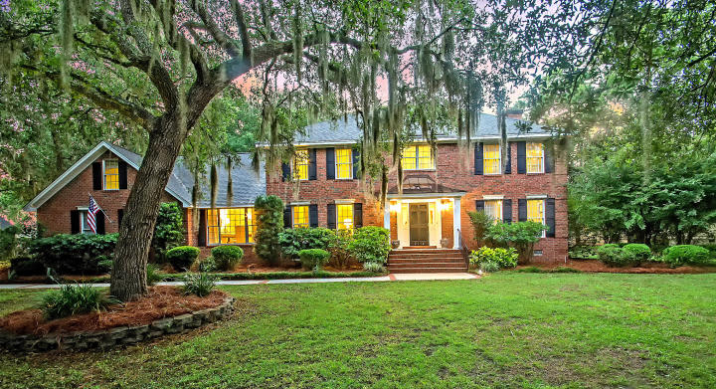
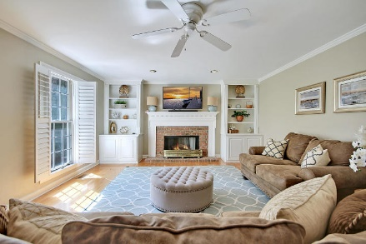
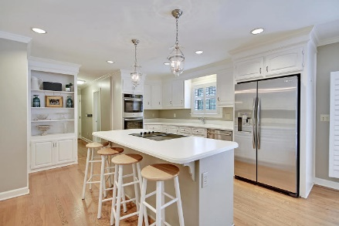
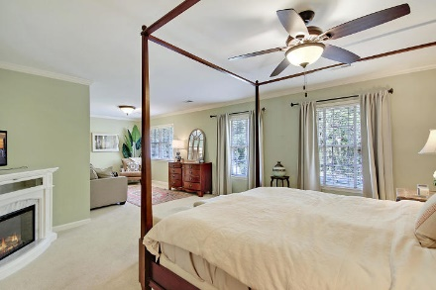

Price Reduced in Dunes West!
New A/C Units With Nest Controllers PLUS a 10 Year Warranty
Just Listed!
Deep-water Dock On Wagner Creek
Just Minutes From The Wando River
2114 Bearing Court
Ravens Run ~ Mount Pleasant, SC 29466 ~ MLS# 19019744 ~ $799,000
Welcome to the unique and stunning Mount Pleasant gated community of Raven's Run! This custom home sits on a expansive, private lot backing to the water that is covered in shade from the many gorgeous live oaks in the front and back of the property. This sprawling, open floor plan has so much to offer with an office, formal living, formal dining, family room with fireplace, eat-in kitchen, massive FROG play room and comfortable accommodations with spacious bedrooms and baths. The master suite has a sitting area, huge walk-in closet and en-suite bath with dual vanities, jetted tub and a spacious step-in shower. Outdoor living spaces include a screened-in porch, deck and patio that look out to the lush backyard and water. Schedule your showing today!
Additional features include:
Large 3 car garage
In addition to great amenities including a clubhouse, pool, ping pong, and racquet ball court, Raven's Run also includes its own private airstrip for residents
Boat yard conveniently located across the street
Book your viewing today!
Nate Gainey nate@mattoneillteam.com 843-513-2038

