Slide 1
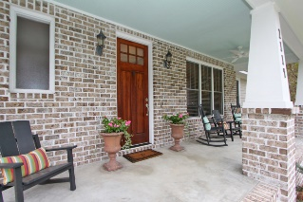
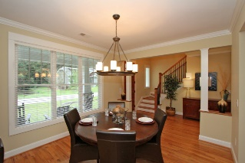
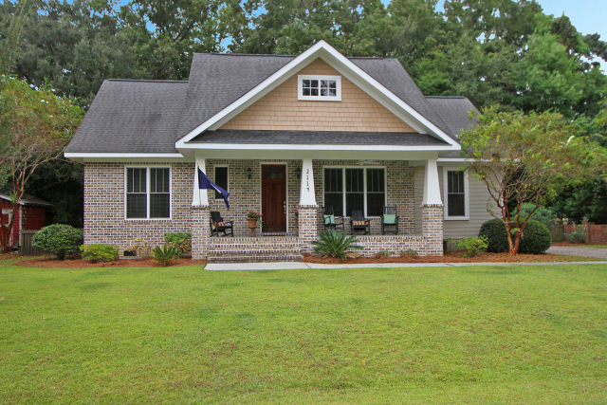
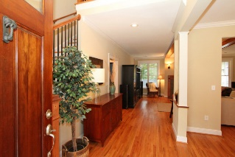
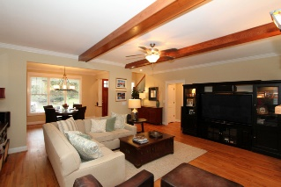
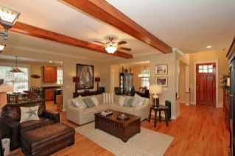
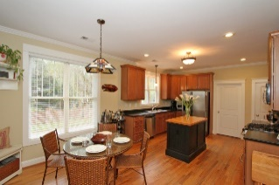
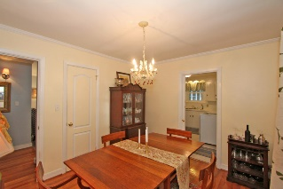
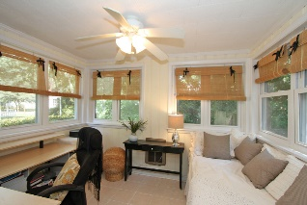
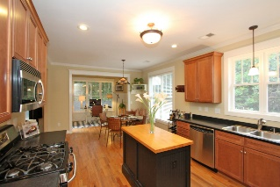
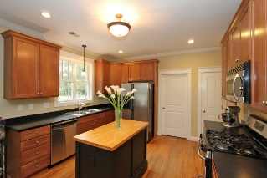
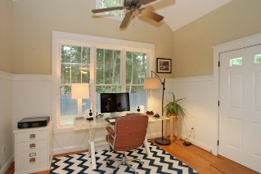
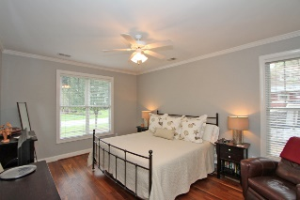
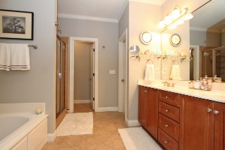
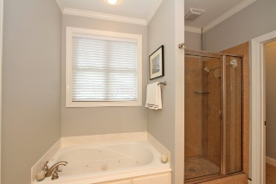
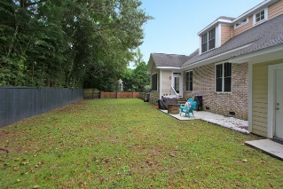
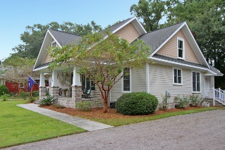


2114 Paw Paw Place Charleston · MLS# 15024963 · $425,000
Open House Sunday
Join me from 1-4
Beautiful Craftsman Style Home
~ Welcome Home ~
PRICE JUST REDUCED $10,000!!
Welcome Home!! This charming 3 bed/2.5 bath custom craftsman style home has it all! You can't beat the location! Situated on a private quiet cul-de-sac 10 minutes to downtown and Folly Beach along with minutes to shopping, restaurants, the Municipal Golf Course, and the County Park. Inside you will find hardwoods throughout the main floor, 9 foot ceilings, an open living and dining room, large eat in kitchen with a wonderful sunroom/office leading to a great patio area and private back yard. The kitchen features a convection oven and gas range. The large master bedroom has an en suite with a walk in closet, jetted tub, dual vanity, water closet, and shower. 2 spacious bedrooms upstairs with a jack and jill bath. Home is under transferable termite bond. 15 seer HVAC installed in last 2 years with air filtration system. Zoned for Murray Lasaine but buyer can opt for Harbor View. If square footage and schools are important, please verify. This is a must see and won't last long!!
Sarah Ellen Lacke
Cell - (843) 607-4330
sarahellen.lacke@carolinaone.com
www.selacke.com
Carolina One Real Estate 1265 Folly Rd Charleston, SC 29412

