Slide 1
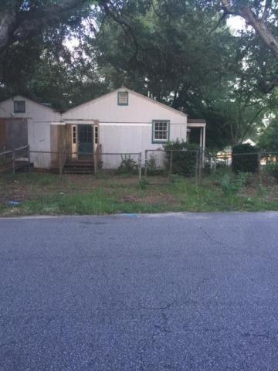

Great Location
2117 Commander Road
North Charleston
MLS# 15017001
$79,999
This property is zoned B1 Limited Business. It was previously used as a residential care facility. It has approximately five bedrooms and two full bathrooms. The possibilities for this 1,972 square foot building are endless. This is a great place to open a business in this very convenient location. It can easily be converted to a residence.
Terry Seabrook
Mobile 843 607-2490
Office 843 577-2676
seabrookspace@aol.com

