Slide 1
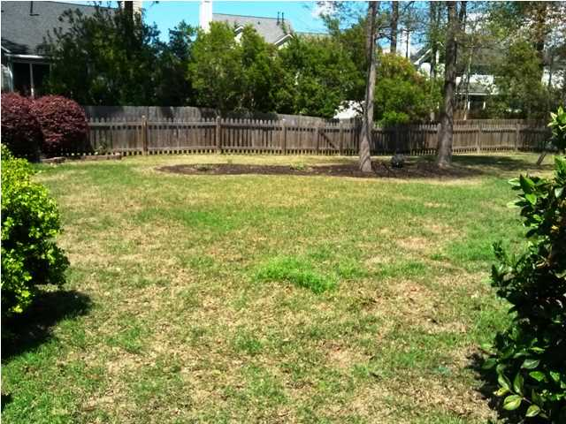
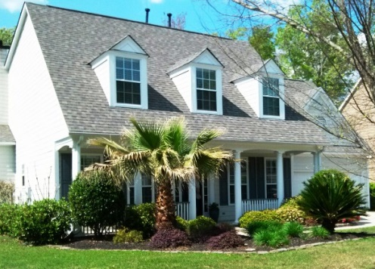
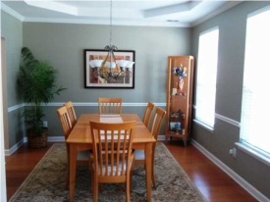
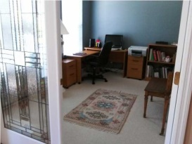
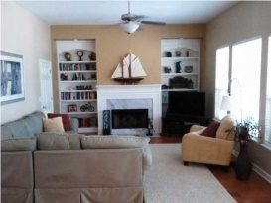
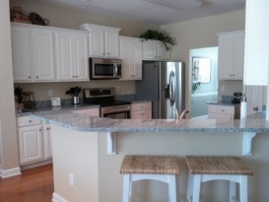
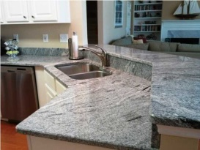
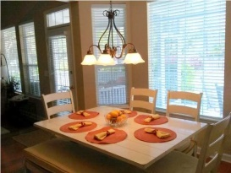
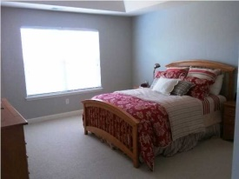
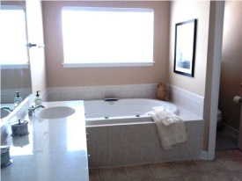
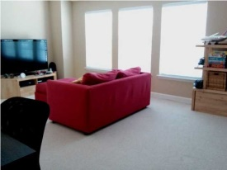
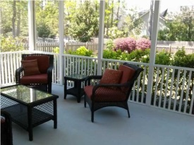
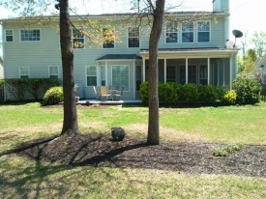
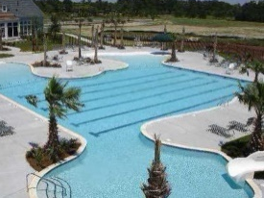


2117 Tall Grass Cir Dunes West Mt Pleasant MLS# 1409833 $439,900
Available Again At A Reduced Price
Due To Buyer's Financing Fall-through
Roomy and perfectly kept Cape in one of the most popular neighborhoods in north Mount Pleasant! Newly upgraded light cherry flooring throughout the first floor. The separate dining room has beautiful molding and a tray ceiling. Study off front hall offers privacy or another living space featuring leaded glass french doors. The Back of house is bright and open with an eat-in kitchen and bay window; counter top bar and family room overlooking the beautiful backyard. You will enjoy your screened porch and patio nearly year-round as it's easily accessed from kitchen and family room. All 5 bedrooms are on the second floor. The fifth bedroom features a separate bath and is currently used as the media/playroom. The master bedroom suite, with tray ceiling, easily accommodates a king-sized bed and more. The master bath is done in travertine tile with a stand alone glass shower, Jacuzzi tub and separate toilet. The two-car garage is extra deep allowing lots of room for extra storage. Dunes West is a premier gated community with it's own golf course, 8 lighted tennis courts, 3 pools, elegant club house on Wagner Creek; fitness club, crabbing dock, boat launch and storage, as well as paved walking/biking trails throughout the neighborhood. Harris Teeter Grocery shopping center is less than on mile away. Easy access to Interstate 526 and beaches. New Roper/St. Francis Hospital 10 minutes away. New compressor on 1st floor HVAC
Peggy Morse
Office - (843) 266-1907 | Cell - (843) 860-4953 pmorse@carolinaone.com
Carolina One Real Estate | 3040 Highway 17 North | Mt Pleasant, SC 29466

