Slide 1
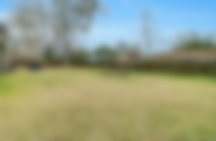
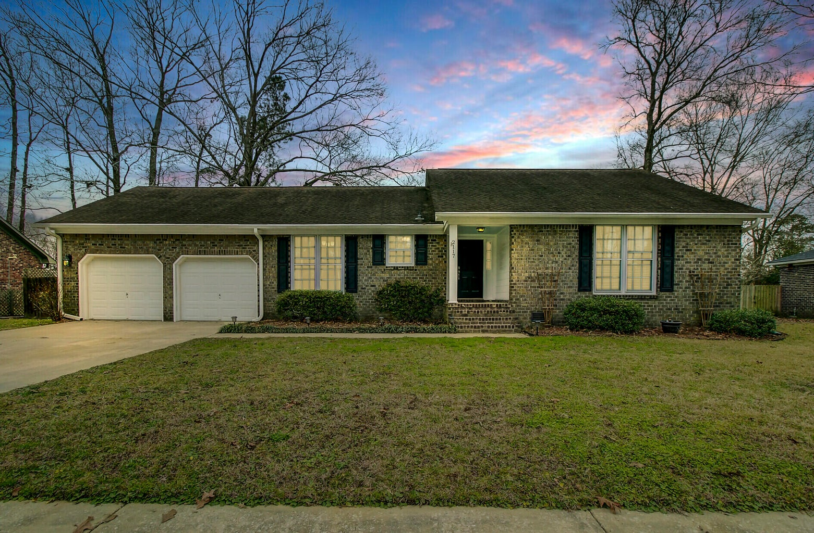
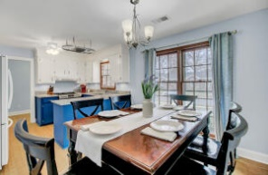
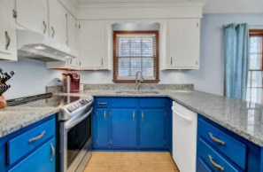
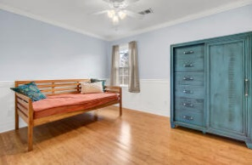
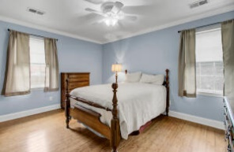
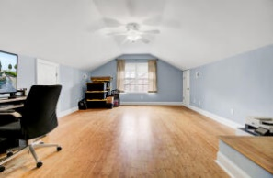
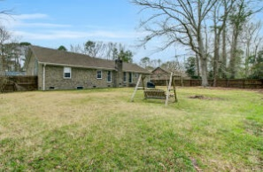
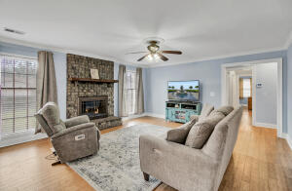
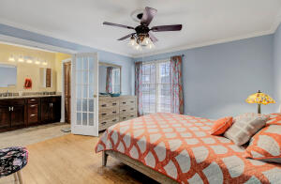

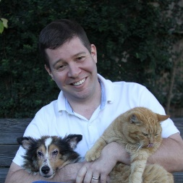
Seller offering 2-1 Rate Buy Down!*- West Ashley Under 500k!
2117 Saint Peters Lane
Forest Lakes | Charleston, SC 29414
MLS# 23003217 | $488,500
Modernized, beautiful brick ranch! The updated kitchen w/new granite counters & fresh paint throughout the home add a modern touch. The bamboo hardwoods and wood-burning fireplace provide a cozy, welcoming atmosphere. The bonus room over garage is perfect for a 4th bedroom, playroom, office, or 2nd living room. Featuring an extra-large yard fully fenced in area is perfect for families with children or pets. A great location in the heart of West Ashley is a major plus, offering convenient access to 526, shopping, & a medical district. Also, no HOA & HVAC replaced in 2018 & Roof in 2015/2022 & Water Heater in 2022. You can bicycle to West Ashley Park, or to the community pool a block away.
*Use our preferred lender Jamie Minster w/CMG Financial and receive a SELLER PAID INTEREST RATE BUY DOWN of $10k! This could reduce the Buyer’s interest rate by 2% the first year and 1% the second year, saving them HUNDREDS of DOLLARS EACH MONTH for the first two years!
David Tester, ABRM
(843) 452-7337 | david@davidtester.com
www.davidtester.com
Charleston First Real Estate, Inc | 2208 Forest Lakes Blvd | Charleston SC 29414

