Slide 1
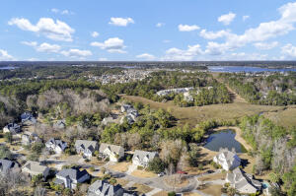
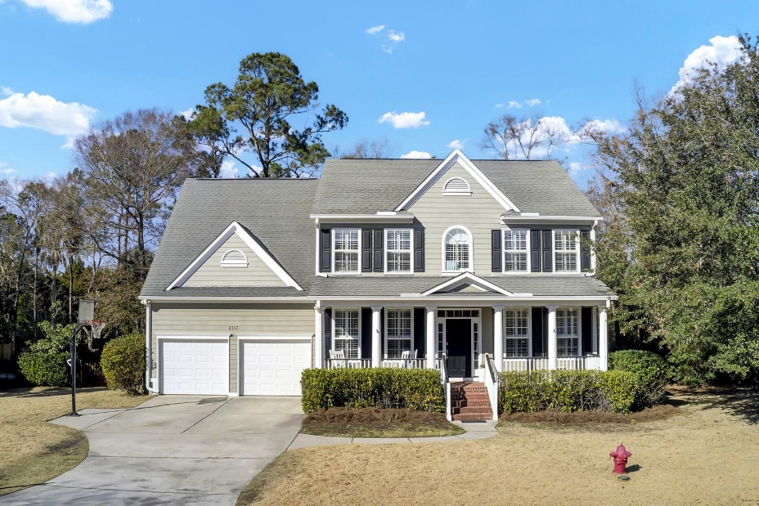
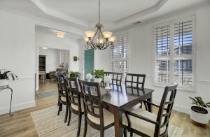
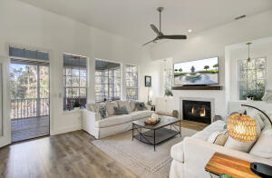
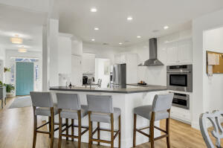
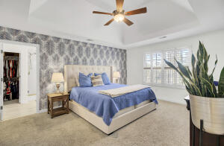
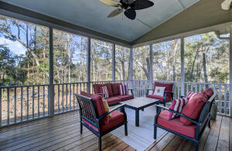
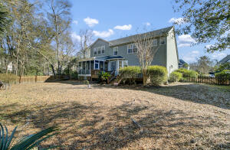


AMAZING HOME IN GATED DUNES WEST
2117 Short Grass Court
Dunes West | Mount Pleasant, SC 29466
MLS# 23000801 | $894,900
Welcome to one of the best homes that Whispering Marsh/Dunes West has to offer. From the brick front porch to the oversized, fenced lot (which backs up to the marsh as well as POA green space,) this home offers all you hope to find when looking for your new home. The home has been tastefully appointed with upgrades throughout including new water resistant laminate flooring on main level, shiplap focal wall surrounding the gas log fireplace, new windows added and new higher-end lighting features throughout the home. The updated kitchen features white subway tiled backsplash, newly installed, high end, stainless steel Thor appliances including convection oven, microwave drawer, hood and cooktop. (Buyer gets to choose, gas or electric? Electric cooktop is featured currently but gas line hookup is installed and ready for the conversion. Thor 6 burner gascooktop to convey.) The large breakfast and eating area overlook the oversized, screened back porch, deck (with gas grill hookup) and large backyard for some of the most amazing marsh and sunset views. The main living area also includes a separate dining area with chair-rail, tray ceiling and heavy crown moulding, an updated office area that features crown moulding and french doors to close for privacy. The main level also features powder room (upgraded walls featuring board and batten), a large walk-in closet under stairs, (be sure to look at the closet within the closet) main floor laundry room, additional storage room under stairs and walk-in pantry. All bedrooms are located on the 2nd level. The primary suite is oversized and leads to an updated ensuite featuring an amazing walk-in closet, new shiplapped wall, lighting and mirrors and great counter space with a new double sink vanity. New tile, large soaking tub, huge glass shower and separate water closet makes this ensuite extra special. The secondary bedrooms are also oversized and have great closet space. Two of the four bedrooms feature their own large bathrooms and grand closets. The added flex space is currently staged as the 5th bedroom, but would be great for a teen hang out room, media room, children's playroom, craft room, or man-cave/she space. This home offers all of these features and sits on a marsh-front lot, has a large two car garage complete with built-in shelves and added water line for a secondary refrigerator for garage, as well as all new nest doorbell and thermostats, a tankless water heater and LED lighting throughout...it is a home that is sure to please even the most savvy of buyers!
Dunes West is a 24 hour gated community (attendant always on duty) and offers residents a Club Membership for an additional fee that includes access to multiple pools, a waterslide, crabbing dock, boat ramp/landing, multiple tennis courts, and exercise facility. Golf course membership and boat storage are all available for an additional fee. Make your appointment to view this spectacular home today!!
Deborah Meuli
(843) 822-0133
dmeuli@comcast.net
Wendy Deitsch
843-270-0433
wendy@lifetreerealestate.com
LifeTree Real Estate, LLC | 3094 Hwy 17 North | Mt. Pleasant, SC 29466 | www.lifetreerealestate.com

