Slide 1
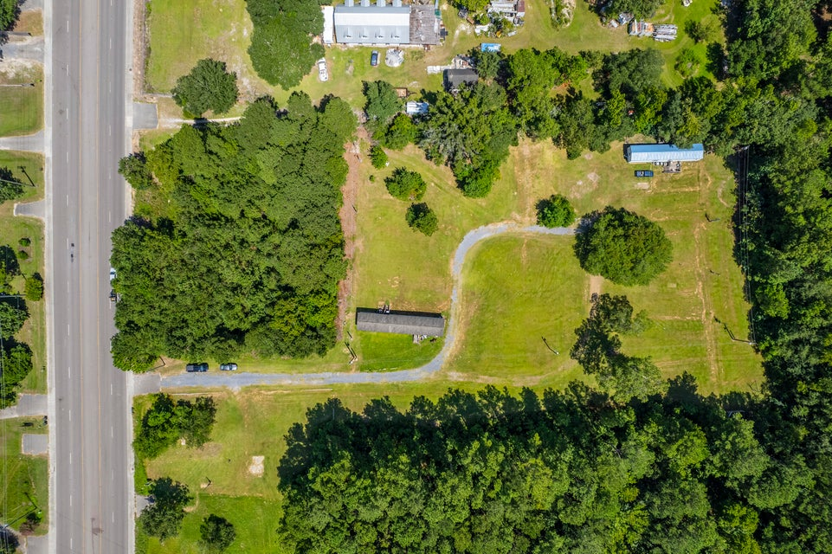
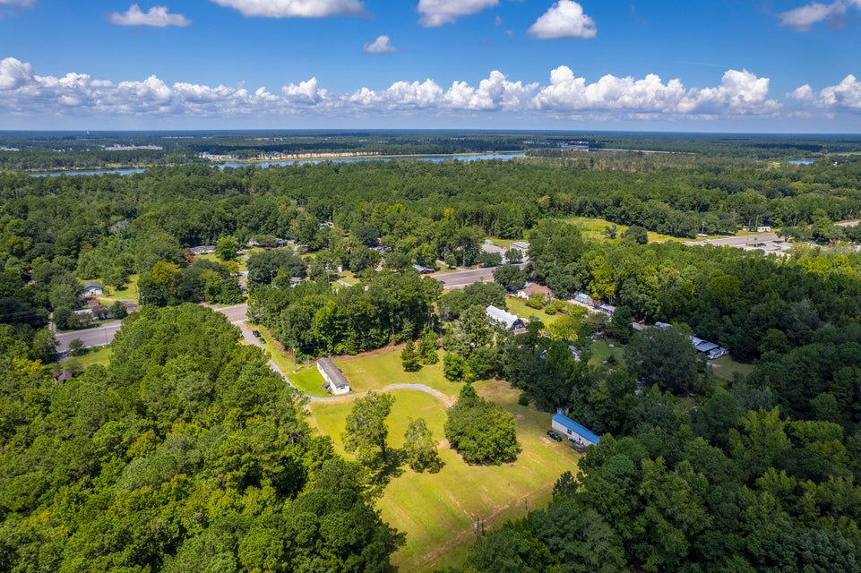
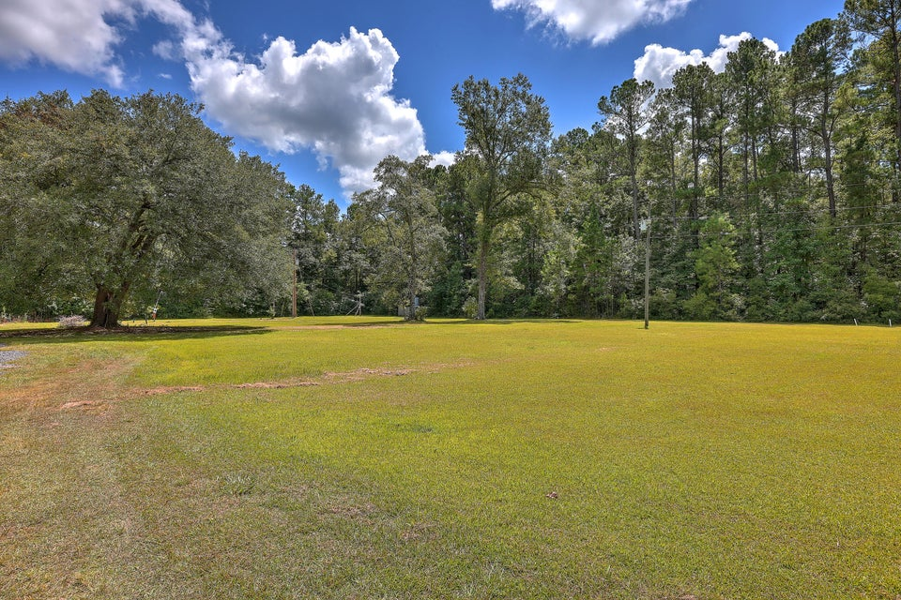
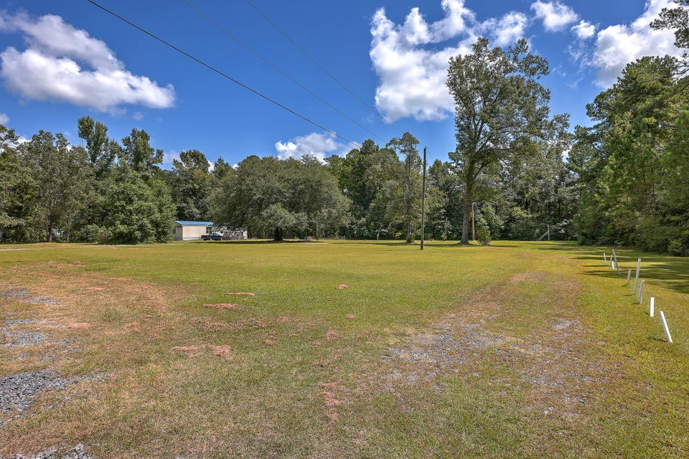


2118 S Live Oak Drive
Moncks Corner, SC 29461 | MLS# 24021775 | $675,000
Moncks Corner! Beautiful Lots! Multiple Uses!
Two lots totaling 4.4 acres. TMS#: 1801401037 is 2.98 & TMS#: 1801401035 is 1.43. Lot 037 is cleared with well, septic systems, and electricity. There are currently two mobile homes on the property that will be moved prior to closing. This lot was set up as a mobile home park in the past and can most likely become another one in the future if that is what you are looking for. Lot 035 is adjacent and is raw land with no improvements, 035 and 037 must be sold together. There are a number of possibilities for this property!
Kelly Rozier
(843) 209-3129
kellywrozier@gmail.com
Brand Name Real Estate
4 Carriage Lane Suite 106
Charleston, SC 29407

