Slide 1
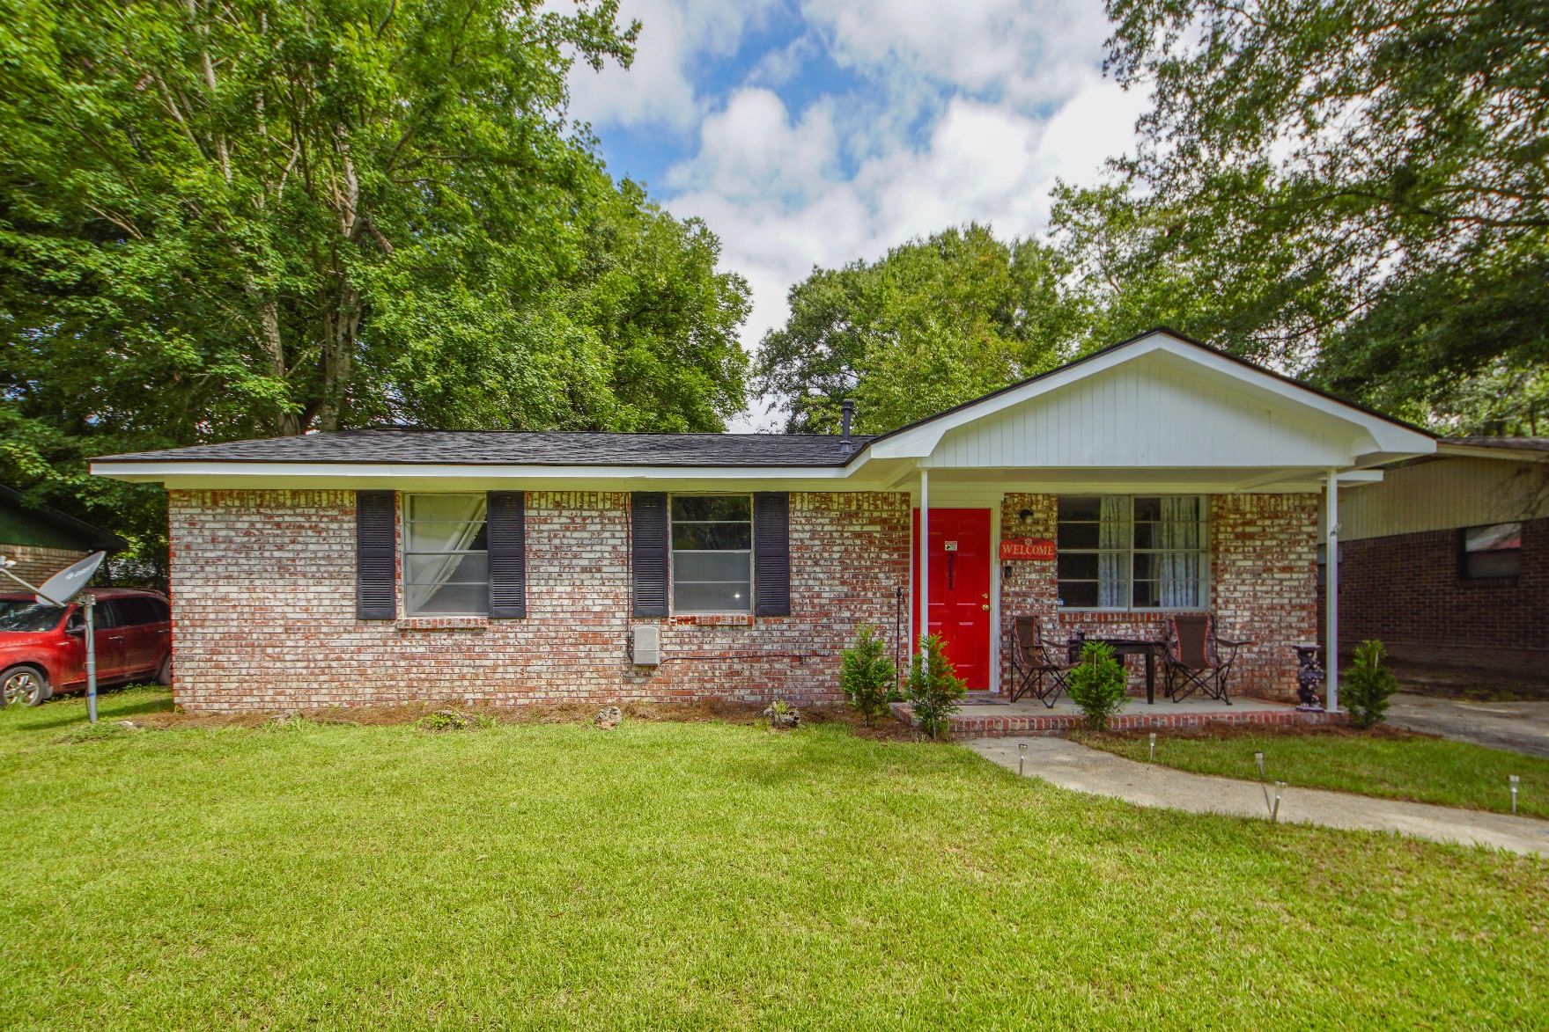
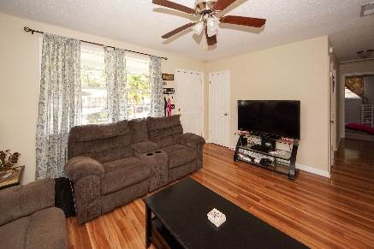
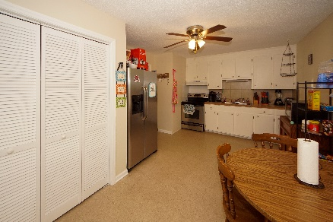
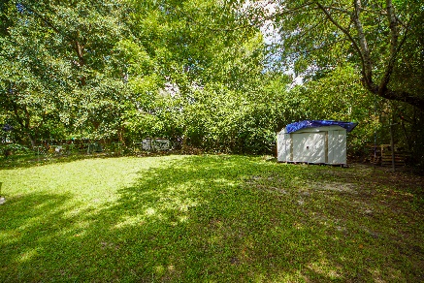


211 Barshay Drive
Flowertown :: Summerville, SC 29483
MLS# 19024846 :: $133,000
3 Bed / 1 Bath
Updated Charmer!
New Listing!
Minutes from downtown Summerville, this home has a new roof, new AC installed 2017, new flooring and fresh paint.
No HOA and Dorchester County School District make this 3 bedroom 1 bath home an attractive place to call home!
Connie White, Broker
843-532-3356
connie@chrepros.com · conniewhiterealestate.com
Charleston Homes · 597 Old Mt. Holly Road · Suite 301 · Goose Creek, SC 29445

