Slide 1
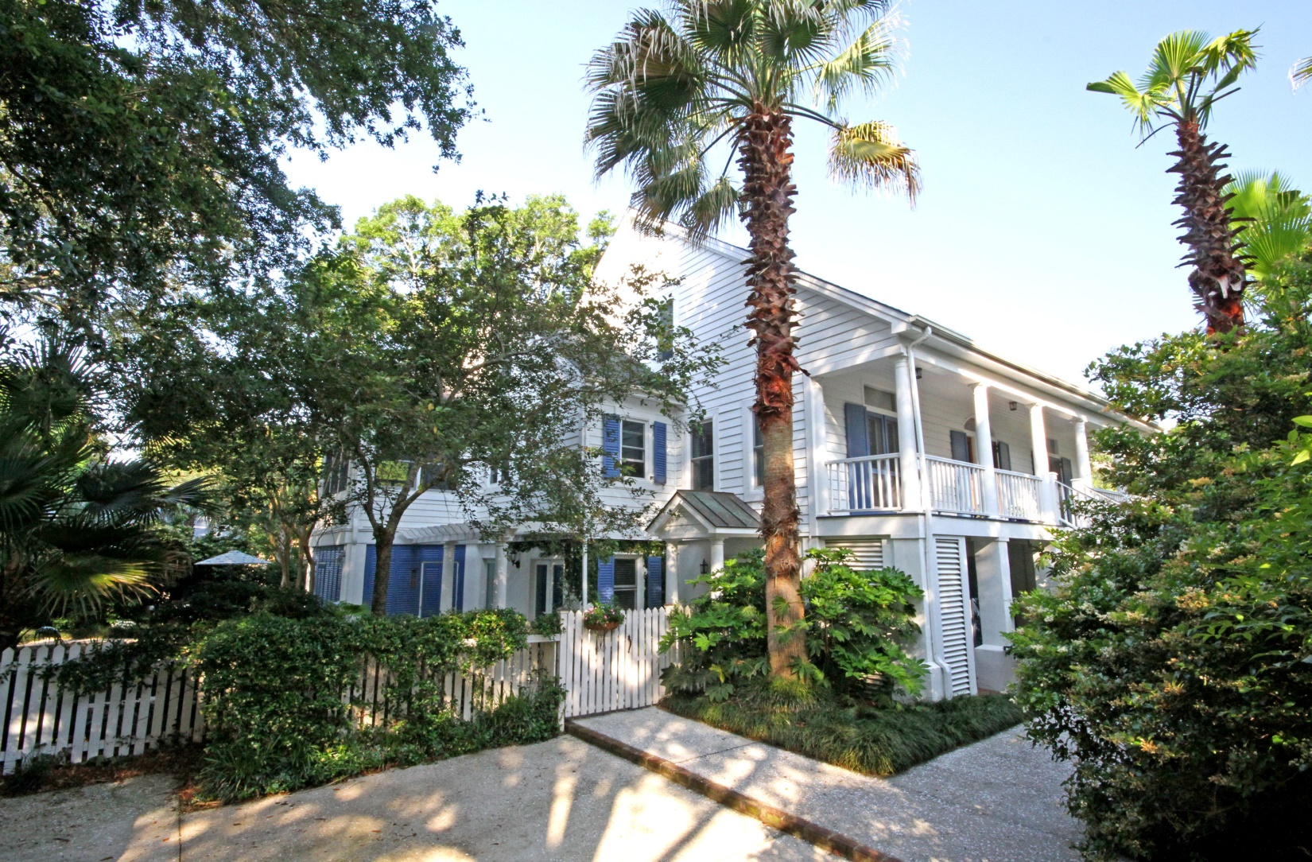
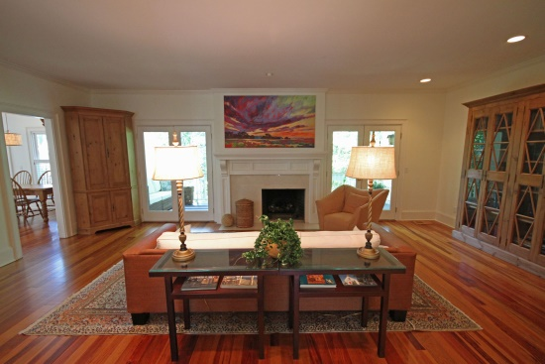
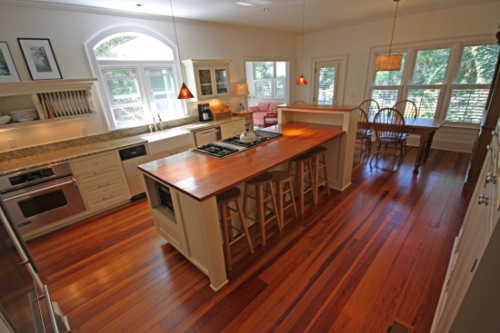
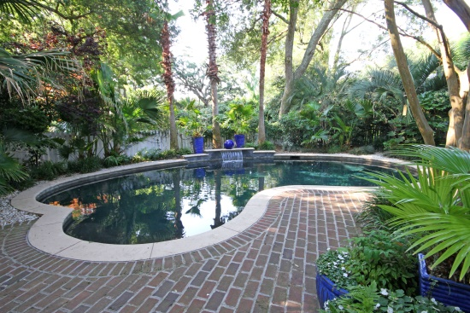


Please Join Us for an Old Village Agent Open House 211 Bennett St. ~ Thursday, July 10th ~ 5-7pm
Beverages, h'ordeuvres and a $100 Drawing for an Old Village Post House Gift Certificate!
Beautiful traditional home in the heart of the Old Village! This charming home has been meticulously kept and updated, and is tucked away at the end of a private drive and surrounded by mature landscaping to create a tropical retreat! The Old Village lifestyle is all right here, steps away from the Old Village restaurants, shops and Charleston Harbor, and a short drive to downtown Charleston or the beaches of Sullivan's Island or Isle of Palms! Award winning elementary and middle schools are right in the neighborhood! With over 5000 square feet of living area on three floors, this home has everything you need. An elegant two story foyer welcomes you to the library on the main floor, and leads to the spacious living room with fireplace and the formal dining room. The kitchen opens to a sunroom and features an island with a butcher block top, gorgeous cabinetry, granite countertops and stainless steel appliances. Also on this floor is the master suite with lavish bath and large closets, and a covered porch overlooking the pool and topical garden. Upstairs is a huge suite with sunny sitting area and ship lap paneling, an additional large bedroom, full bath and lots of storage. The ground level offers a cozy den that opens to the pool and garden area. Additionally on this level are two bedrooms, full bath, full size laundry room and kitchenette, and additional flex space to use as you please. This home is also equipped with a state of the art generator! Flood insurance is not required for this home!
The Ed Hunnicutt Real Estate Team
Cell: 843.814.4378
Office: 843.416.3050
ed@edhunnicutt.com | cathy@edhunnicutt.com
www.EdHunnicutt.com
195 West Coleman Blvd.
Mt. Pleasant, SC 29464

