Slide 1
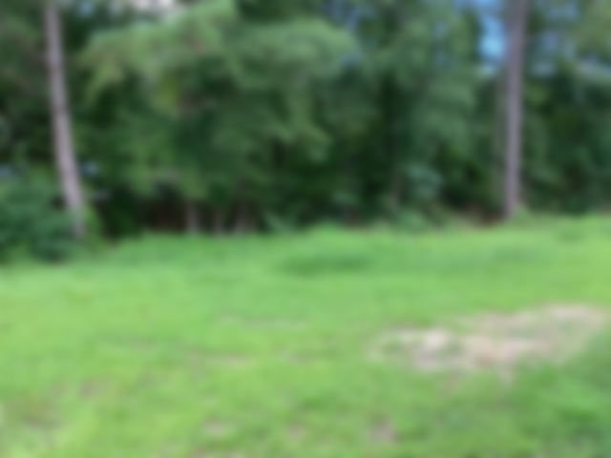
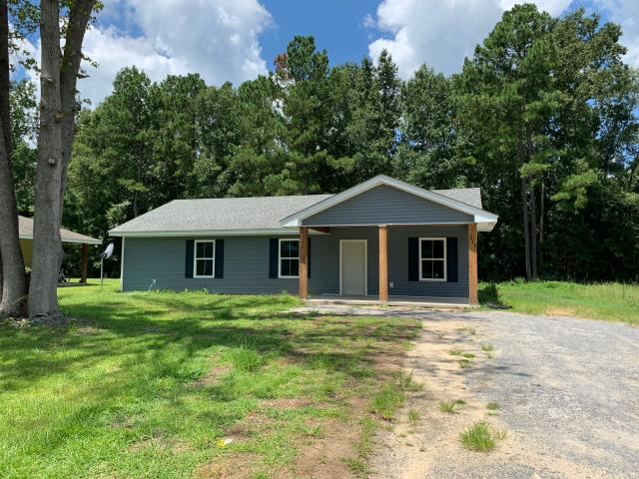
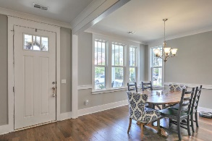
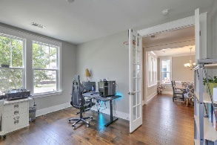
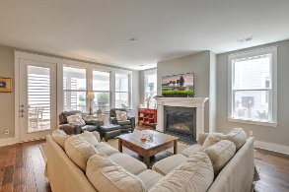
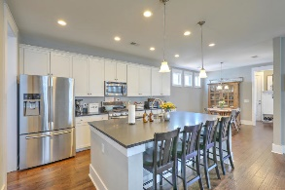
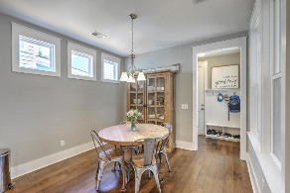
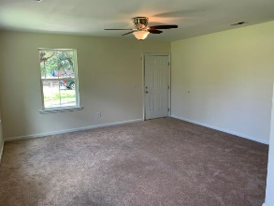
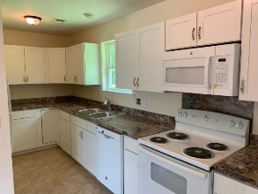
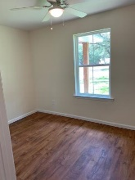
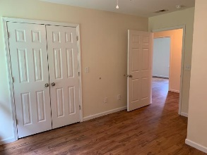
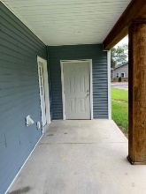
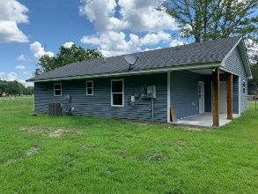
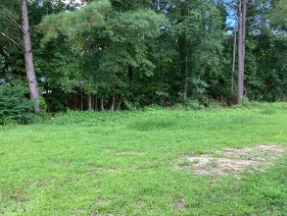

211 Cooper Street Moncks Corner, SC 29461 ~ MLS# 19021515 ~ $164,900
Open House Sunday, Aug 18th from 1-3
Light Refreshments Served
Lovely, newly renovated home near downtown Moncks Corner. A great front porch greets you to this home, perfect for enjoying Lowcountry days/nights. Newly renovated kitchen, new appliances, fresh paint, and a spacious storage room off the side porch are enticing features of this house. The back yard is sizeable and perfect for a firepit or storage building. Don't miss out on this gem!
Chris Phillips
(843) 446-9199
chris.phillips@cbcarolinas.com
www. cbcarolinas.com
Coldwell Banker Residential Brokerage
4969 Centre Pointe Dr
Suite 203
Charleston, SC 29418

