Slide 1
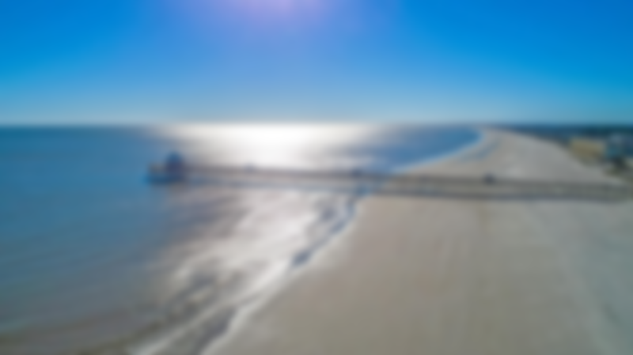
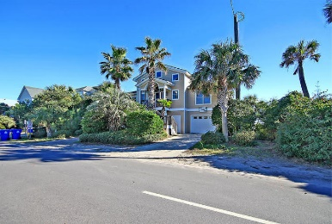
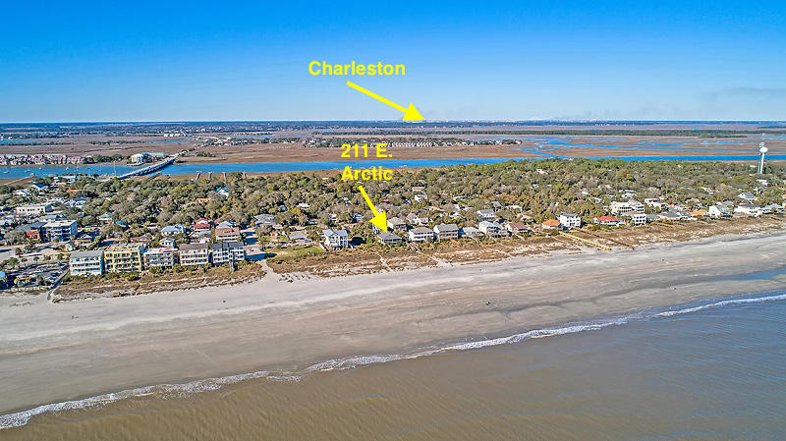
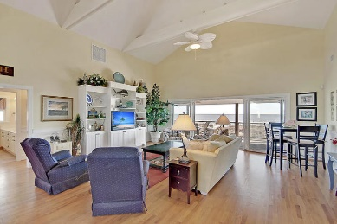
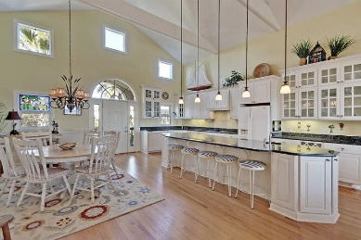
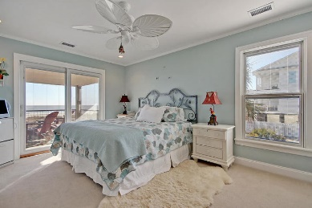
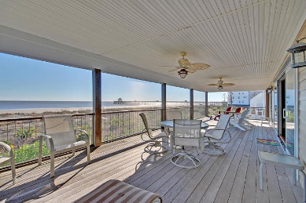
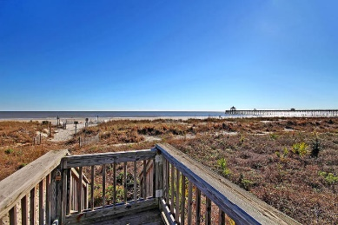
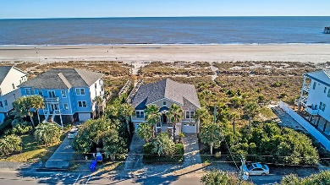
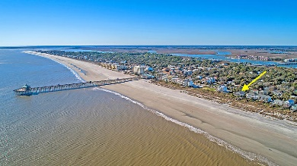


Best Location on Folly Beach
211 E Arctic Avenue
Folly Beach, SC 29439
MLS# 19000961
$1,395,000
One of the best locations on Folly Beach, the Edge of America, this beach house is turn key and is being sold fully furnished and includes a golf cart. Excellent rental potential! This house has never been rented and has only been lightly used as a second home. Get here and leave the keys hanging. Walk, bike, or take a golf cart everywhere and leave your worries behind. Beachfront & steps to the iconic pier, restaurants and bars, and Bert's Market, living just doesn't get any better than this. This newer build features a large open floor plan with 4BR/4BA, massive kitchen island with beautiful granite, a dumbwaiter that can be converted into an elevator, huge screened porch w/ipe flooring w/hidden fasteners, grilling deck, & elevated construction with room for 3 or more cars plus tons of storage. Very energy efficient with Pella sliders and windows, Rinnai water heater, and spray foam insulation. This home is the perfect beach house and makes a great residence or rental property. Other features include a beautiful vaulted ceiling, irrigation system, alarm system, and dual zone HVAC.
Lee Lindler
Cell (843) 637-0803 | LeeL@NVRealtyGroup.com
NV Realty Group | 1900 Seabrook Island Rd | Johns Island, SC 29455
LeeLindler.NVRealtyGroup.com

