Slide 1
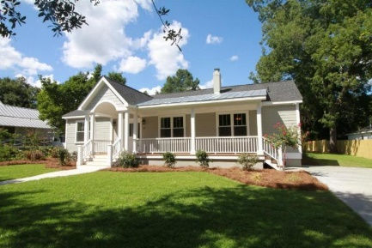
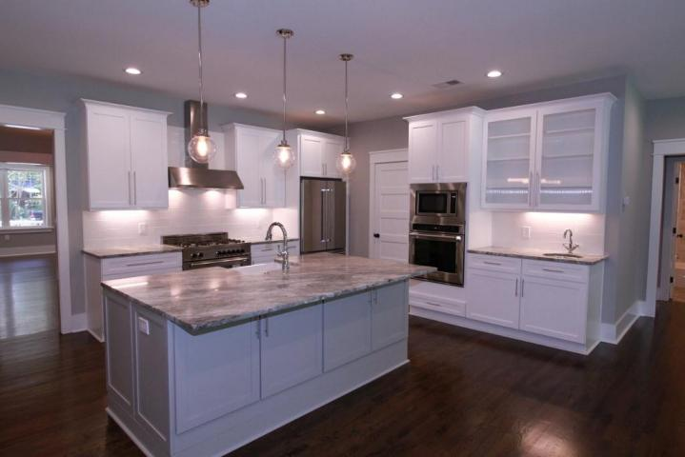
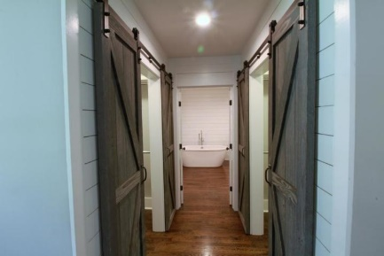
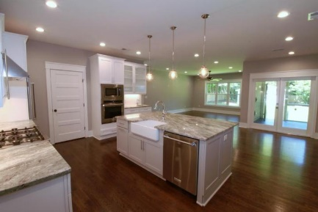
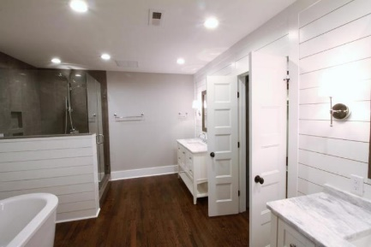
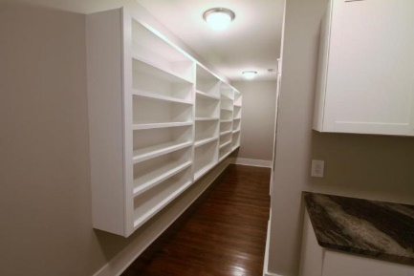
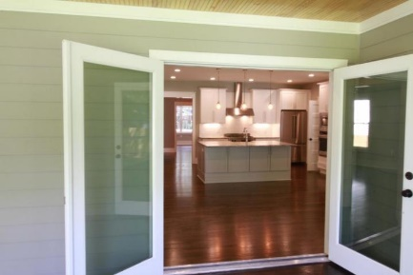
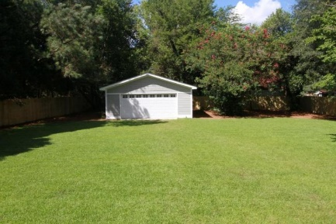
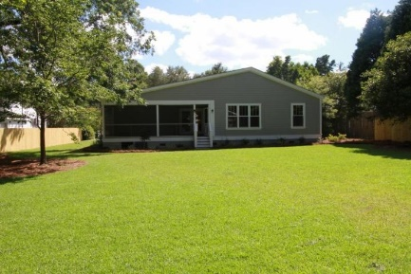


Must see to believe!
Absolutely stunning renovation in Historic Downtown Summerville!
$2000 Buyer's Agent BONUS!!!
Limited time offer!!
211 E Richardson Avenue | Summerville, SC 29483
MLS# 16020091 | $599,000
5 bedrooms and 4 bathrooms (all on one floor) within a few hundred yards of town square! This home has been completely rebuilt from the floor up. There are beautiful oak hardwood floors throughout the entire house, except for the bathrooms which all have high-end tile. The kitchen is absolutely stunning with brand new, solid wood cabinets. There is a modern gray island with a beautiful white farm sink. The appliances are high end and the granite counters are stunning. The kitchen opens into a large living room. Recessed LED can lights and 9' ceilings give this room a large, clean feel. The master suite is very large, with a spacious bedroom, and large his and her custom built walk-in closets. The rustic barn doors are the perfect accent for the closets. You will be blown away when you enter the huge master bathroom! The free-standing tub along with ultra high-end shower will appeal to anyone. The 2 vanities feature solid wood cabinetry and gorgeous marble countertops. You won't believe the shiplap accent walls! No expense was spared in this renovation! You will love the huge pantry/laundry room directly off of the kitchen. There is tons of storage space for any large family. The other 3 bathrooms each have high-end tile work, and solid vanities with natural stone tops. There are too many upgrades to name. The front porch features an original barreled ceiling that was saved from the original house. The screen porch at the rear of the house has modern stainless steel cable and solid tongue and groove flooring, as well as can lighting and a new ceiling fan. There is a large back yard with brand new sod, as well as a 2 car garage/workshop in the rear of the property. You won't find another property that can compare to this in this location. List agent is owner.
AgentOwned Realty Co.
Premier Group
141 A N. Main Street
Summerville, SC 29483
Michael Marshall
Mobile - (843) 693-5973
michaelbmarshall@gmail.com
www.agentownedrealty.com

