Slide 1
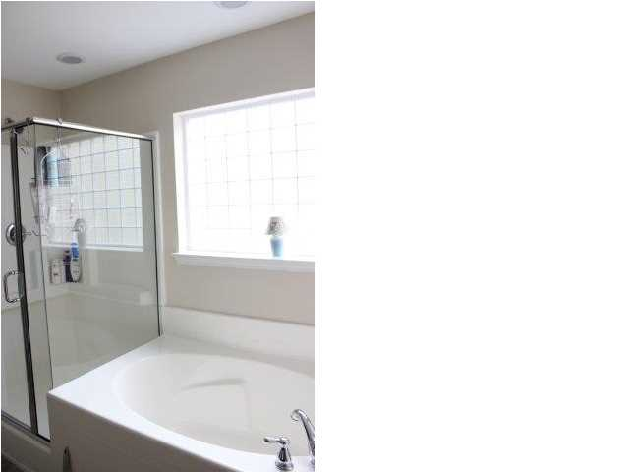
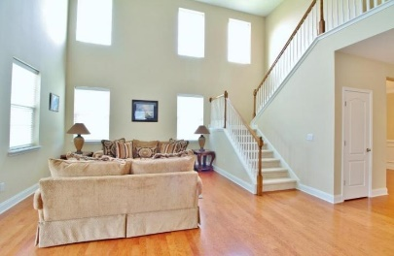
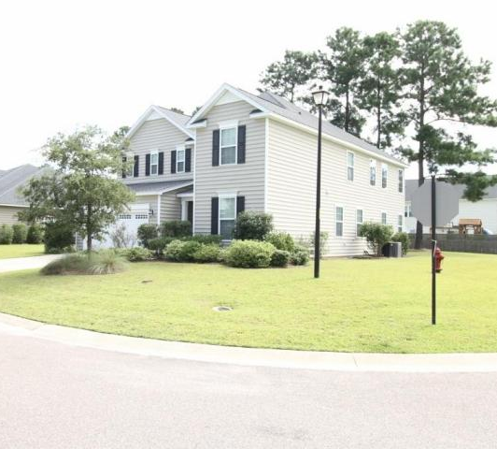
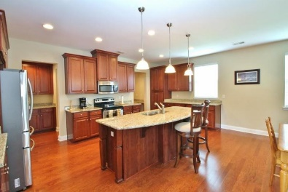
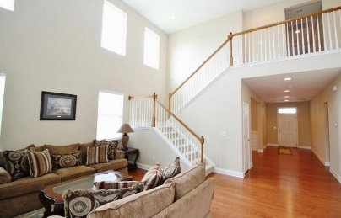
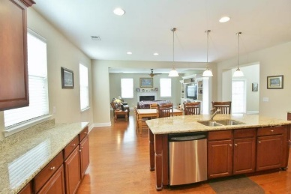
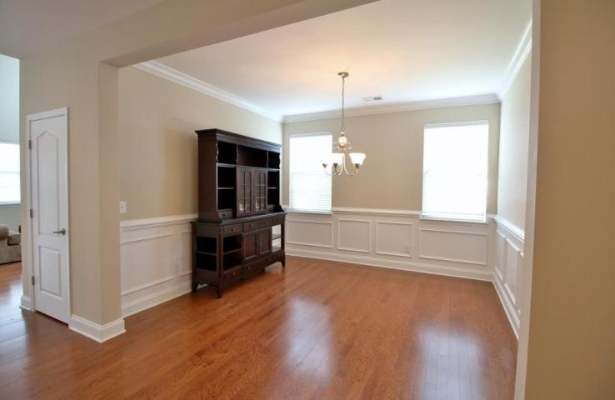
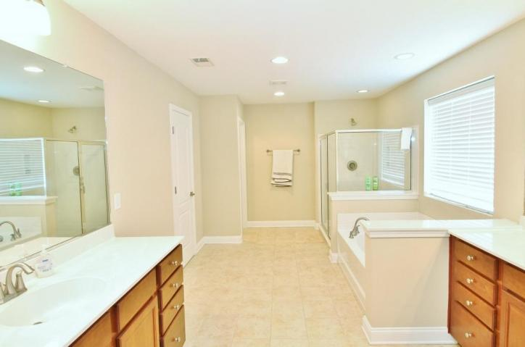
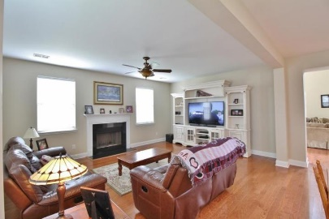
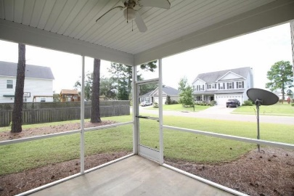
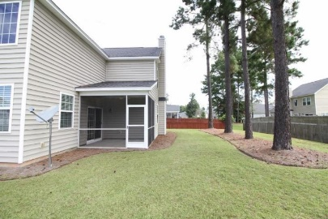
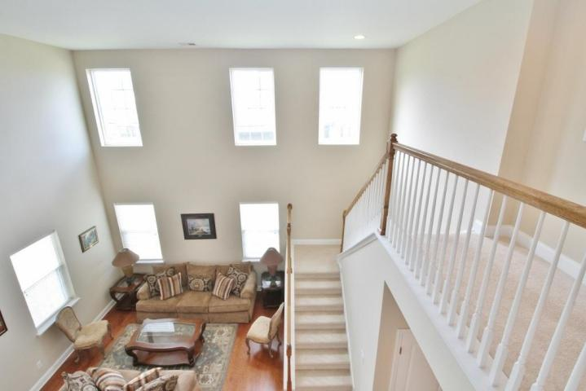

Foxbank Plantation Open House Saturday 2-4 $1000 Agent Bonus!!
Free Charleston Print to First 10 Visitors
Register for a Housewarming Gift Basket!
211 Red Leaf Boulevard
Moncks Corner ~ MLS# 18021596 ~ $312,000
Absolutely immaculate home on a corner lot with many upgrades throughout. Four bedrooms, including one on the main floor, Three full baths and a large flex space. The main floor has all Hardwood Flooring, two living areas and cathedral ceilings. The eat in kitchen is very large with granite counter tops, large island, Butler's pantry, huge separate pantry, more cabinet space than you can fill and all stainless steel appliances. This home also features a separate Formal Dining room. Home has a fireplace and large screened porch. Master bedroom is very large with Dual Master walk in closets. Master bathroom is very spacious with garden tub, Dual vanities and large glass shower. You have to see this home to believe it.
Joanie Rhoten
Office: 843-261-7166 | Mobile: 513-518-7475
joanie.rhoten@agentownedrealty.com
www.agentownedmainst.com
AgentOwned Realty Co. Premier Group | 141 A N. Main Street | Summerville, SC 29483

