Slide 1
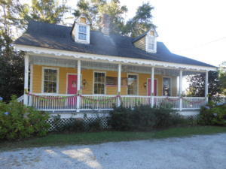
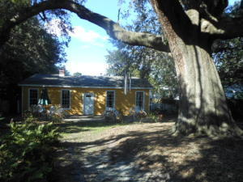
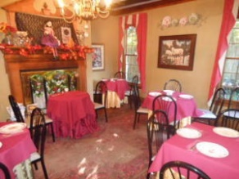
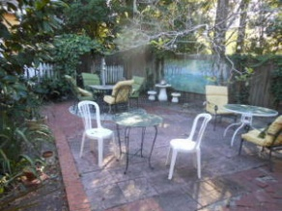
COMMERCIAL PROPERTY/BUSINESS
FOR SALE OR LEASE
$40,000
Price Reduction!
211 Stallsville Road ~ Summerville, SC 29485
MLS #16027384, MLS #16027476 - $365,000, Business $100,000
A very unique property! 2 Separate buildings with the larger building (2,700 sq ft) currently being used as an operating business..."Time Well Spent"...that serves tea and lunch (The Building Owner is also the Owner of the Business which is also for sale). This property has been updated and upgraded with HVAC and Roof just a couple of years old plus wiring and plumbing updates. The property includes a commercial kitchen, 6 separate rooms for guests dining/tea, and 2 old fireplaces and a lobby gift area. The highlight of the property is a 600-800 year old oak tree in the rear yard. The tree's canopy covers the entire rear yard which is surrounded by outdoor patio seating and an area for a band to play music (they host weddings and Special Events). The front building is not currently being actively used except for storage but can easily be leased as either a residence or commercial use (currently non functioning bathroom). The Business is also for sale separately and is a profitable 20 plus years old with lots of repeat customers. The Owner of the building also owns and operates the business. The property will rent between $3,500 to $4,000 per month. Owner will finance the business...terms to be negotiable. Each building is available for lease or purchase.
Rick Willis
843-327-3017
Rick@RickWillis.com
The Group, LLC

