Slide 1
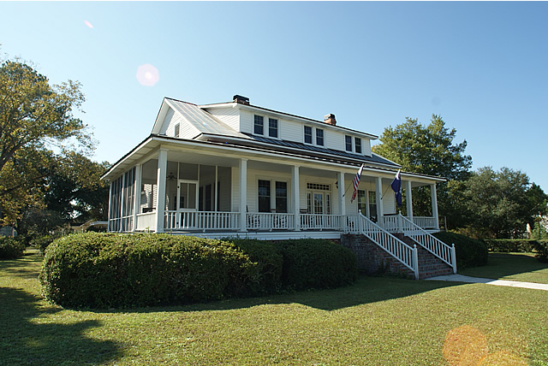
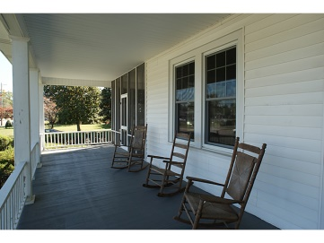
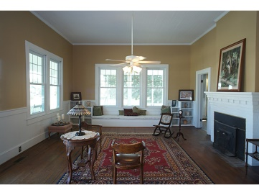
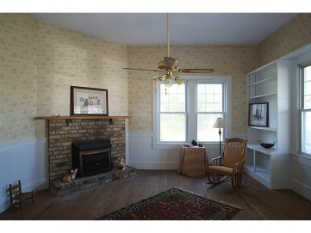
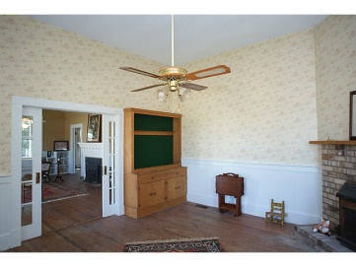
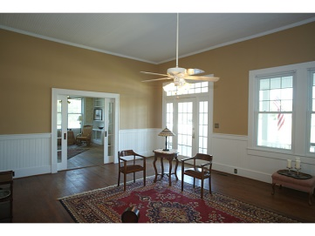
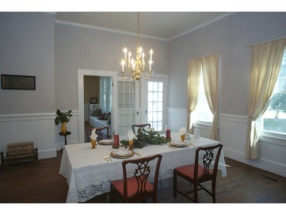
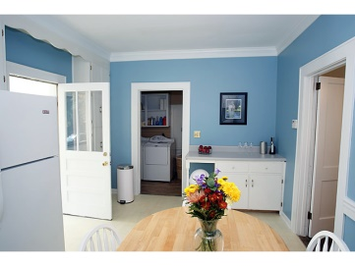
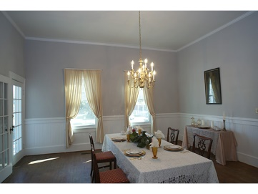
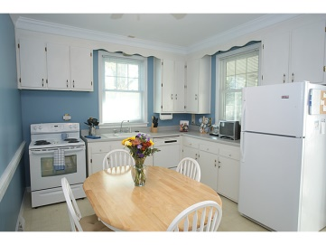
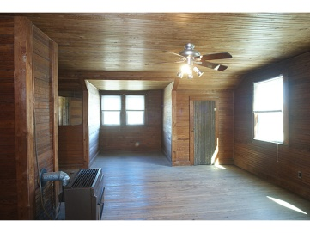
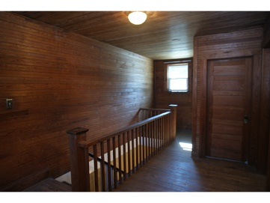
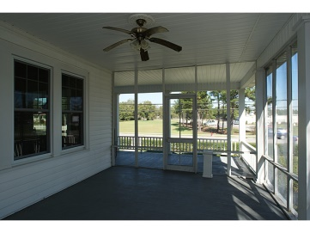
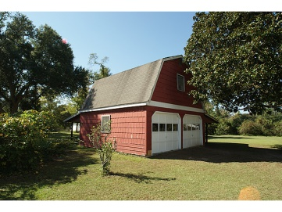
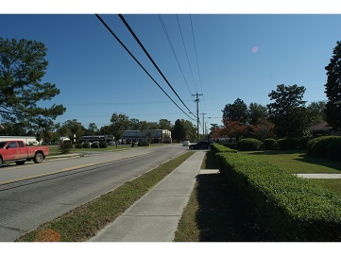
211 W Main St
Moncks Corner
MLS# 1316507
$297,000
Residential OR Commercial
POSSIBLE ZONING CONVERSION
TO COMMERCIAL WITH RIGHT USE (GENERAL OFFICE)
OR
LEAVE IT AS ONE LARGE HOME!!
Owners state this will be sold this year
Michelle Riser & Bob Glover
843-860-1229 (Michelle) | 843-693-1837 (Bob)
mriser@ccim.net | bobglover08@gmail.com
Matthew Ryan Company, 104 Berkeley Square, PMB 59, Goose Creek, 29445

