Slide 1
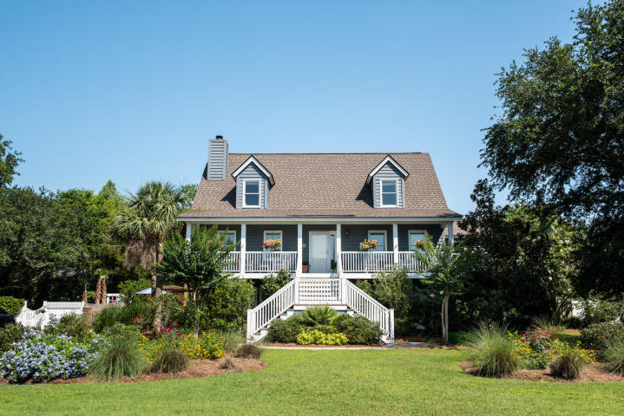
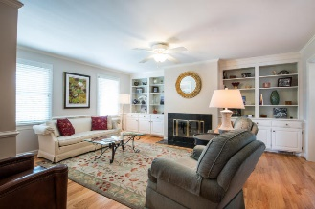
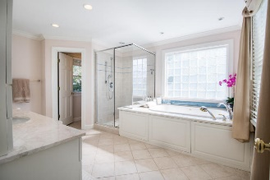
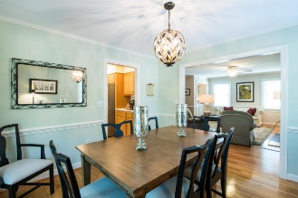
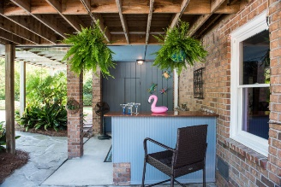
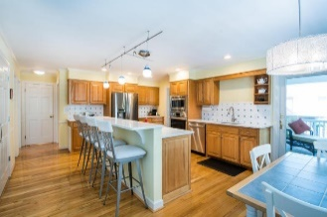
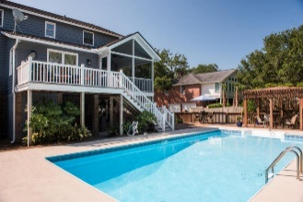
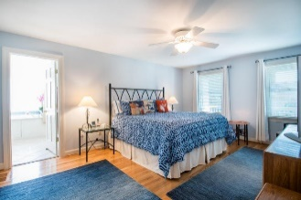
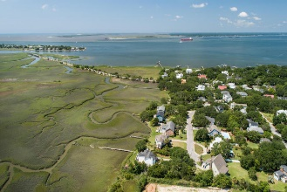


211 William Street Old Village ~ Mount Pleasant ~ MLS# 18017544 ~ $1,375,000
Price Reduced
in the Old Village!
Just Listed - Old Village
Open House Sunday, 6/24 2-5
Come Enjoy Some Refreshments!
This exceptional home has all the features you would dream of having with an ideal, quiet location minutes from both downtown and the beach! It is nestled close to where the harbor meets the islands, meaning wonderful breezes on the screen porch, steps to the Old Bridge Park and great schools, and in the iconic Old Village! This fully renovated home is elevated, has three gathering areas, master on main level and four bedrooms upstairs. Many upgrades throughout this beautiful home with great storage and flex space. This private lot is beautifully landscaped, with a completely fenced in backyard including pool, patio and outdoor bar. Entertaining is effortless in this remarkable home. Enjoy true Lowcountry living at its finest! Close to beaches, shopping and the best dining! Must see!
Mac Jenkinson
M (843) 224-0210
mac@carolinaone.com
Beth Moore
M (843) 532-4892
bmoore@carolinaone.com
Jenkinson & Moore, LLC | Carolina One Real Estate | 1503 Palm Blvd | Isle of Palms, SC 29451-2280

