Slide 1
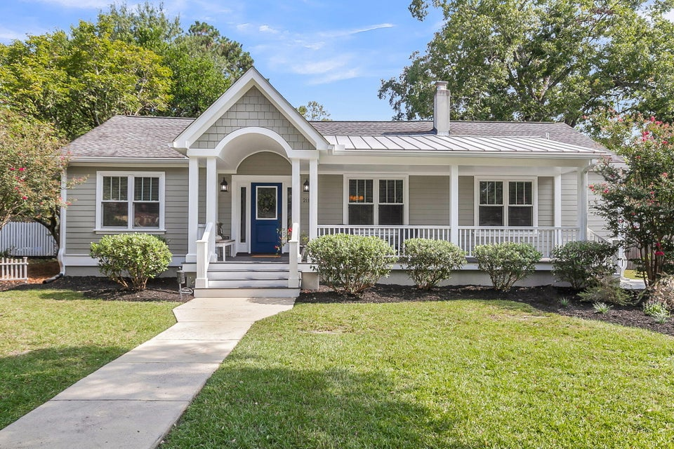
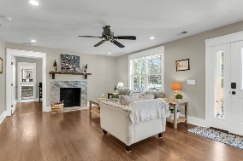
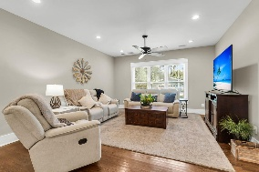
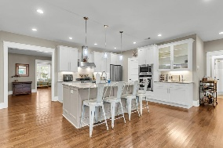
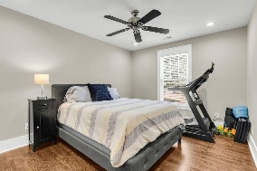
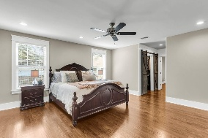
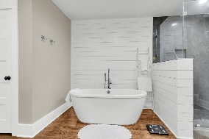
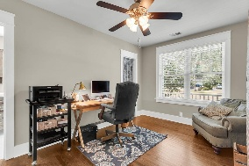
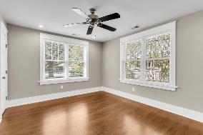
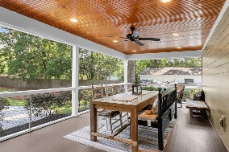
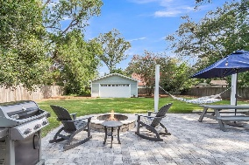
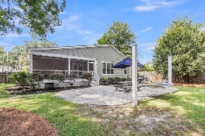
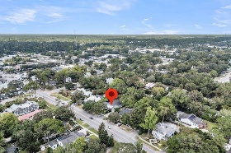
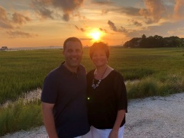

Downtown Summerville Gem! One Block from Square!
211 E Richardson Avenue
Historic District
Summerville, SC 29483
MLS# 25025575
$1,050,000
4 Bedrooms | 4 Baths | 3,000 sf
Discover the perfect blend of modern comfort and small-town charm in this beautiful four-bedroom, four-bath, 3,000 square foot home, located just a block and a half from the heart of downtown Summerville. This prime location puts you right in the middle of all the action, with over 20 restaurants and bars, boutique shops, bakeries, and a community theater all within an easy quarter-mile walk. Immaculate move-in condition with no work to do! Enjoy the vibrant local scene with events like the popular Third Thursday, the annual Flowertown Festival, concerts in the square, running events and the weekly Saturday morning farmers market. Forget the car and embrace a walkable lifestyle, where you can sip coffee on your front porch before strolling downtown to meet friends or grab dinner.
Step inside this stunning home, which underwent a full renovation in 2017, to find an open and inviting floor plan. The gleaming wood floors stretch throughout the entire house, leading you to a spacious, modern kitchen with a massive pantry, perfect for any home chef. The four generous bedrooms and four full baths provide plenty of space and privacy for family and guests. The office, with its own full bath, could be a fifth bedroom if needed. The living area flows seamlessly to a large screened-in porch, creating an ideal space for relaxing or entertaining. This overlooks a huge patio with a fire pit and a nearly half-acre, fully fenced backyard, offering a private oasis for outdoor gatherings, gardening, or simply unwinding. There is a large two-car detached garage in the backyard that is perfect for storage. This isn't just a house, it's a gateway to the Summerville lifestyle. Don't miss your chance to own a piece of this vibrant community!!
Larry & Kathy Mazalatis
Larry Cell 843-693-0529
Kathy Cell 843-693-0159
mazteamrealty@gmail.com
AGENTOWNED REALTY | 1800 TROLLEY RD | SUMMERVILLE, SC 29485

