Slide 1
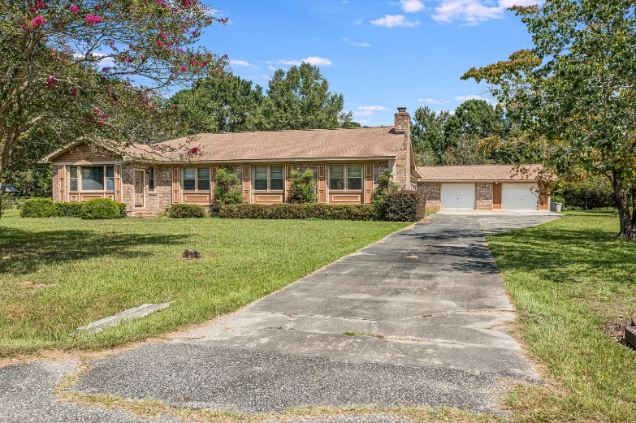
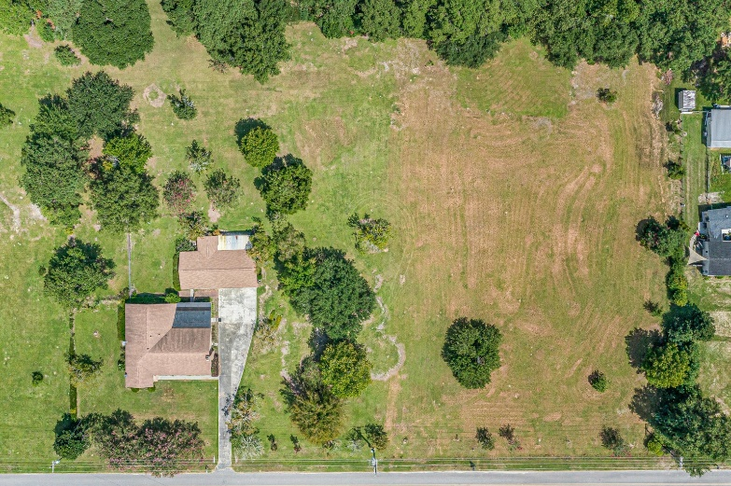
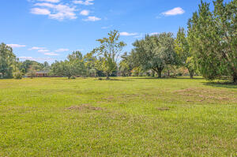
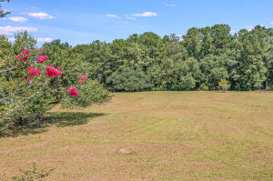
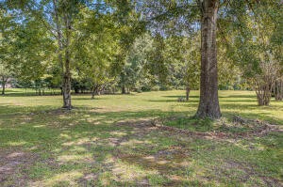
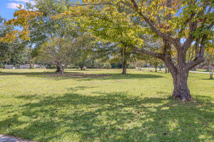
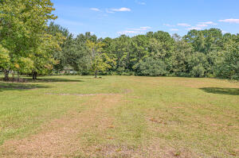
Don C. Mason, CIAS, CNE
(843) 364-9090 nibsc@aol.com
3 Acres PLUS
2,450SF Brick Home
211 Elrod Drive
Elrod Estates
Goose Creek, SC 29445
MLS# 23019982 ~ $625,000
3 ACRES... Plus a unique opportunity to own a gorgeous all brick 3 bedroom 2-bathroom home with a very large, vaulted ceiling family room with a real brick fireplace. A very large all brick detached garage with 2 storage sheds. A large separate mud room and very large sunroom. You will really appreciate the craftsmanship of all of the crown molding and custom-built cabinets and real hardwood floors. This home is located in the City of Goose Creek; however, it is officially in Berkeley County. You can sell the other 2 acres. You can build a single-family home on each acre. You can have horses. Or you can enjoy your privacy on all 3 acres. A lot of opportunity with this property.
Take a video tour: https://youtu.be/NfUI1a5X1wM
Flat Rate Real Estate
1150 Hungryneck Blvd | Ste C314
Mt. Pleasant, SC 29464

