Slide 1
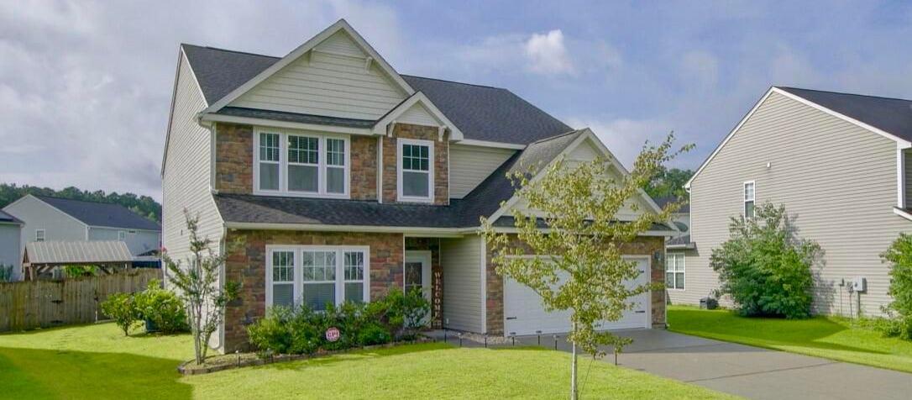
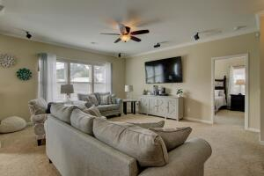
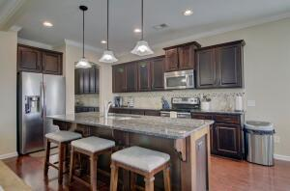
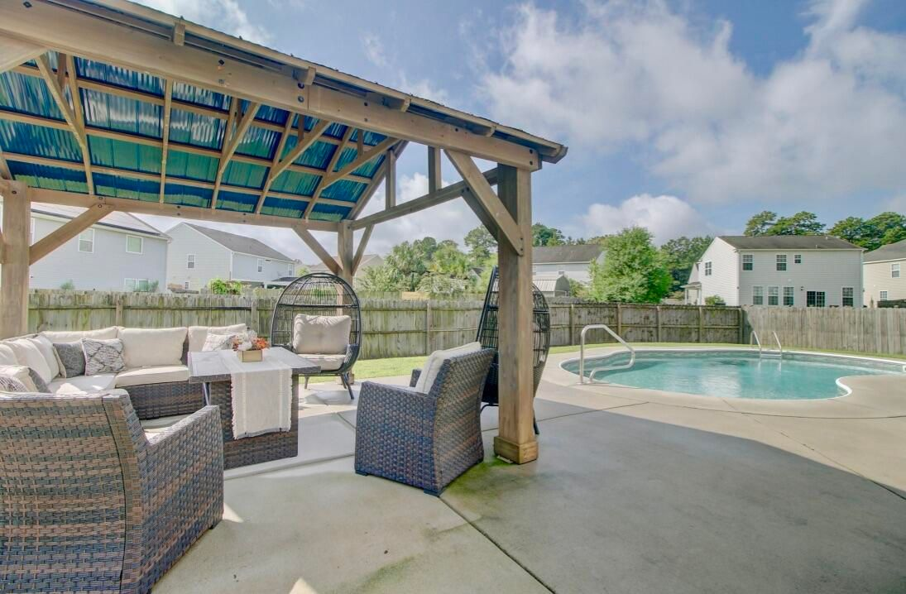


Sunnyfield
211 Medford Drive | Summerville | MLS# 22022206 | $445,000
JUST LISTED
Pool, Schools and Tons of Space! Welcome Home to 211 Medford Drive. Not only does this home have plenty of space inside, the large backyard has a saltwater pool, gazebo, and patio. Space for entertaining inside and out! This home has a HUGE kitchen island, stainless steel appliances, granite counter tops, plus a butler's pantry connecting the kitchen to the dining room. This home is conveniently located to shops, restaurants and schools. Home is zoned for desirable DD2 schools. Only 5 miles to Historic Downtown Summerville! Schedule your appointment today!!
Take A Virtual Walkthrough
Tracy Arnett
843-973-2314
tracyarnett5@gmail.com
ERA Wilder Realty Inc | 103 Church St | Mt. Pleasant, SC 29464

