Slide 1
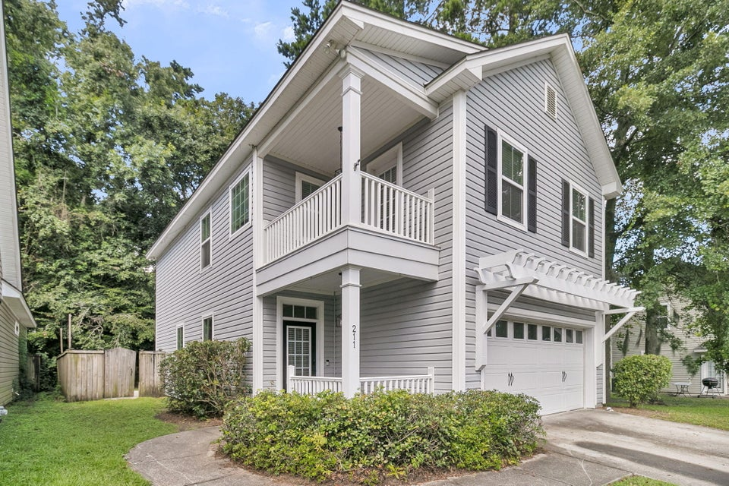
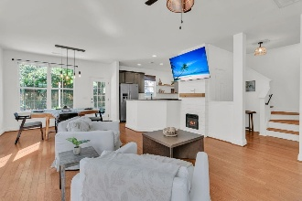
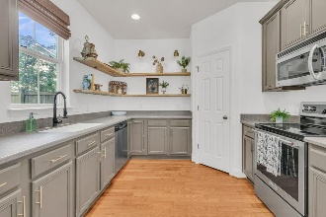
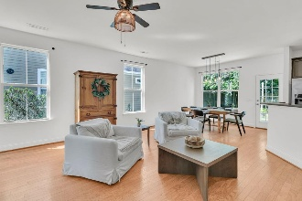
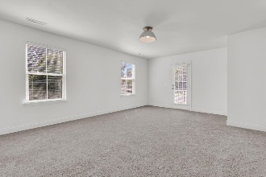
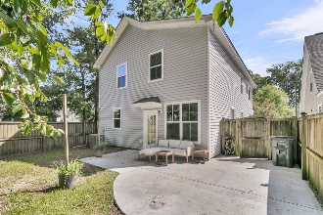


Just Listed in The Reserve at Eagle Run!
Stylish, Spacious, And Full Of Warmth
$15,000 Agent Bonus
with ratified contract by 4/15/18
211 Recess Drive
Eagle Run
Ladson, SC 29456
MLS# 25020000
$363,500
$12,100 Under
Recent Appraised Value
WELCOME HOME! Prime LOCATION, beautiful home, and Modern Charm. 211 Recess Dr. is the One You've Been Waiting For. Welcome to this beautifully updated 4-bedroom, 2.5-bath home that effortlessly blends modern style, everyday comfort, and unbeatable convenience. Tucked away in the desirable Reserve at Eagle Run, this move-in-ready gem offers the convenience and comfort of the home you've been waiting for! From the moment you pull into the driveway, this home makes a statement. Think: a welcoming front porch that sets the tone for what's inside. Bright, Natural Light throughout and contemporary updates, truly make this an amazing opportunity for any buyer! Step through the front door and into a light-filled, open-concept living space designed for connection and comfort.
The living room flows seamlessly into the chef-style kitchen, featuring:
Granite countertops | Modern appliances | Spacious eat-in dining area | Ample pantry and sleek cabinetry
Perfect for entertaining or easy family dinners, this space is as functional as it is beautiful.
Upstairs, the primary suite feels like your personal sanctuary complete with a spa-inspired en suite featuring a soaking tub, dual vanities, and a separate shower. Three additional bedrooms and a second full bath provide space to grow, host, or create your perfect home office.
Bonus features you'll love:
2-car garage
Laundry room with storage
Energy-efficient systems
All new paint through out as well as, upper level bedrooms have new flooring
Located in the award-winning Dorchester II School District
Minutes from Boeing, Joint Base Charleston, shopping, dining, and historic Summerville, 211 Recess Dr. offers the perfect mix of peaceful living and everyday accessibility.
This isn't just a house - it's home.
William R Everett, Jr
(843) 693-8539– C
(843) 576-2701 – O
bill@theeverettgroup.net
RE/MAX Southern Shores
9209 University Blvd, Charleston, SC 29406

