Slide 1
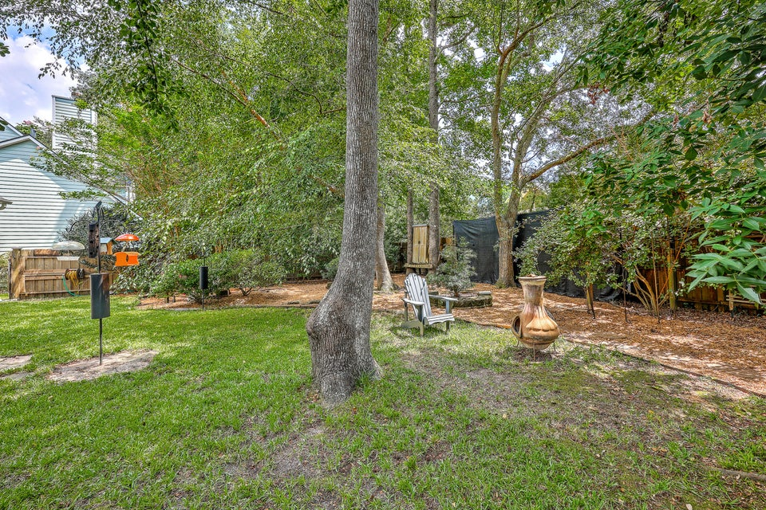
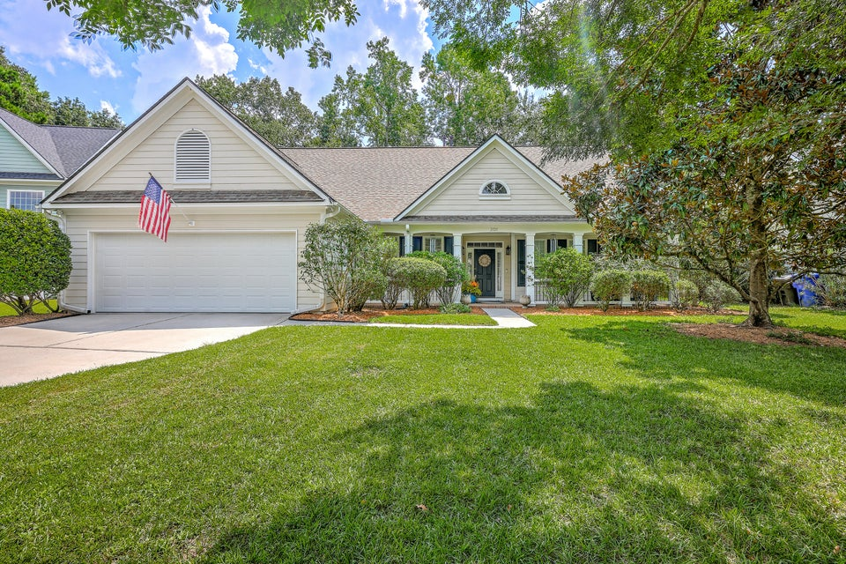
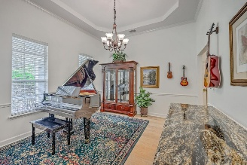
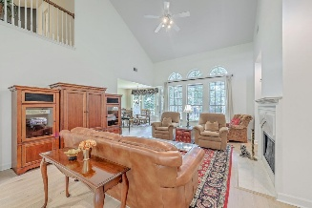
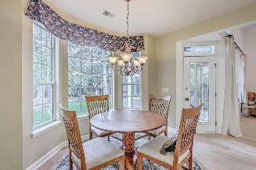
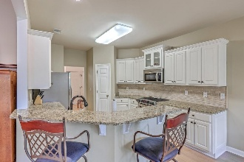
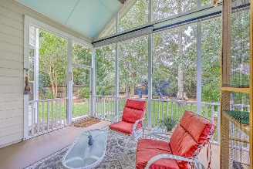
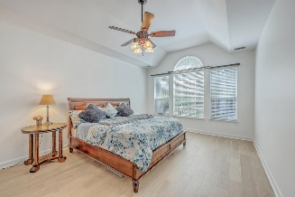
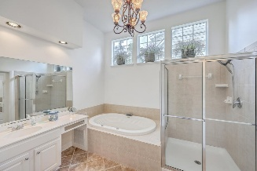
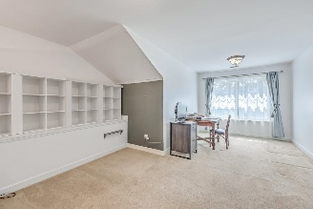
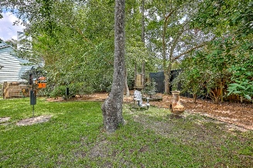
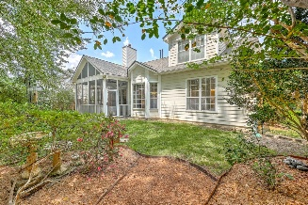

NEW BEHIND THE GATES IN DUNES WEST!
2120 Tall Grass Circle
Dunes West
Mount Pleasant, SC 29466
MLS# 25023157
$837,500
4 Bed | 3½ Bath | 2,700 SF
Don't miss this wonderful ranch-style home in the Whispering Marsh subsection of Dunes West! Spacious and bright with plenty of natural light, this comfortable home features a bonus upstairs space that could easily be a mother-in-law suite! As you walk up to the front of this beautiful home, you'll notice the huge covered front porch, with plenty of space for outdoor seating. Inside you'll find a fantastic layout with two guest rooms and full bath on the left side of the home; the primary suite on the right - separated by the spacious eat-in kitchen, living room and separate dining room. Notice the recent interior paint and wide plank light-oak wood flooring on the main floor!
Upstairs you'll find a terrific loft space overlooking the living room; a full bathroom; a bedroom; and tons of storage. This ground-level home also features a large two-car garage, screened porch off the living room, and a nature-lovers backyard with cute spaces and lots of wildlife visitors! Don't forget to stop by the neighborhood amenities center on your way in. It features pools, waterslides, community center, and tennis/pickleball courts. Dunes West and this beautiful home have so much to offer!

