Slide 1
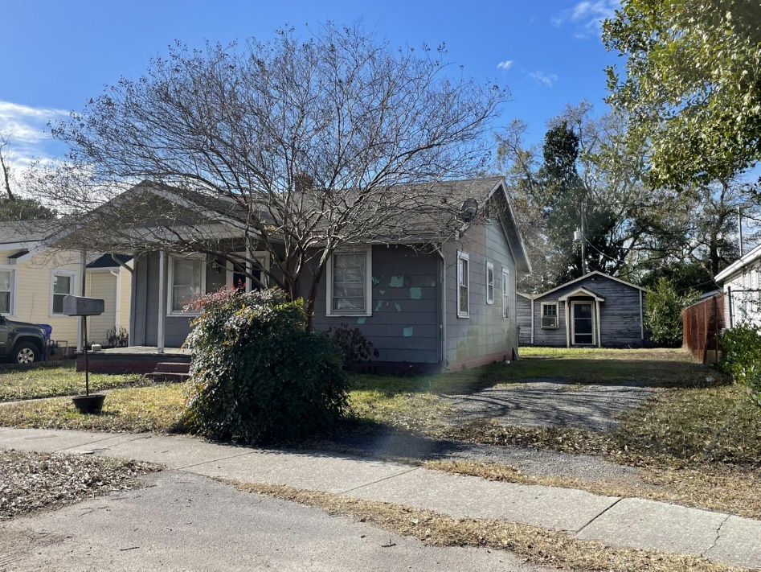
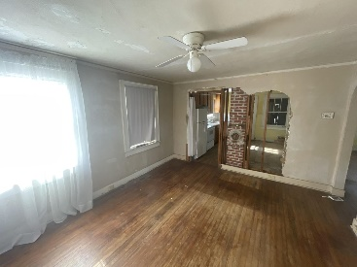
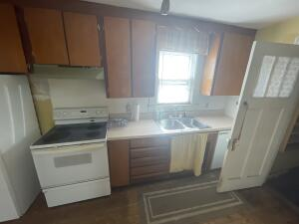
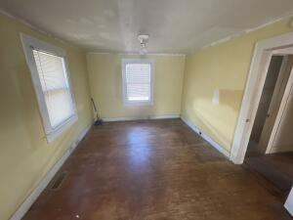
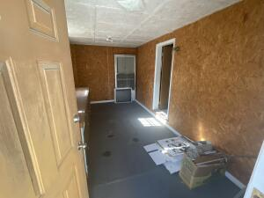
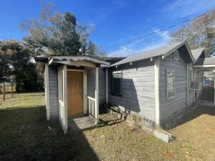



RARE INVESTMENT OPPORTUNITY
2120 Thornlee Drive
Whipper Barony
North Charleston, SC 29405
MLS# 22031275
$190,000
4 Bed | 2 Bath | 1,500sf
Fantastic investment or house hack opportunity! Located in an up and coming area of North Charleston, this cottage has a secondary house/ADU (accessory dwelling unit) in the back. Each house has 2 bedrooms and 1 full bathroom. The second house even has its own backyard, making it great for a long term tenant or airbnb! Both homes are in need of TLC and are handyman specials. Houses need new HVAC or window units. Main house has new gas hot water heater and main sewer line. Sewer line was NOT connected to second cottage, but can be for investment opportunities. Newer plumbing in kitchen and bathroom for main house - drain lines and water lines redone in the last 2 years.
Secondary cottage has plumbing for bathroom and kitchen, but needs to be connected to sewer line. Water line to shed has 2 known holes and needs approx 25ft of water line replaced from main house to secondary house. Has it's own electrical panel. Come grab this fantastic opportunity!
Nick Mazzilli (843) 640-5575
nick@nickmcharleston.com nickmavencharleston.com
Maven Realty
2180 McMillan Ave
#71672
Charleston, SC 29405

