Slide 1
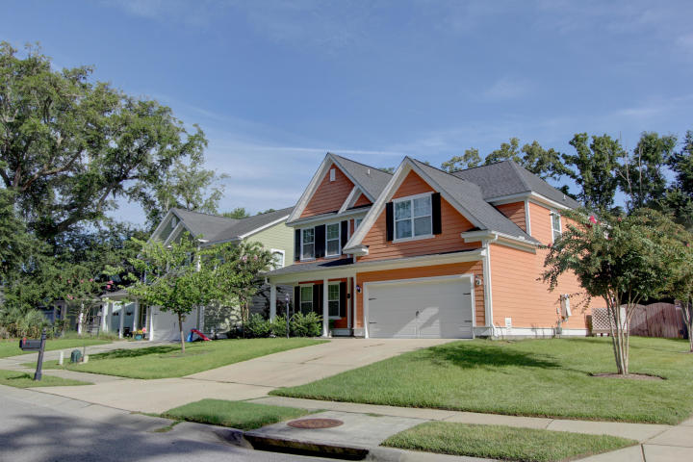
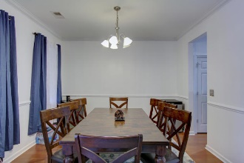
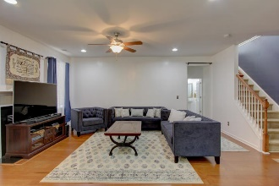
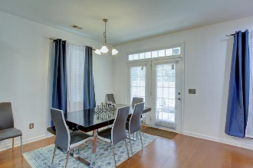
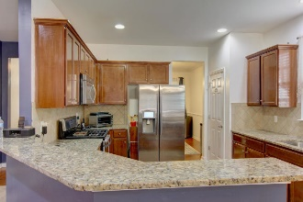
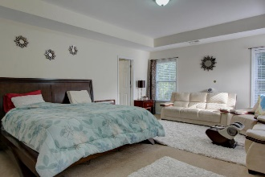
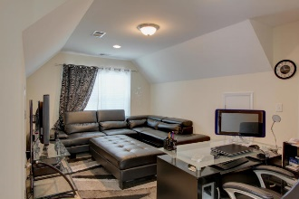
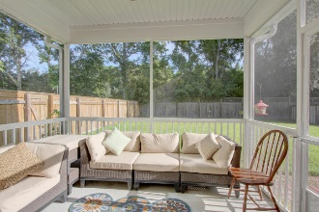
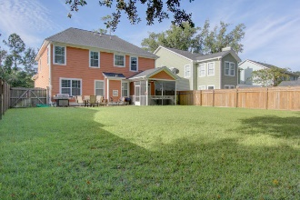


2122 Terrabrook Lane
Terrabrook · Charleston, SC 29412
MLS# 18023728 · $490,000
Price Correction
Welcome to 2122 Terrabrook, Located in the Highly desirable neighbor hood of Terrabrook. On James Island 10 minutes to the beach and 10 minutes to downtown. This custom built Crescent Home boasts 5 bedrooms and 3 full baths. With the Master Bedroom Upstairs, The master layout and full bath makes a beautiful setting for relaxing. Their is also a guest bedroom downstairs that can used for a Mother In Law Suite or guest quarters. The Kitchen has gas stove top with a gas wall oven. The touch screen refrigerator is High Tech and very efficient on the Power bill. Extra Large washer and dryer convey. , touch screen front door lock,and tons of extras.
$550,000
Nick Collins
Office - (843) 266-5000
Mobile - (843) 224-8771
ncollins@carolinaone.com
www.nickacollins.com
Carolina One Real Estate | 2713 Highway 17 North | Mt. Pleasant, SC 29466

