Slide 1
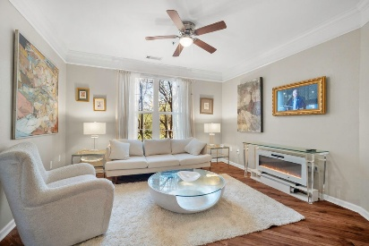

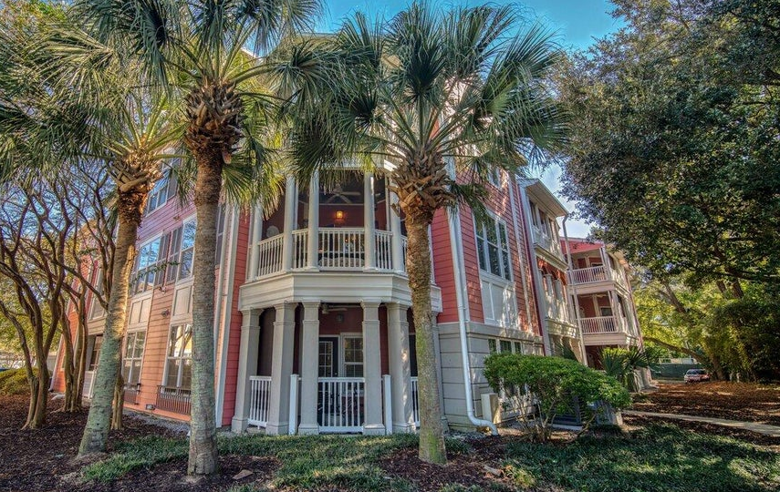


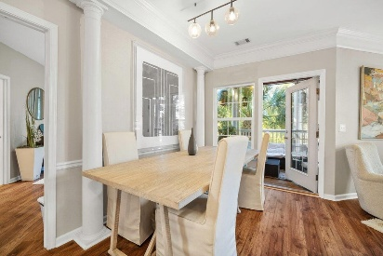


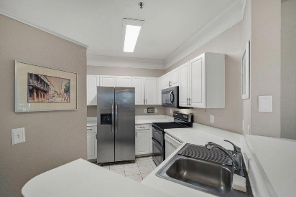



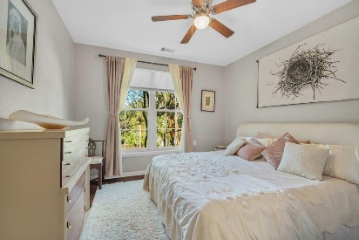


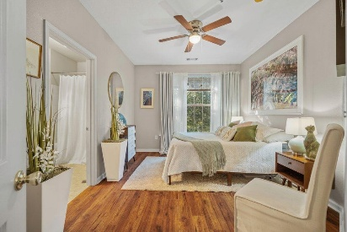

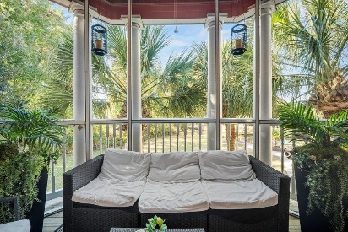

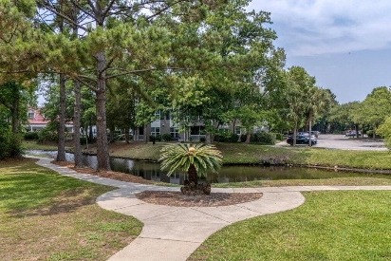

2122 TELFAIR WAY Mira Vista | Charleston, SC 29412 | MLS# 25029751 | $364,500
A Christmas Special in Mira Vista
Offering $2500
Lender Credit
Get your Buyers home for the Holidays...Seller needing to close by End of Year! JUST REDUCED $15,000 AND $10,000 Seller Credit offered with an acceptable offer that can CLOSE BY 12/30!!!
Location, Location, Location! If you've dreamed of living just minutes from everything Charleston has to offer—only 10 minutes to Folly Beach, 5 minutes to Historic Downtown Charleston and a short walk to Restaurants, Shopping, Doctors, Vets offices and more —welcome home to 2122 Telfair Way in Mira Vista. Perfectly positioned in the heart of James Island, this 2- Bedroom, 2-Bathroom beautifully upgraded and impeccably maintained condo offers the ultimate in low-maintenance coastal living. Step inside and immediately feel the difference. Fresh paint graces every wall, new LVP flooring runs throughout (no carpet anywhere!), custom blinds have been added in every room and newer HVAC. The renovated kitchen shines with new cabinetry, hardware, upgraded counters, new double oven, refrigerator and microwave, perfect for the home chef or entertainer.
Both bathrooms have been completely remodeled with new fixtures, lighting, cabinetry, and even luxurious European towel warmers. The electrical system has been upgraded as well. with wiring replaced throughout and pre-wired TV connections now hidden neatly behind the walls for a clean, modern look.
The open-concept kitchen and living area is designed for gathering and entertaining, with bar seating plus a spacious adjacent dining area. The inviting living room offers generous seating, a built-in desk, and custom built-in shelving that enhances both style and storage. Each of the two large bedrooms can easily function as a dual master suite, offering privacy and comfort for guests.
Step onto the screened porch and take in the breathtaking view of the park and water. This serene spot is perfect for sipping your morning coffee or evening glass of wine in peace and privacy. It also has an additional storage area, perfect for all your beach gear!
Beyond the home itself, Mira Vista offers resort-style amenities: a sparkling pool, fitness center, walking trails with benches, and a beautiful clubhouse with kitchen-all within a gated community. It's the perfect "lock-and-leave" lifestyle with luxury at every turn. This would make a great Coastal Retreat or Income-Producing Property.
Coastal life is calling...come enjoy the good life at 2122 Telfair Way today!
House Tour
Elissa Campbell
843-853-1433 | elissa.campbell@agentownedrealty.com
AgentOwned Realty Preferred Group | 824 Johnnie Dodds Blvd | Mt Pleasant, SC 29464

