Slide 1
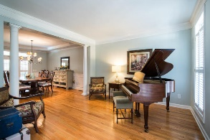
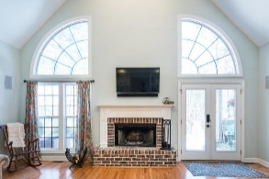
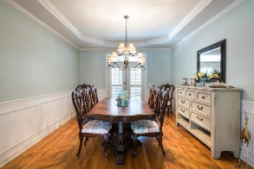
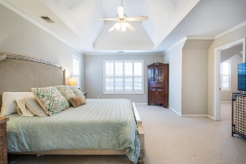
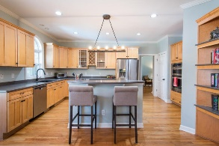
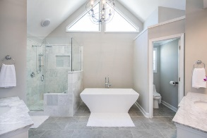
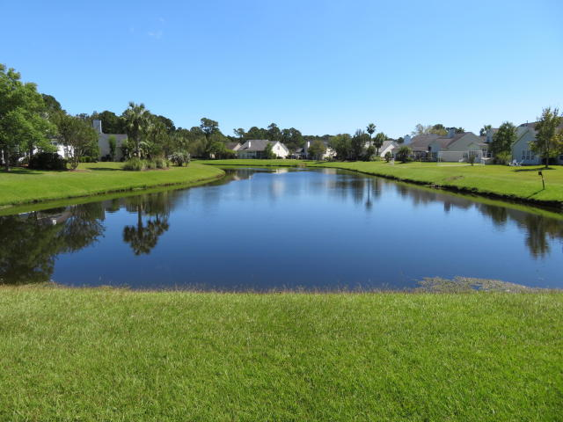
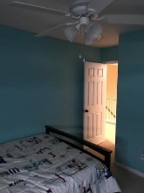
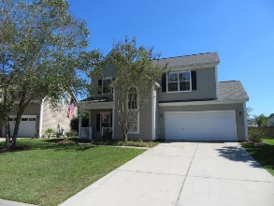
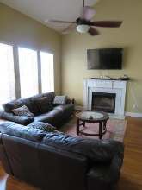
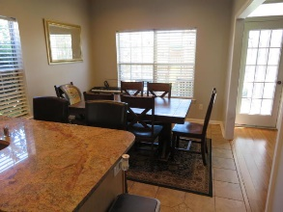
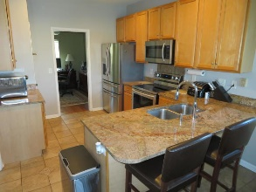
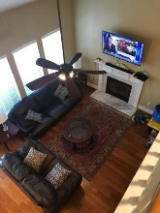
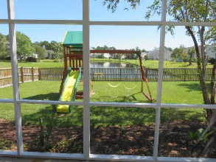
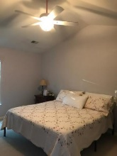
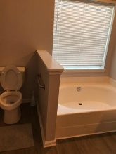
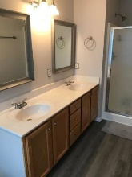
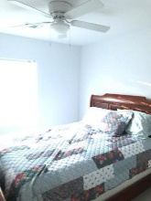
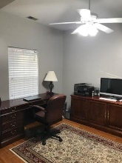
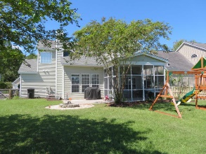
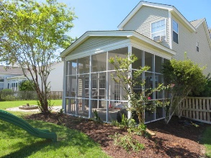


2123 Andover Way Park West ~ Mount Pleasant ~ MLS# 19027546 ~ $372,500
Impressive Home On Pond With Lots Of Upgrades
$550,000
Impressive open floor plan with lots of upgrades. Seller has taken time to get this home show ready sparing no expense. Kitchen has all new stainless appliances with marble counter tops. New flooring in all 3 bathrooms. Some fresh painting and all New carpeting. New screen and lattice on porch. Custom wood fence enclosure for rear yard. One of the largest subdivision lots with panoramic views of pond and beautiful landscaped yard. The large Master Suite and Master Bath offer walk-in closet, double sink vanities, soaking garden tub plus separate shower. Other two bedrooms are nice sizes and share a full bath. Dining room plus eat-in kitchen, vaulted family room with fireplace. Oversized double car garage. This is a rare find for price, size, and condition with upgrades galore!!!!
Tommy Lovett Tommy - (843) 442-1276
tlovett@carolinaone.com www.tommylovettrealestate.com
Carolina One Real Estate
628 Long Point Rd.
Mt Pleasant, SC 29464-3032

