Slide 1
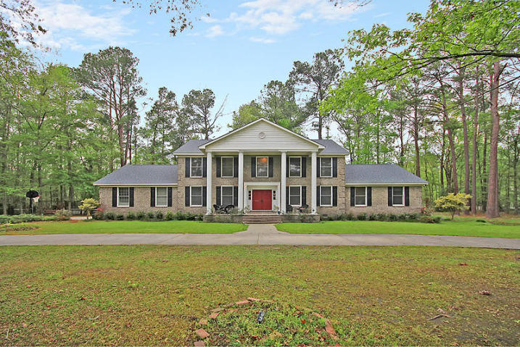
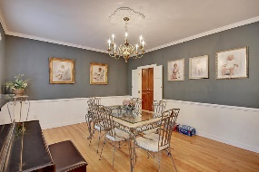
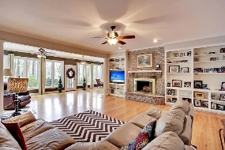
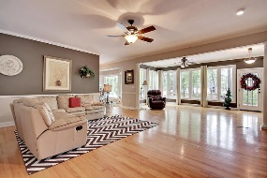
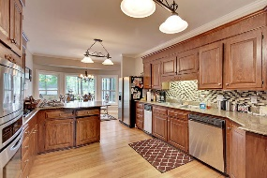
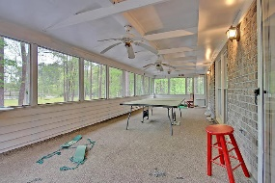
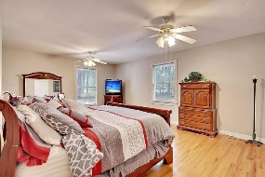
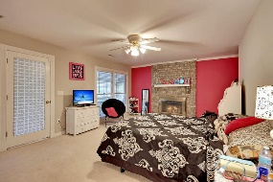
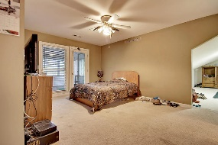
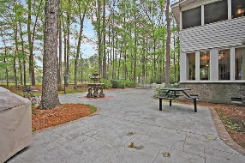
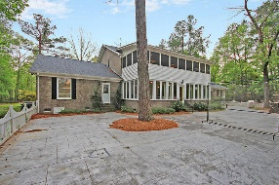
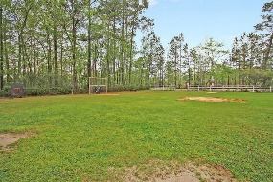
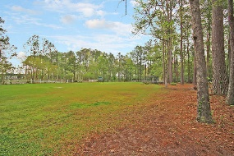


3 Acres Just 3 Miles From Downtown Summerville!
2123 Hummingbird Lane
Summerville, SC 29483
MLS# 17009943
$575,000
6 Bedrooms | 5 Baths | 5,771 sf
Would you like to live on 3 acres in Summerville? No HOA? Have a mother in law suite? Then this is the house for you! Just a few miles outside of downtown Summerville awaits this grand home with amazing curb appeal. Three acres of gorgeous, level land, partially wooded, partially fenced with endless opportunities! The large circular drive and columns on this house give you a grand welcome. Upon entering, you'll notice the beautiful wood floors throughout. The dining room is very large, perfect for entertaining. The formal living or sitting room has walls lined with book cases. The family room is huge and has a fireplace, built in cabinetry, wet bar and is open to the beautiful sunroom, which gives this home tons of natural light. The kitchen offer ample cabinet space, tiled backsplash, trash compactor and large eat in area. Off the family room, is a private office space which offers built in cabinetry and a full bath which also opens to the hall. On the first floor there is also a flex room, which is currently being used as an at home gym. Then you have your mother in law suite, with it's own outside entry, wood floors, large walk in closet and a kitchenette. The first floor is finished off with a large laundry room/mud room. Upstairs, you'll find two large bedrooms that share a jack and jill bathroom. The vanities for this bathroom are private from the shower area. The master bedroom has its own fireplace and access to a large screened in porch overlooking the beautiful property. The master bath has a separate jetted tub and shower. Down the hall, you'll find another large bedroom with its own bath and huge bonus room. On the other side of the home is a large bonus room which could be the 6th bedroom. There is tons of storage in this home!! The property is gorgeous and offers tons of room for horses or you can have your own baseball field! The back patio is perfect for entertaining. If you want to have it all, this is the house for you. Close to town, Dorchester District 2 schools, privacy and tons of house for the money.
Larry & Kathy Mazalatis
Larry Cell 843-693-0529
Kathy Cell 843-693-0159
Office 843-871-9133
AGENTOWNED PREMIERE GROUP | 1800 TROLLEY RD | SUMMERVILLE, SC 29485

