Slide 1
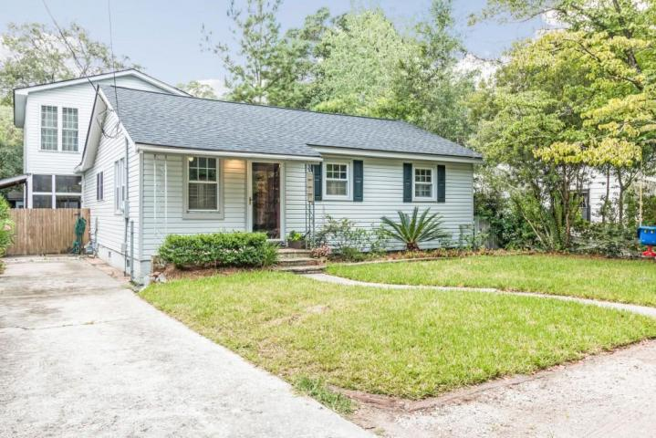
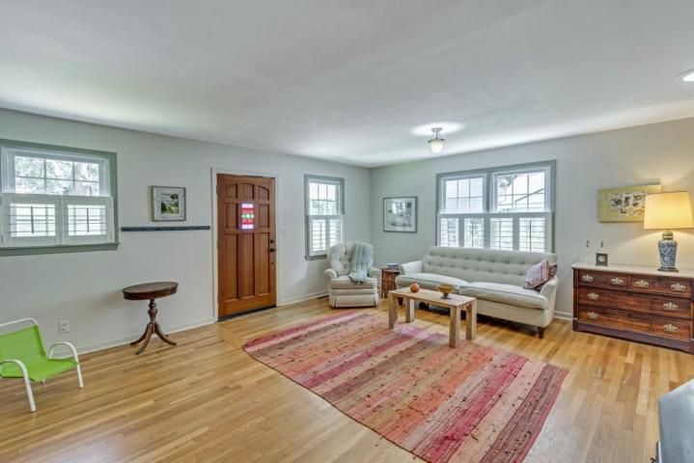
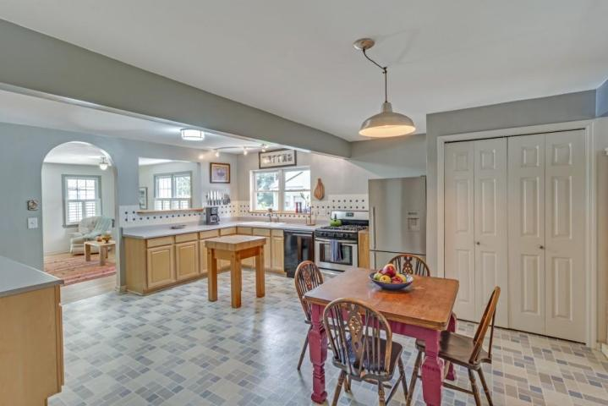
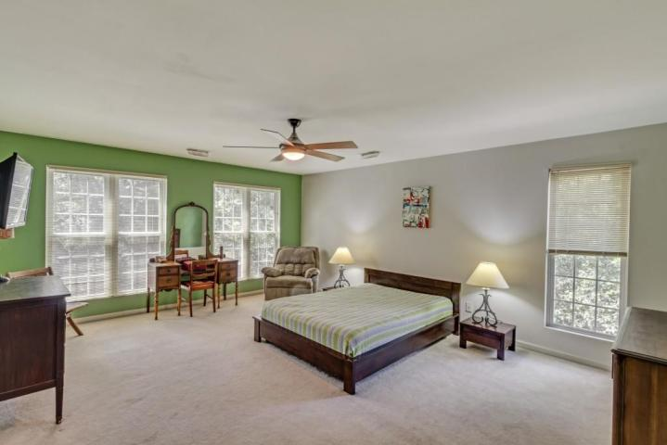
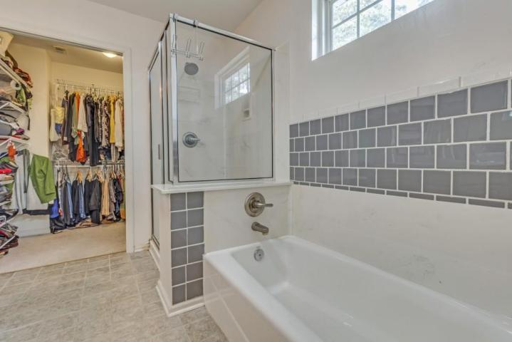
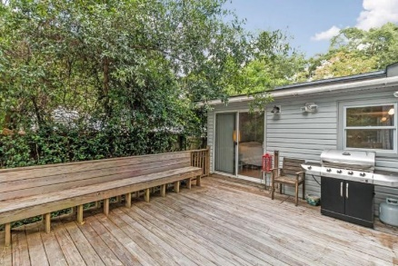
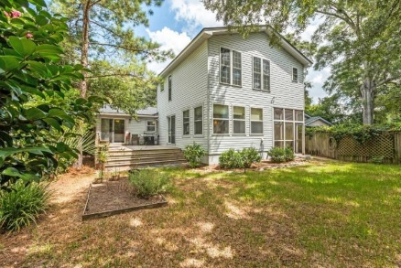
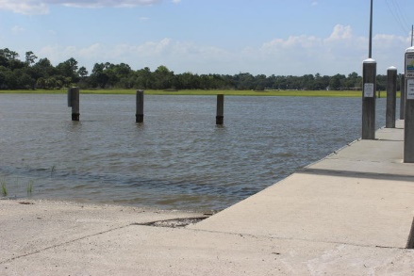


2125 Edisto Ave
Riverland Terrace ~ Charleston
MLS# 16020315 ~ $399,900
Open House
Tues August 3oth ~ 11:30a-1:30p
Lunch Served
Charm, location and square footage are yours at 2115 Edisto in beautiful and funky Riverland Terrace. To enhance the floor plan and add square footage for a new Master Suite, Laundry Room and Office, the home had a major renovation 2001. The result is that there are dual Master Suites with baths en suites, a third bedroom, Family room, Kitchen three baths in total, Laundry Room, Office and Office/Nursery/Media Room. Complementing the home are hardwood floors throughout much of the home, 2 recently renovated baths, new 2015 roof, spacious deck, screen porch and workshop. No flood insurance!
Riverland Terrace is known as a friendly and active neighborhood. 2125 Edisto is at the entrance to Medway Park which is a beacon of activity with its recreational opportunities, dog park and community garden. Also in Riverland Terrace is the Plymouth Street public boat ramp and the Charleston Municipal Golf Course. A short walk brings you to the Terrace Theatre shopping area, the James Island Farmer's Market, the Pour House, the Public House, Zia's, How Art Thou, Crust, Lot and other dining and music experiences.
With the convenience to shopping at South Windermere or James Island, with downtown Charleston and Folly Beach only 10 minutes away, with numerous restaurants nearby, and being in desirable Riverland Terrace, this property is a must-see!
Kay Kennerty
MBA, ABR, CRS, GRI
843-345-5011
kkennerty@aol.com
www.KayKennertyHomes.com
The AgentOwned Realty Company
824 Johnnie Dodds Blvd
Mt. Pleasant, SC 29464

