Slide 1
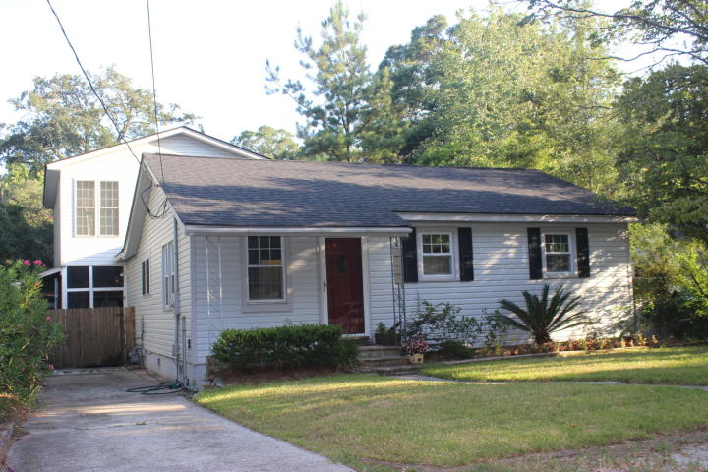
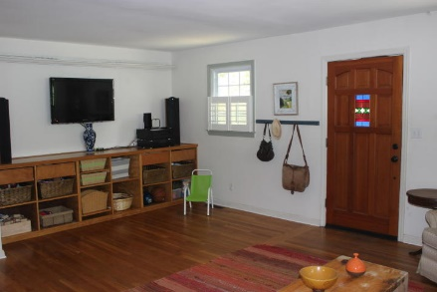
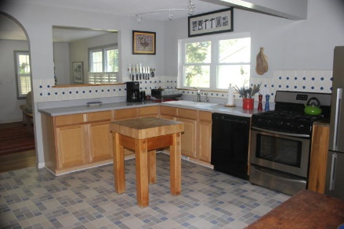
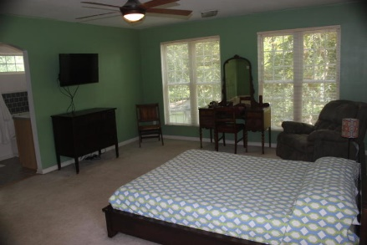
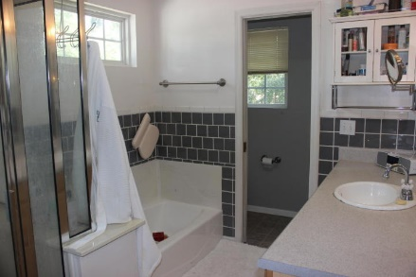
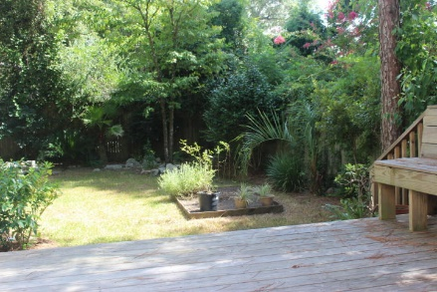
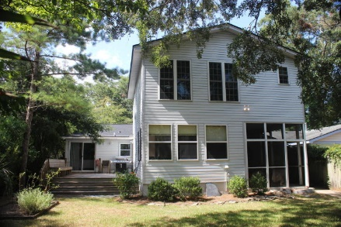
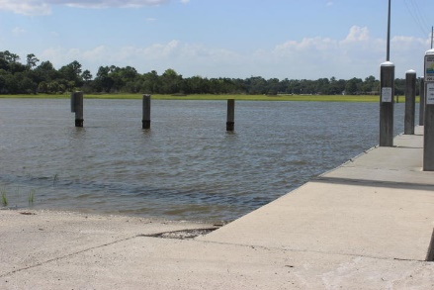


2125 Edisto Avenue
Riverland Terrace ~ Charleston ~ MLS# 16020315 ~ $415,000
Open House
Aug. 3rd from 10-12
If you looking for a home in Riverland Terrace with space, 2125 Edisto is for you. This 2,183 SF home is full of charm and its open floor plan is wonderful for entertaining. In 2001 a major renovation added square footage while updating and enhancing the floor plan. With the recent addition of the deck, the ease and flow of the house for daily living and entertaining is tied together. There are dual Master bedrooms with bathrooms en suite, a guest bedroom and a well located and updated bath. The spacious kitchen has tons of cabinets and storage as well as a dining area. The family room, the downstairs Master suite and the guest room have original hardwood floors. On the second floor, there is the Master bedroom with a spacious bath, shower, tub and walk-in closet as well as an additional room with Pergo flooring for an office/nursery/media room. On the first floor, there is a roomy laundry room and a bonus room (office/nursery/media room) overlooking the backyard. In the backyard, the fence, the grand oak tree and camellia, and the mature shrubbery create a private refuge for the owners. There is also a raised herb garden, a workshop and a screened porch. In 2015, a new roof was installed. The termite bond is in place. No flood insurance required!
The location of the property within Riverland Terrace offers opportunities to enjoy this friendly and active neighborhood. The home is at the dead end of Edisto Avenue where it adjoins Medway Park. Medway Park has become a beacon of activity with its recreation opportunities, dog park and community garden. For boating and golfing, access could not be more convenient than living in Riverland Terrace. The Plymouth Street boat ramp to the Wappoo Cut gives boaters only a 5 minutes ride to the Charleston Harbor or to Folly Beach. The Charleston Municipal Golf Course is also within Riverland Terrace. From home, a short walk brings you to the Terrace Theatre shopping area, the James Island Farmer's Market, the Pour House, the Public House, Lot and other dining and music experiences.
With the convenience to shopping at South Windermere or James Island, with downtown Charleston and Folly Beach only 10 minutes away, with numerous restaurants nearby, and being in desirable Riverland Terrace, this property is a must-see!
Kay Kennerty
MBA, ABR, CRS, GRI
843-345-5011
kkennerty@aol.com
www.KayKennertyHomes.com
The AgentOwned Realty Company
824 Johnnie Dodds Blvd
Mt. Pleasant, SC 29464

