Slide 1
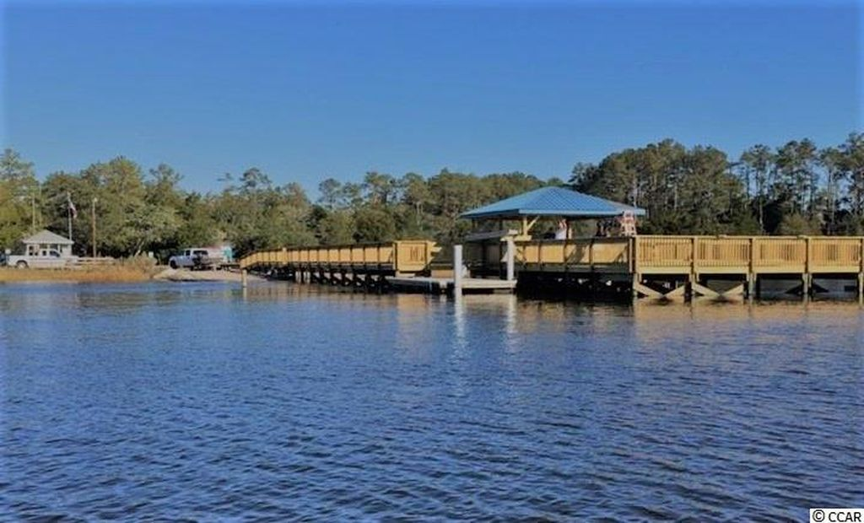
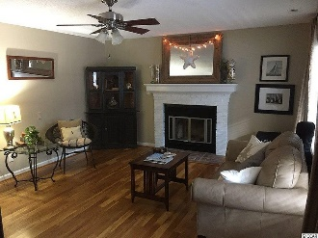
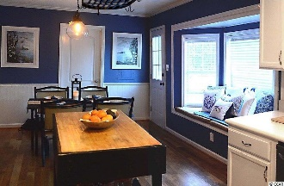
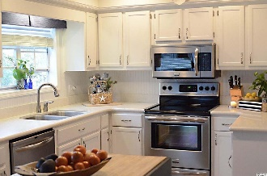
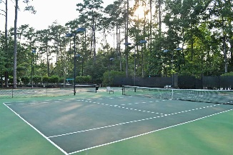
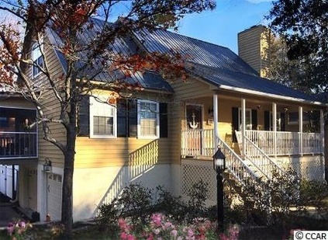
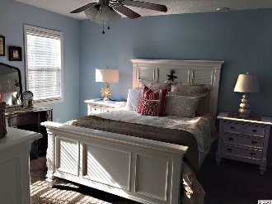
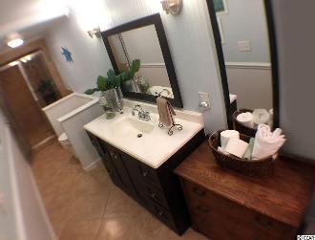
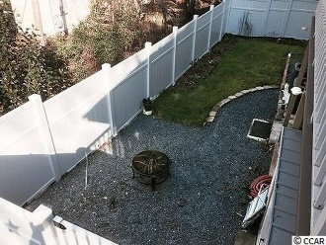
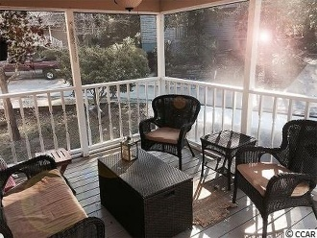
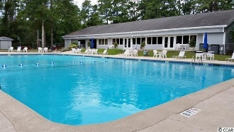
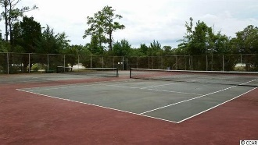


2125 Lafayette Cir
Windjammer Village
Little River, SC 29566
MLS #: 1702707
$259,000
5 bedroom 3 full bath home in gated, amenity rich
Intra Coastal Waterway residential resort community
Rare and truly amazing opportunity to purchase a charming, completely upgraded and beautifully refurbished multi-level, 5-bedroom 3-bath home, vacation home or investment property in popular Windjammer Village “WJV.” Welcome to Starfish Cottage! Spacious bedrooms include two masters; main floor master has en suite. There is one signature bath on each floor. Home can easily afford separate living quarters or mother-in law suite with a private entrance, as the basement level has many possibilities. – with two bedrooms, a large modern bath, kitchen appliances, washer/dryer hook-up, private parking, and private access, this could be a separate living space with a few modifications.
Cheery kitchen with stainless steel appliances. Cozy living room with fireplace. Lives comfortably on every level. Great for families and vacation rentals. Short and long-term rentals allowed. Motorcycles for both owners and tenants are allowed. Gated nature enclave with direct Intracoastal Waterway access and complimentary community storage.
Minutes from the Atlantic Ocean -- marsh walk, fishing pier, new boat dock, boat ramp, lighted tennis courts, Olympic-size swimming pool, childrens' pool, rec room for children, playground, basketball court, horseshoes, and shuffle-board court. There is a private, keyed entrance for owners into Vareen Park for strolling and dog-walking, as well as a private, dog-friendly beach along the ICW. There is a large storage yard for boats, RVs, motorcycles, kayaks, etc., a meeting/social room with kitchen facilities, library and exercise room.
Deborah Collins
843-424-9013
dctidewater@yahoo.com
Connie Ross-Karl
702-306-2643
conniesross@aol.com
NEW WAY PROPERTIES MYRTLE BEACH

