Slide 1

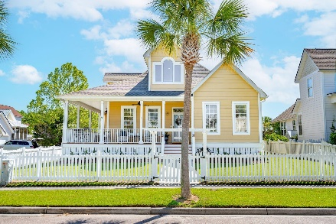
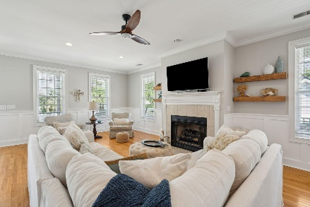
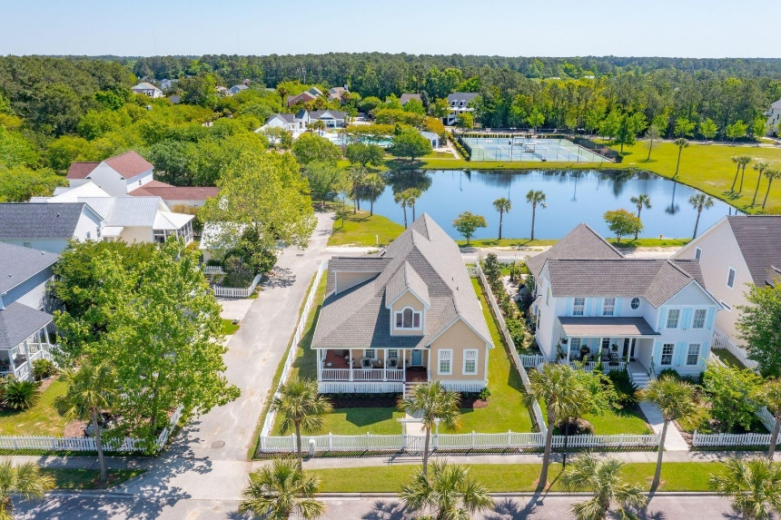
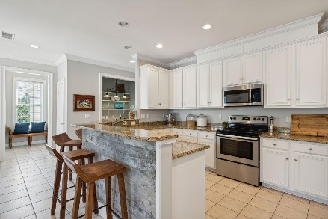
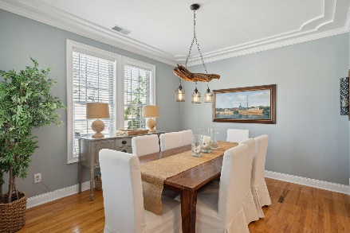
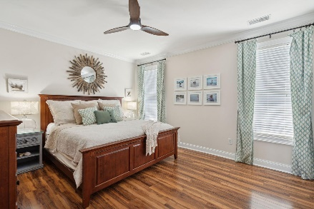
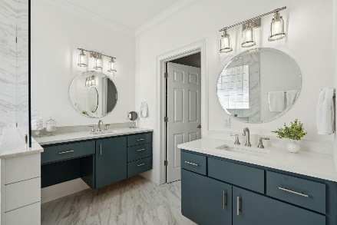
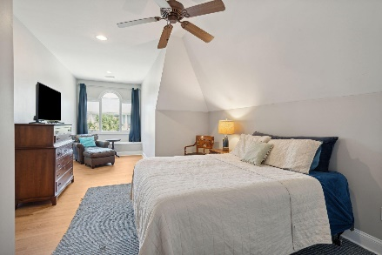
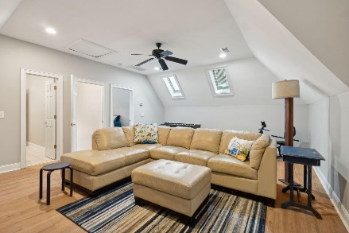
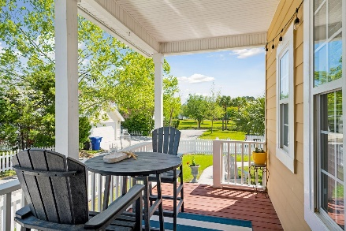
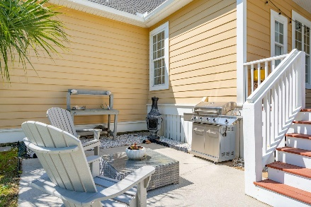
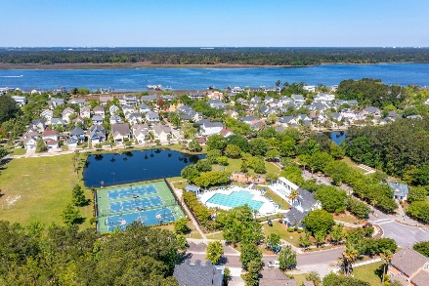
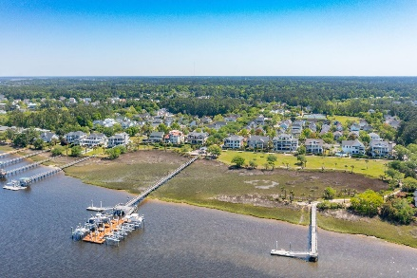


2127 Hartfords Bluff Lane Rivertowne On The Wando Mount Pleasant, SC 29466 MLS# 24009691 | $910,000
Best Value in Rivertowne
Charming coastal cottage located on a quiet street in the highly sought after Rivertowne on the Wando. Surrounded by a classic white picket fence, you'll enter through a gated arbor and be greeted by a wrap-around porch, ideal for relaxing with a glass of sweet tea while enjoying the soothing river breeze. Step inside to find updates and custom touches throughout. Gorgeous millwork, including custom board-and-batten, crown moulding, and hardwood flooring are a few of the upgraded features of this home. A large, sun filled family room features a gas log fireplace with stone surround and mantle. The expanse of this room allows for multiple seating arrangements as well as separate conversation areas or reading nooks. A formal dining room is open to the spacious kitchen allowing for ease of hosting holiday and celebratory dinners. The dining room features a beautifully detailed tray ceiling and a custom crafted driftwood light fixture. Adjacent the dining room, a shiplap clad bar encloses the kitchen providing an excellent area for entertaining as friends pull up a stool and sip a glass of wine while you prepare the evening's treats. Elaborate dinners and daily meal prep will both be enjoyable in this cook's kitchen. Stainless appliances (including refrigerator) compliment white cabinetry and long expanses of granite countertops. Casual meals can be enjoyed at the bar or in the sunny breakfast nook just off the kitchen. A much desired main floor primary suite is tucked away in the rear of the home. Private and serene, this owner's retreat features a brand new, stunning luxury en-suite bathroom. Gorgeous floating dual vanities with quartz countertops and brushed nickel fixtures, a walk-in frameless shower with custom tile, linen closet, and a private water closet complete the space. Two additional bedrooms and a beautifully updated full bathroom are found on the opposite side of the home. Additional first floor conveniences include a built-in work station with open shelving, a drop zone with storage closet/pantry, and laundry room. Upstairs, a huge flex space offers the convenience of multiple uses. Media room, play room, exercise/wellness studio, home office, craft room, secondary family room... the possibilities are truly endless. A large bedroom complete with walk-in closet, updated full bathroom and cozy reading or sitting nooks with built-in window bench provides a perfect teen retreat or guest/in-law suite. Additionally, just off the bonus room is an unfinished attic space that is currently used as storage but could be finished to provide additional square footage in the form of an office, bedroom or more. Lowcountry living means lots of time spent outdoors and this home provides plenty of opportunity to do just that. In addition to the wrap-around front porch, a side porch located off the kitchen steps down to a patio and offers a peaceful place to sip your morning coffee, dine al fresco, or host friends for s'mores! Enjoy the peaceful pond view while watching Egrets and shore birds hunt for dinner and children or pets frolic in the fully fenced yard! The garage offers storage space not only for parking your cars but for all of your outdoor necessities such as kayaks, beach gear, lawn equipment, and more! All of this and located in the prestigious Rivertowne on the Wando Neighborhood with three community docks for fishing, boating or just to relax and watch the amazing Wando River sunsets. Enjoy golf at Rivertowne Country Club's Arnold Palmer Signature Course then meet friends at the club for dinner. Additional amenities include neighborhood pool, tennis courts, walking trails and play park all conveniently located to beaches and the world class dining and shopping of historic downtown Charleston.
Video Tour
Don Dawson 843-514-0452 ddawson@carolinaone.com Carolina One Real Estate • 2713 Highway 17 North • Mount Pleasant, SC 29466
www.TeamDawsonSC.com

