Slide 1
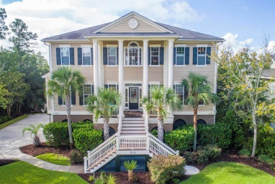
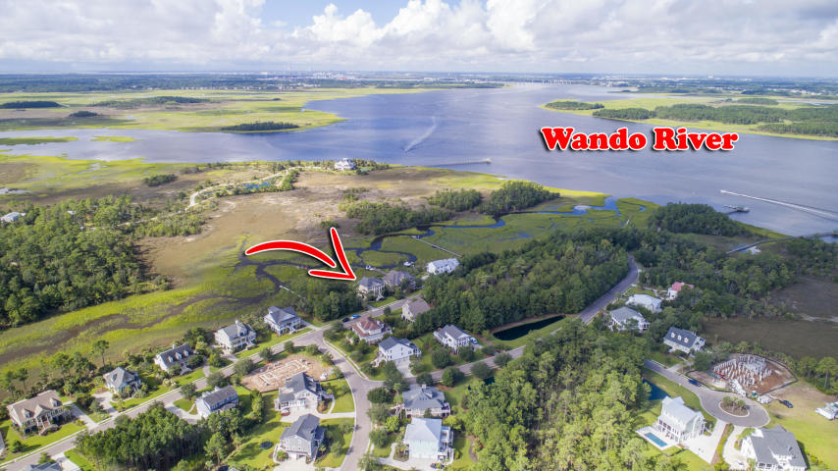
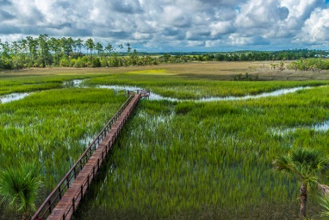
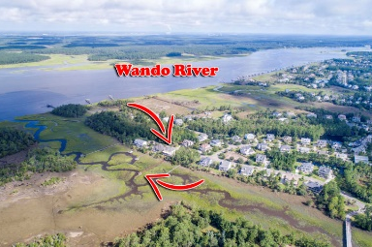
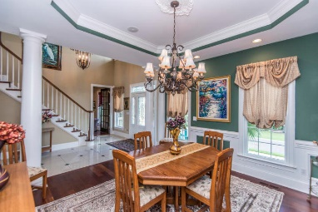
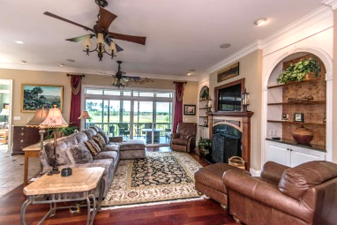
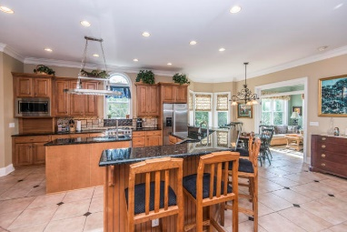
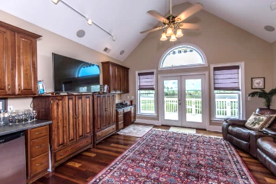
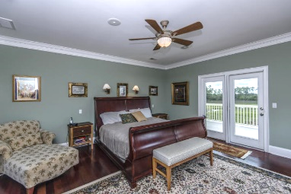
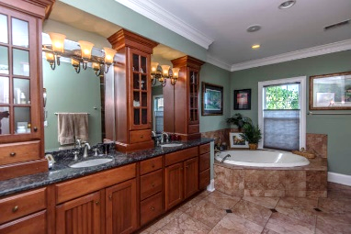
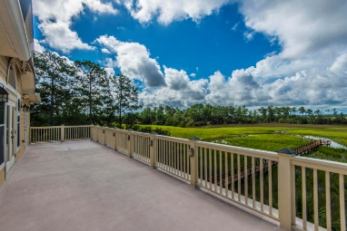
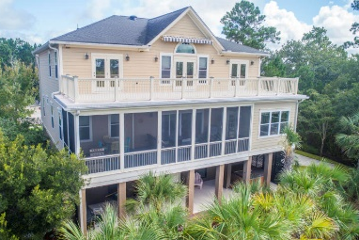
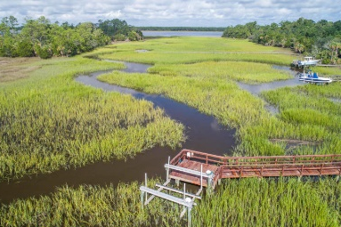
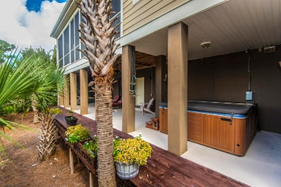


2128 Breezy Point Drive Rivertowne Country Club Mount Pleasant, SC 29466 MLS# 18024848 ~ $1,199,000
Private Dock - Spectacular Marsh, Creek & Wando River Views!
Private dock, 5-10 min to the Wando River, boatlift (10,000 lbs)
Spectacular panoramic views of the marsh, tidal creek, river and even the Ravenel Bridge off in the distance!
This gorgeous elevated home just oozes "low country" architectural design with its grand stately columns, stunning wood and etched glass front door and welcoming real gas lanterns.
The dining room has beautiful wainscoting and trim work, tray ceiling and chandelier with an elegant medallion.
The entire back of the home has an open floor plan and flows from family room to kitchen to sun room to screened porch.....All offering magnificent views!
Rivertowne Country Club offers an Arnold Palmer Signature 18-hole golf course, swimming, tennis, 1/2court basketball, and children's play park right nearby. You will also be close to historic downtown Charleston, Mount Pleasant dining, shopping, movies and the beaches of Isle of Palms and Sullivan’s Island!!
WOW!! THIS JUST MIGHT BE THE ONE!!
PLEASE SHOW THIS WONDERFUL HOME
Bob Crawford
CRS, ABR, SRES, REALTOR
Mobile - (843) 860-8008
bcrawford@carolinaone.com
www.CharlestonGolfProperties.com
Carolina One Real Estate
2713 Highway 17 North
Mt. Pleasant, SC 29466

