Slide 1

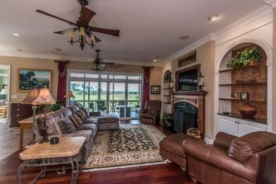
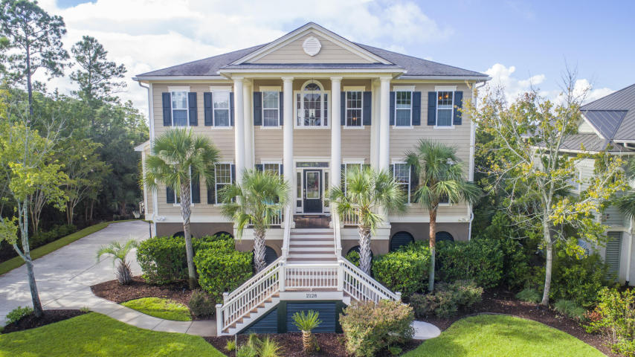
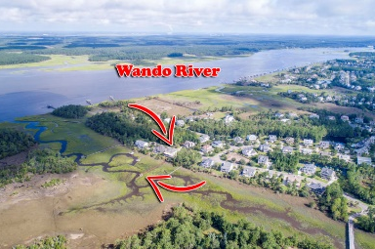
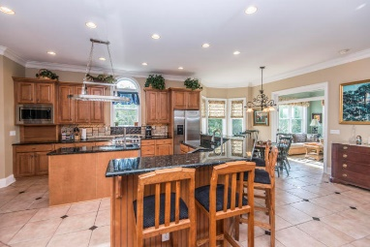
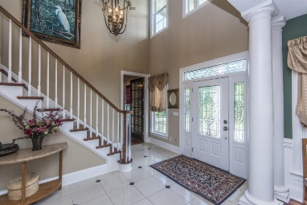
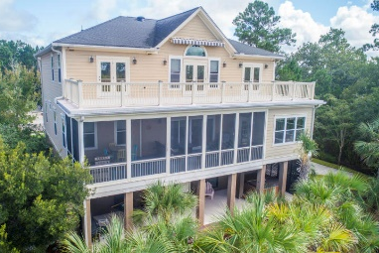


2128 Breezy Point Drive Rivertowne Country Club Mount Pleasant, SC 29466 MLS# 18024848 ~ $1,199,000
Private Dock - Spectacular Marsh, Creek & Wando River Views!
PRIVATE DOCK, 5-10 min.TO THE WANDO RIVER, BOATLIFT (10,000 lbs), SPECTACULAR PANORAMIC VIEWS OF THE MARSH,TIDAL CREEK, RIVER AND EVEN THE RAVENEL BRIDGE OFF IN THE DISTANCE! Want more? OK, here's more....This gorgeous ELEVATED home just oozes ''Low Country'' architectural design with its GRAND STATELY COLUMNS, STUNNING WOOD AND ETCHED GLASS FRONT DOOR and welcoming REAL GAS LANTERNS. ***** Enter the 2-story inlaid Marble FOYER to find the FORMAL LIVING/OFFICE/BEDROOM # 5 to your right and the FORMAL DINING ROOM to your left. The Dining Room has beautiful WAINSCOTING AND TRIM WORK, TRAY CEILING and CHANDELIER with an ELEGANT MEDALLION. ***** Whether you love having big parties or simple family gatherings, THIS HOME is ''MADE for ENTERTAINING''! The entire back of the home has an OPEN FLOOR PLAN and FLOWS FROM FAMILY ROOM TO KITCHEN TO SUN ROOM TO SCREENED PORCH.....all offering MAGNIFICENT VIEWS! ***** The Family Room has a GAS LOG FIREPLACE flanked by beautiful BUILT-IN BOOK SHELVES. ***** The SPACIOUS KITCHEN has inlaid TILE, LOTS OF GRANITE counter tops including a PREP ISLAND and a HUGE BAR that could seat up to 8 if you so desired! All STAINLESS appliances, including a Jenn-Air Gas Stove Top. STORAGE ABOUNDS with lots of 42" Cabinets and Walk-In Pantry. ***** The LAUNDRY ROOM is off the Kitchen and offers not only the Washer, but also a Dryer with an Upper unit for sweaters and Dry Cleaning. ***** Enjoy Reading, Chatting, Napping, etc in your OH, SO LOVELY SUNROOM. Or lounge on your SERENE, PRIVATE SCREENED PORCH with those oh, so AMAZING VIEWS! The Porch is approx 11' x 32'.....such a splendid extension of your ENTERTAINING SPACE. ***** Bedroom #1 is downstairs with an En Suite Full Bath. ***** The LIGHT-FILLED MASTER Bedroom is upstairs and opens onto to the UPPER DECK WHICH EXTENDS ACROSS THE ENTIRE BACK OF THE HOUSE and offers up those EXPANSIVE VIEWS of the marsh, creek and river. The MASTER BATH has INLAID TILE, GORGEOUS WOOD CABINETS, GRANITE DUAL VANITY, HIS AND HER WALK-IN CLOSETS, MULTI-JET SHOWER, HUGE SOAKING TUB, and PRIVATE WATER CLOSET. ***** Bedrooms #3 and #4 and another Full Bath are upstairs, as well. ***** Also upstairs is the VERY SPACIOUS MEDIA/GAME ROOM with small Fridge, great BUILT-INS and it opens onto that very cool UPPER DECK with........of course, MAGNIFICENT VIEWS! ***** The Lower Level offers a 3-CAR GARAGE, lots of STORAGE SPACE, Workshop Space, and outside Lower Deck ********** Rivertowne Country Club offers an Arnold Palmer Signature 18-Hole Golf Course, SWIMMING, TENNIS, 1/2Court Basketball, and CHILDREN'S PLAY PARK right nearby. ********** You will also be close to HISTORIC DOWNTOWN CHARLESTON, Mount Pleasant DINING, SHOPPING, MOVIES and the BEACHES OF ISLE OF PALMS AND SULLIVAN'S ISLAND !! WOW !! This just might be THE ONE !! *************** IMPORTANT MAINTENANCE ***** Replaced both HVAC Units in 2014 ***** New Tankless Water Heater in 2015 ***** Replaced Well Pump in 2014 ***** New Gas Logs installed in 2013 ***** New Washer in 2017 ***** New Microwave in 2018 ************ IMPORTANT FEATURES ***** 3-STOP ELEVATOR ***** POWER AND WATER OUT ON THE DOCK ***** GAS HOOK-UPS ON 2ND AND 3RD DECKS (GAS LINE AVAILABLE ON LOWER DECK LEVEL) ***** HOOK-UP FOR EMERGENCY GENERATOR ***** SURROUND SOUND SPEAKER SYSTEM ***** CENTRAL VAC ***** "NO-SEE-EMS" SCREENING ON PORCH ***** BRAZILLIAN CHERRY HARDWOODS, MARBLE, AND CERAMIC TILE FLOORING ***** OUTSTANDING TRIM WORK !! ********** COME SEE YOUR NEW HOME !!!! *************
Bob Crawford
ABR, EPRO, SRES, REALTOR
Mobile - (843) 860-8008
bcrawford@carolinaone.com
www.CharlestonGolfProperties.com
Carolina One Real Estate
2713 Highway 17 North
Mt. Pleasant, SC 29466

