Slide 1

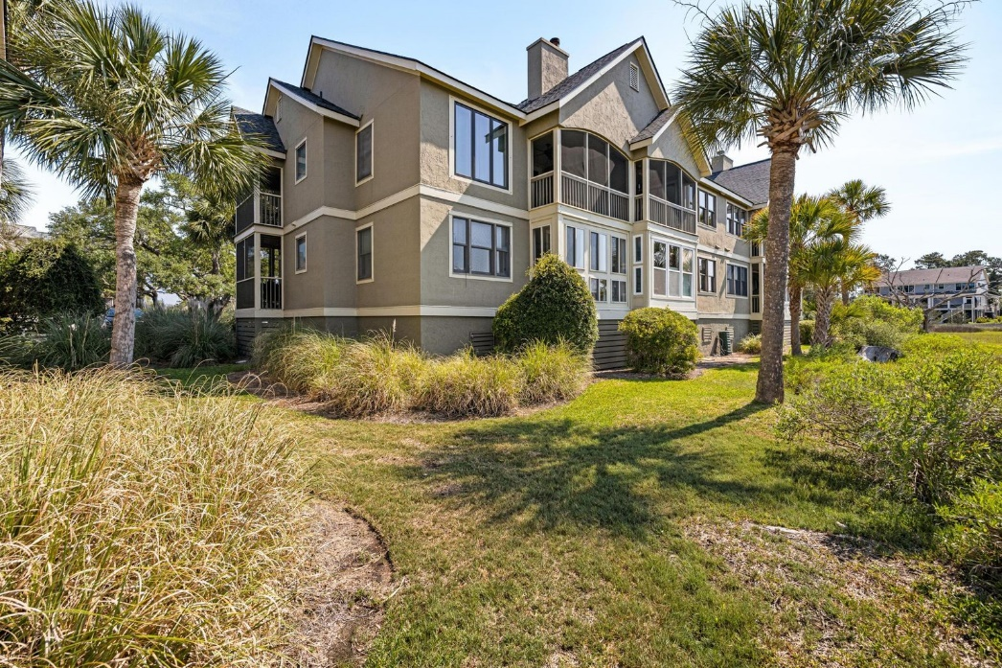






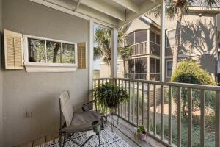



2128 Landfall Way Bldg D Bay Pointe Villas | Seabrook Island, SC 29455 MLS# 22013719 | $585,000
Price Improved!
Fabulous Views Of The Marsh!
Completely renovated end unit with new flooring, baths, new kitchen, porch area opened up , new windows( living room area)/to be installed ) , & new HVAC . Both bedrooms have ensuite baths . Light and bright a perfect fulltime residence or vacation spot. All new appliances in kitchen Quiet enclave with magnificent sunsets & views of the open water with a private community pool, kayak storage and launch for owners, community gated dock, charging station, plus private grilling area . The regime covers exterior maintenance, pest control ,dock, pool maintenance, & all insurances, except the owners personal contents. Complex had new roofs installed in 2021. Private gated Oceanfront Community with Golf, Tennis, Equestrian Center, Indoor Pool & 3 miles of beach
MJ Collins
484-844-7350
mjkcollins@aol.com
Agent Group Realty
4000 S. Faber Place Dr Ste 300
Charleston, SC 29405

