Slide 1
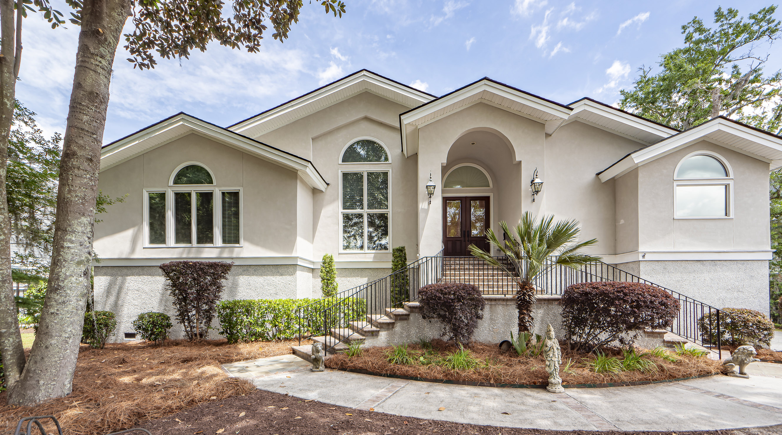
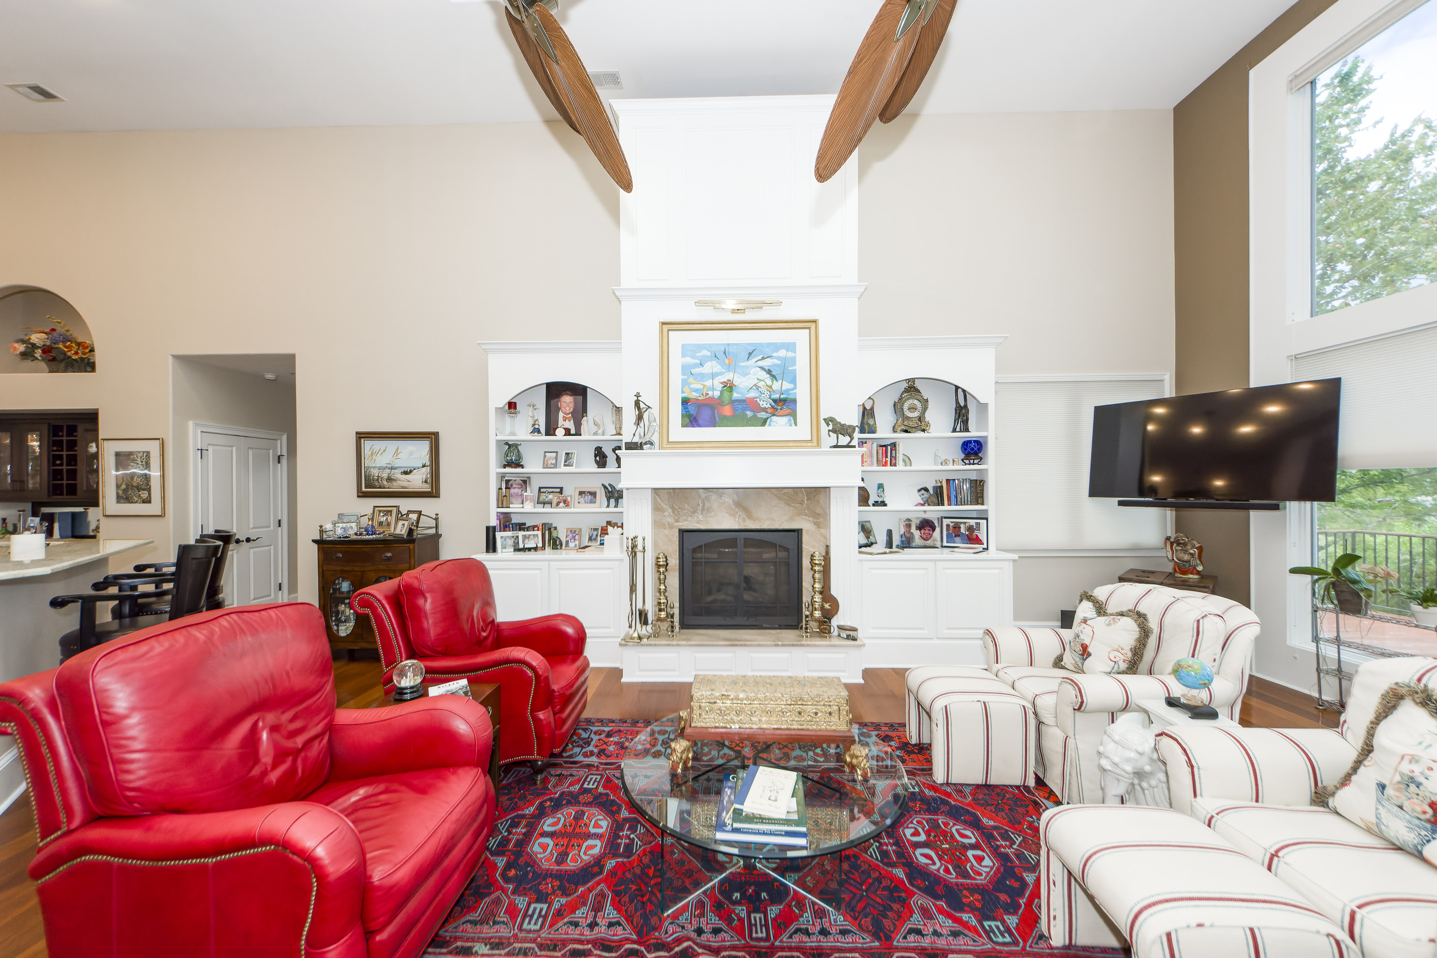
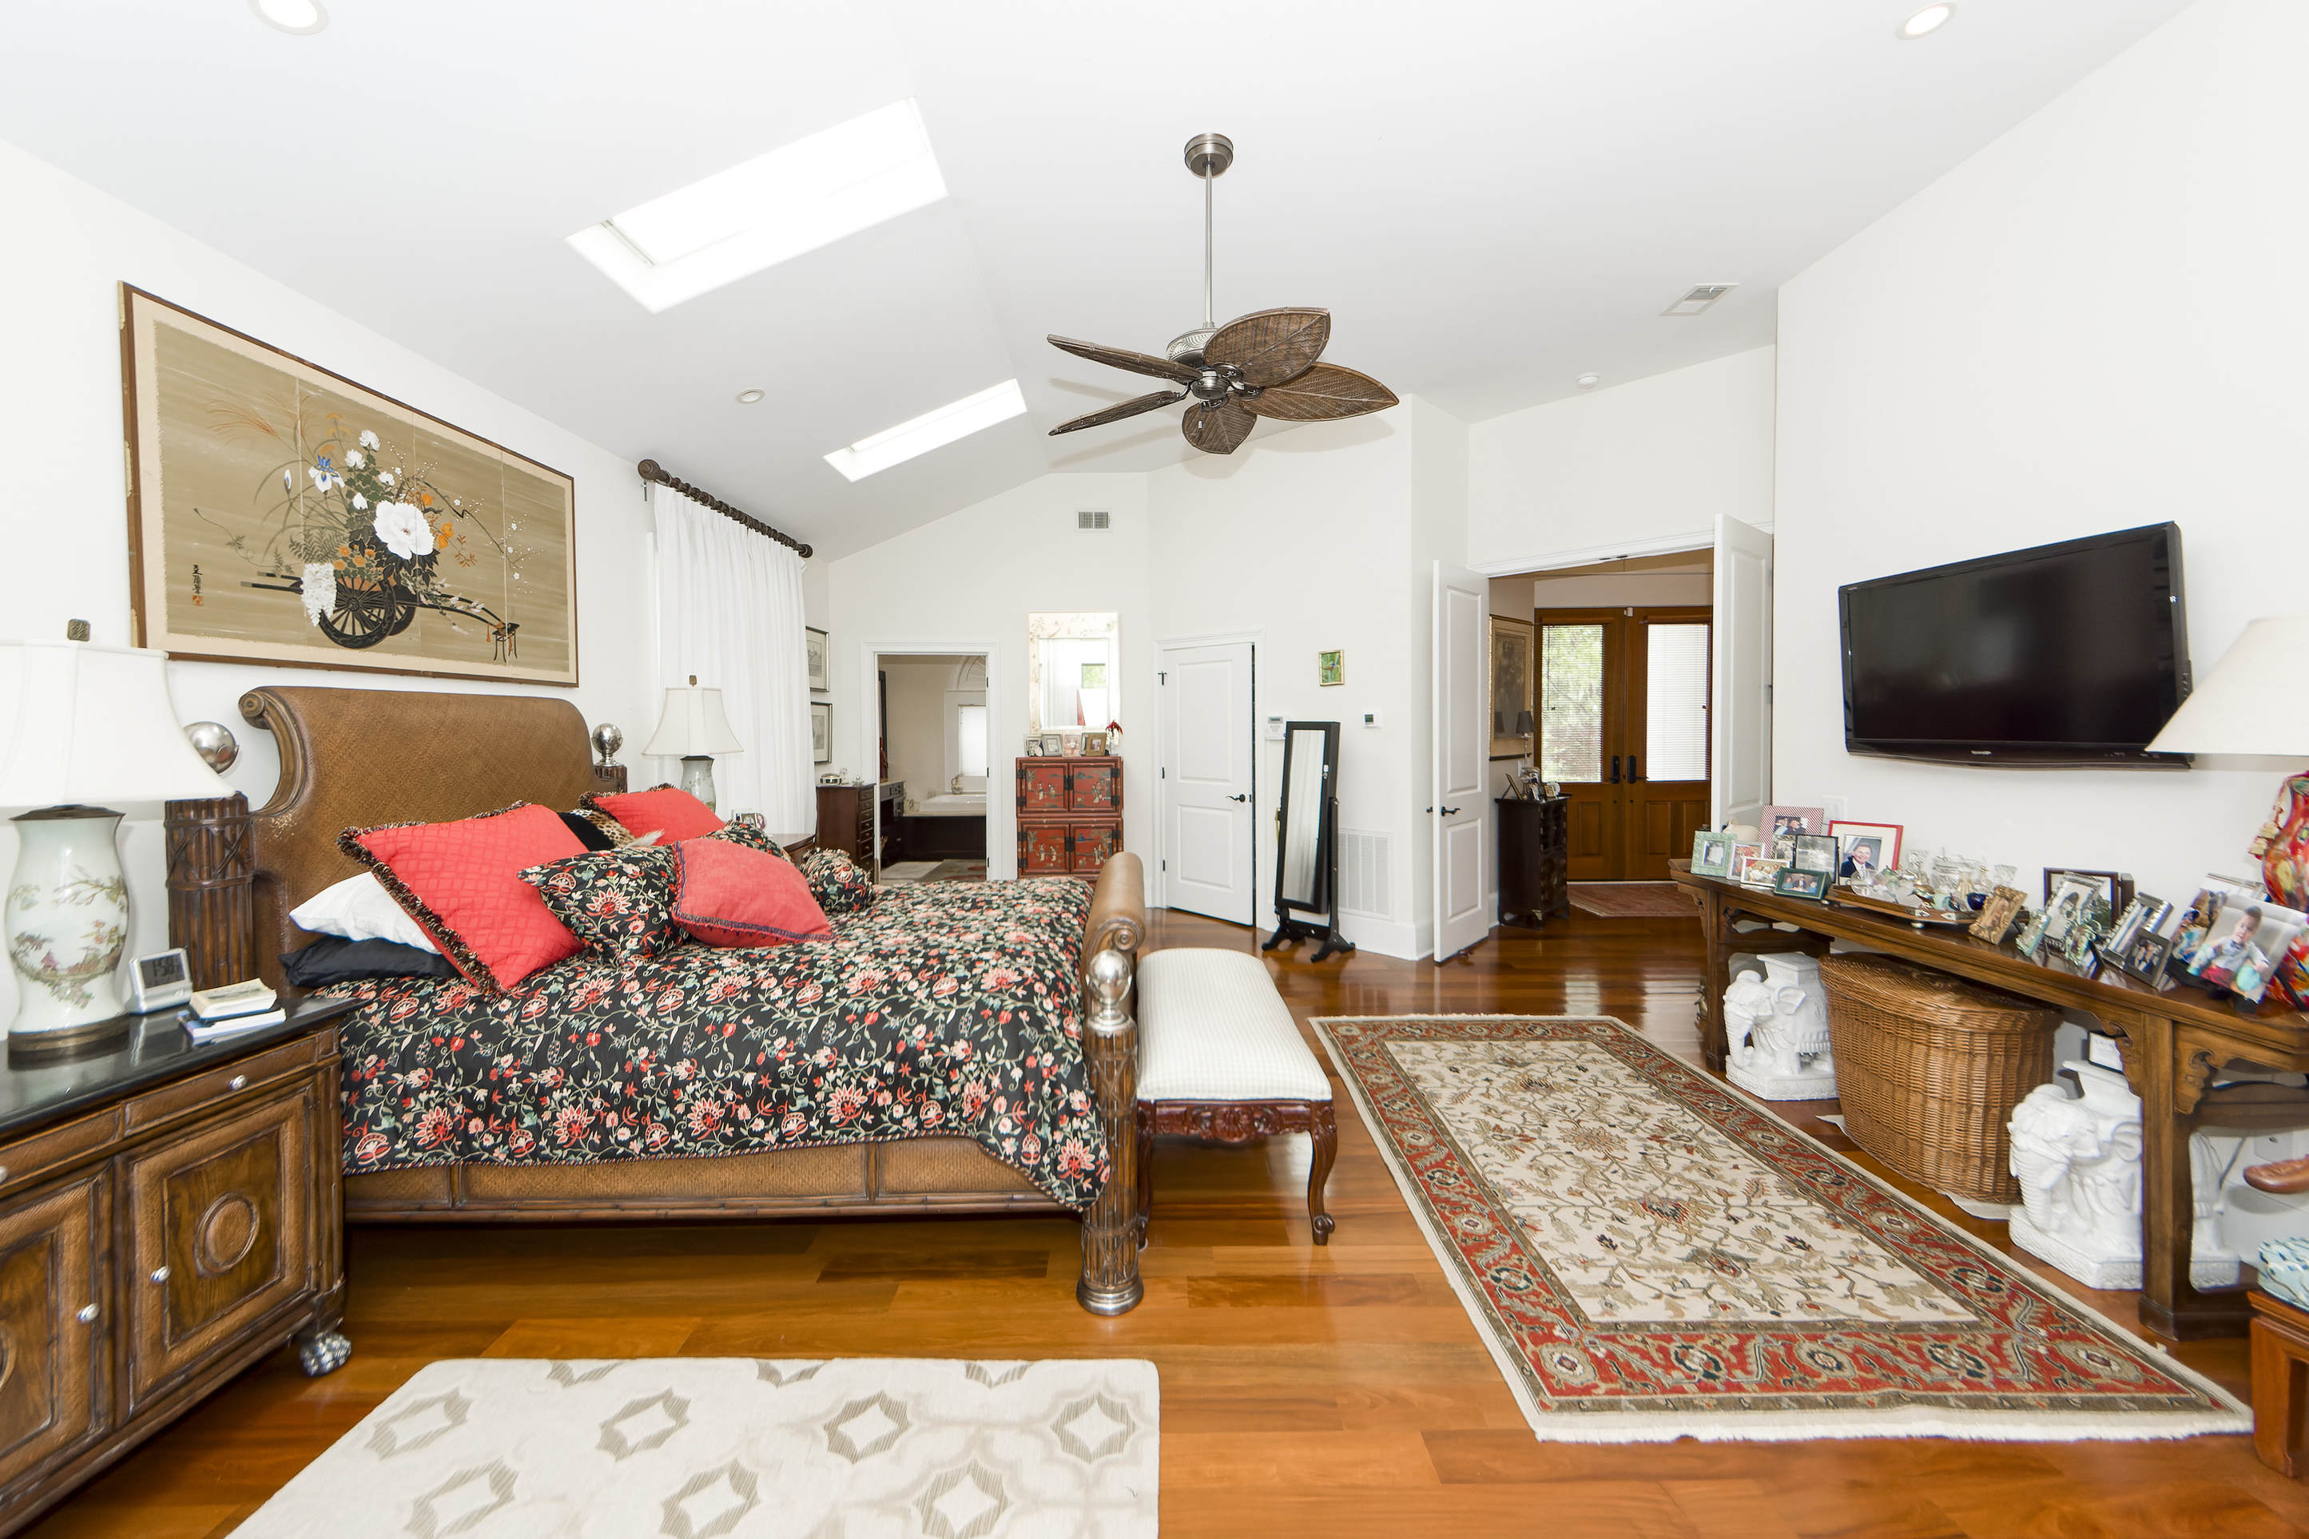
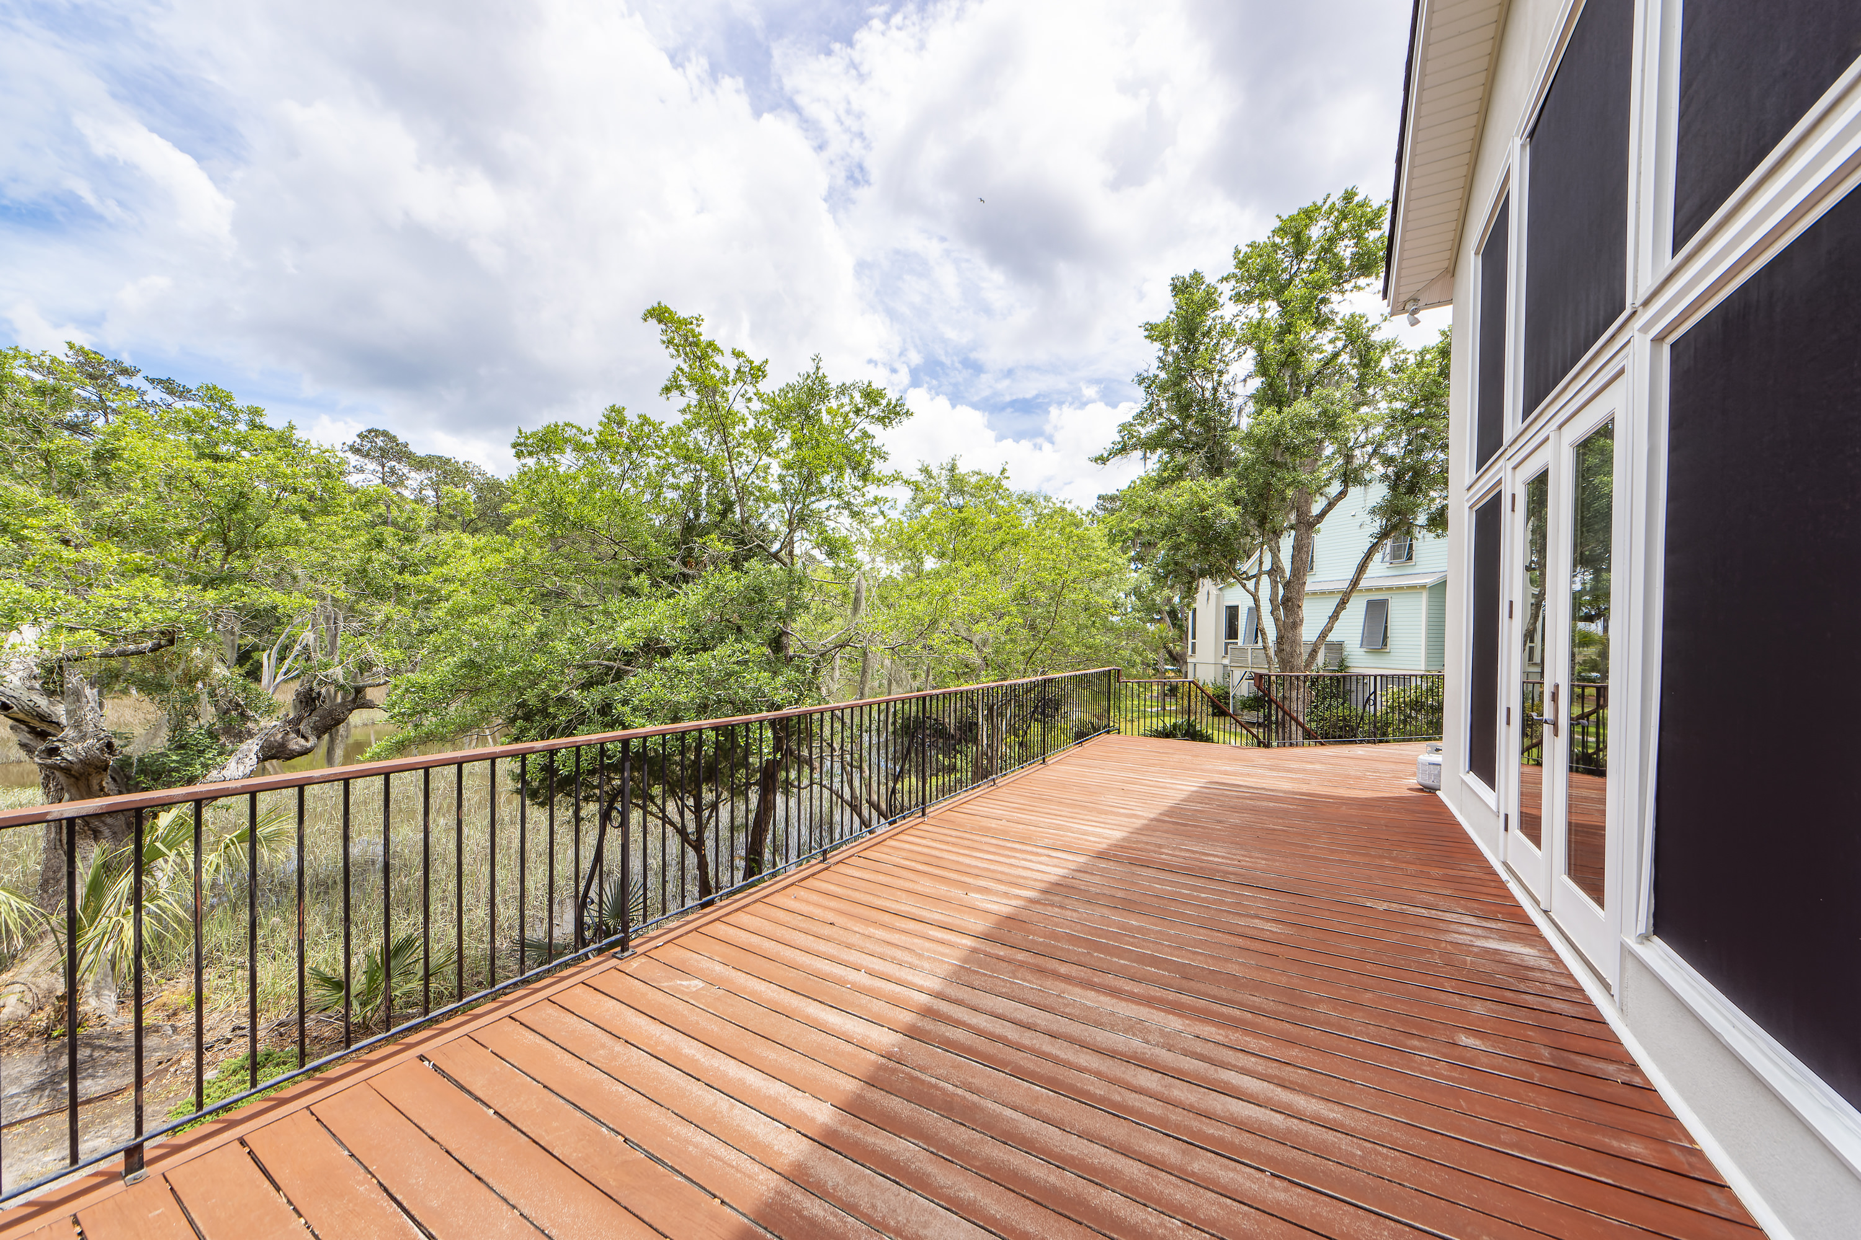
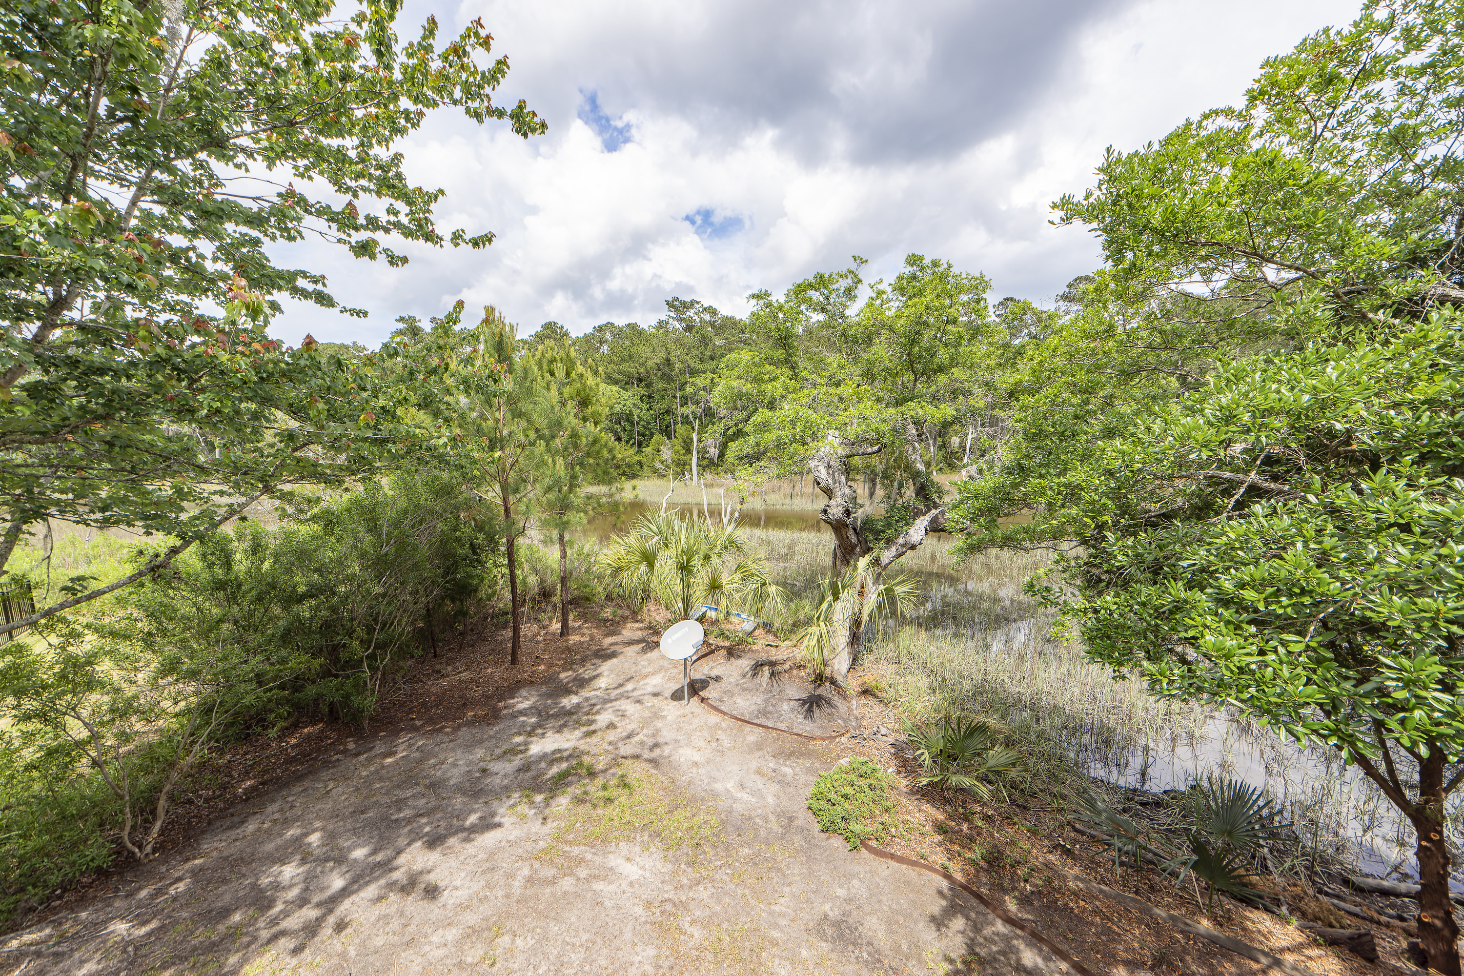
Wonderful Tidal Creek Property
2128 Rookery Lane
Croghan Landing | Charleston, SC 29414 | MLS# 24010894 | $1,250,000
Now this is a winner!! * When one encounters high quality, there will always be certain characteristics- brilliant design. functionality, utility, and solid construction and they are all present in this wonderful elevated home that offers 4 bedrooms, 4 full baths, 3029 sqft all on one floor * as you enter through the front door you will walk up the bullnosed brick stairs to the double front door * the door opens onto an open floor plan that has soaring, 16ft ceilings, teak hardwood floors and lots of large windows and skylights * immediately to your left is the large, separate dining area - lots of room for any occasion * to your right is the entrance to the elegant, spacious master suite that offers a sitting area, a skylight and access to a private, outside screened porch that is adjacent to the deck * the master walk-in closet is more than adequate for lots of clothes and shoes * then there is a large, very well done master bath with tile floor, dual sinks, a large tub and shower * coming out of the master bedroom, you find yourself in a large open space that accommodates multiple conversation areas * the kitchen is located almost mid-point of the space and has upgraded appliances, a gas range, fridge, microwave and granite counter tops * There are 2 pantries for storage * there is a long breakfast bar for those early morning meals or a late night snack * you are now in the great room and spacious is not the word * plenty of room to stretch out in front of a bank of glass windows and a gas log fireplace * included in this area is a full wet bar with sink and ice maker * the 3 secondary bedrooms are all on the far side of the home and are generous in size and each offers a full bath, skylight and walk-in closet * off of the great room you have 2 access doors to the wrap around deck overlooking the marsh and tidal creek, just perfect for enjoying those Charleston days and evenings * the laundry room with granite top cabinet and sink is off of the small hallway * in the area of the great room there is a wide staircase that leads to the garage with its own small space heater * Now, to call this a garage is like calling the Empire State Building an office building * this space is HUGE * it is equal to the entire foot print of the living space above * there is so much that one could do with this much space * the home has 3 Rinnai water heaters and 3 almost new HVAC units as well as a 3 year old roof * home has been extremely well maintained and is ready for the new owner * Welcome to 2128 Rookery
Take a Virtual Walkthrough!
Fudgy Brabham
843-568-1241
fudgy@hbrtwn.com
www.hbrtwn.com
Harbourtowne Real Estate
672 Marina Drive, Ste 110
Daniel Island, SC 29492
Harbourtowne Real Estate | 672 Marina Drive, Ste 110 | Daniel Island, SC 29492

