Slide 1
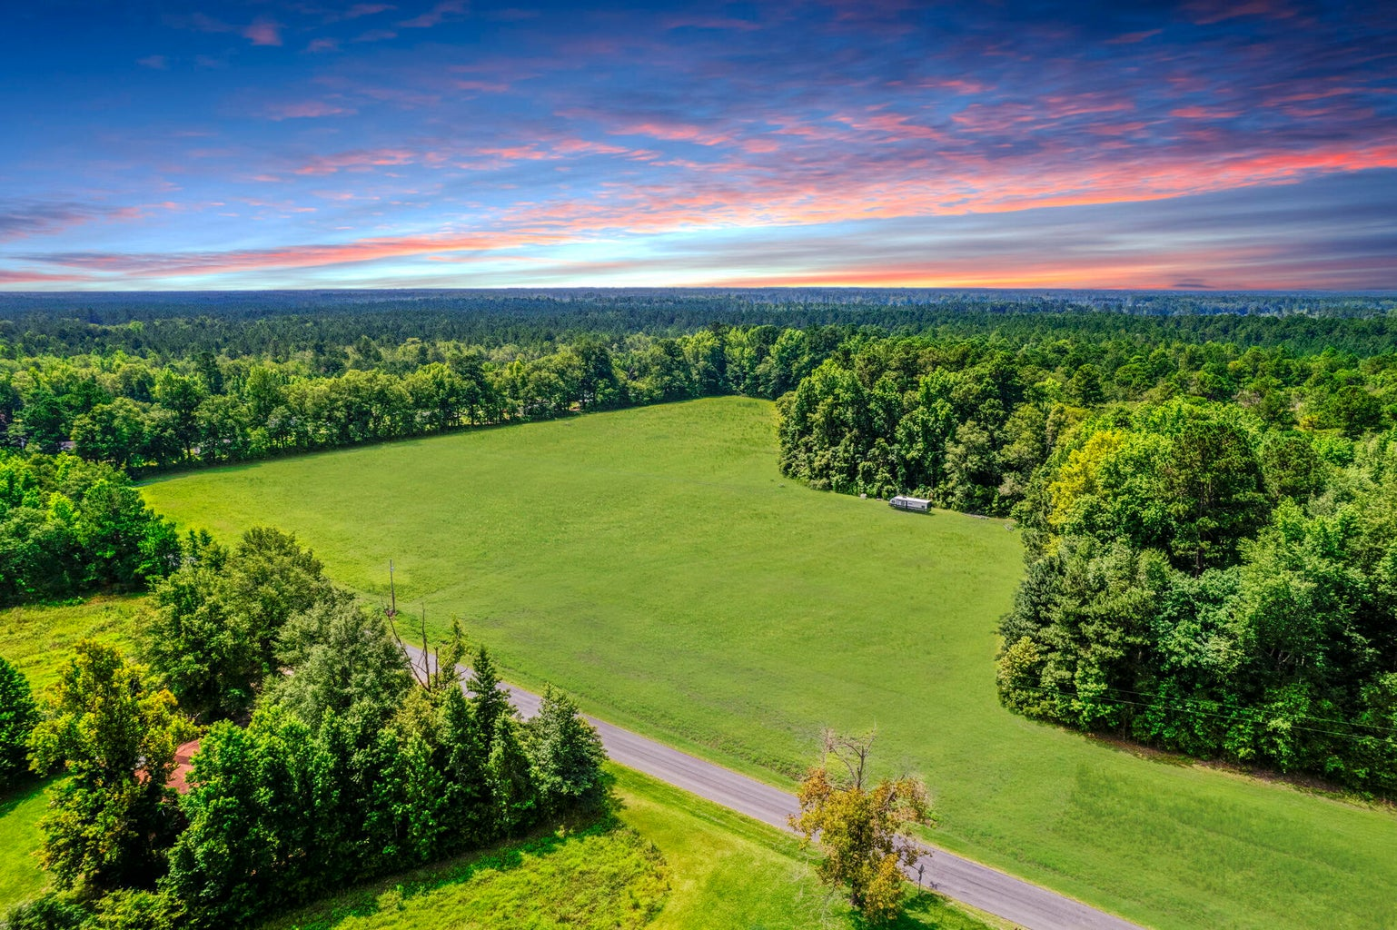
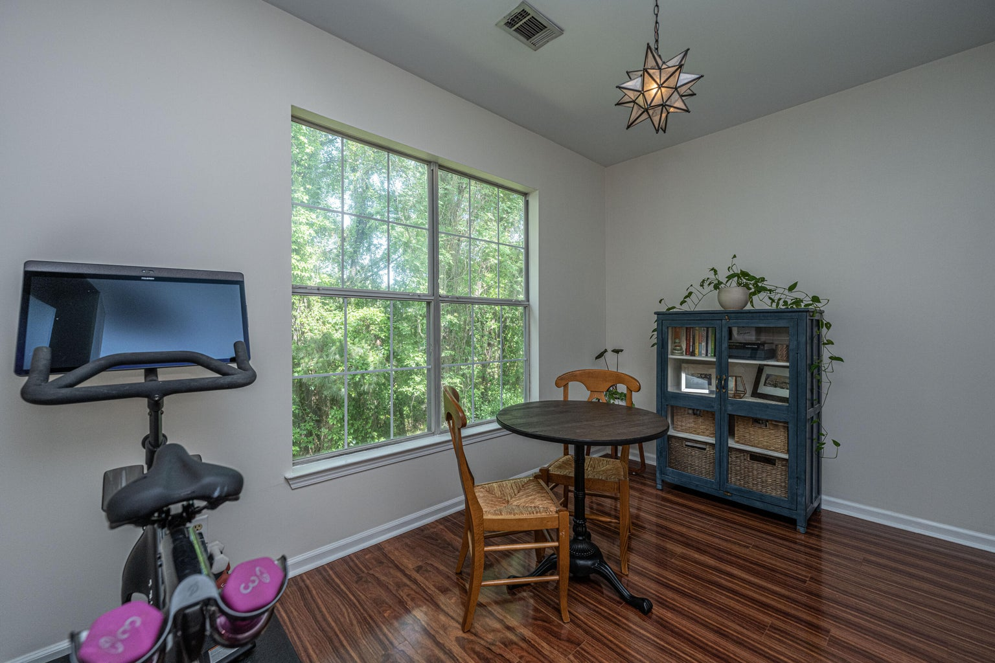
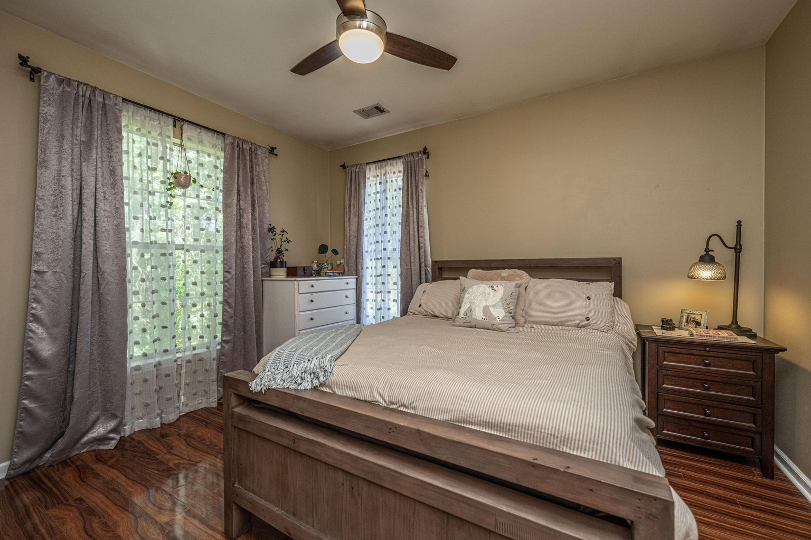



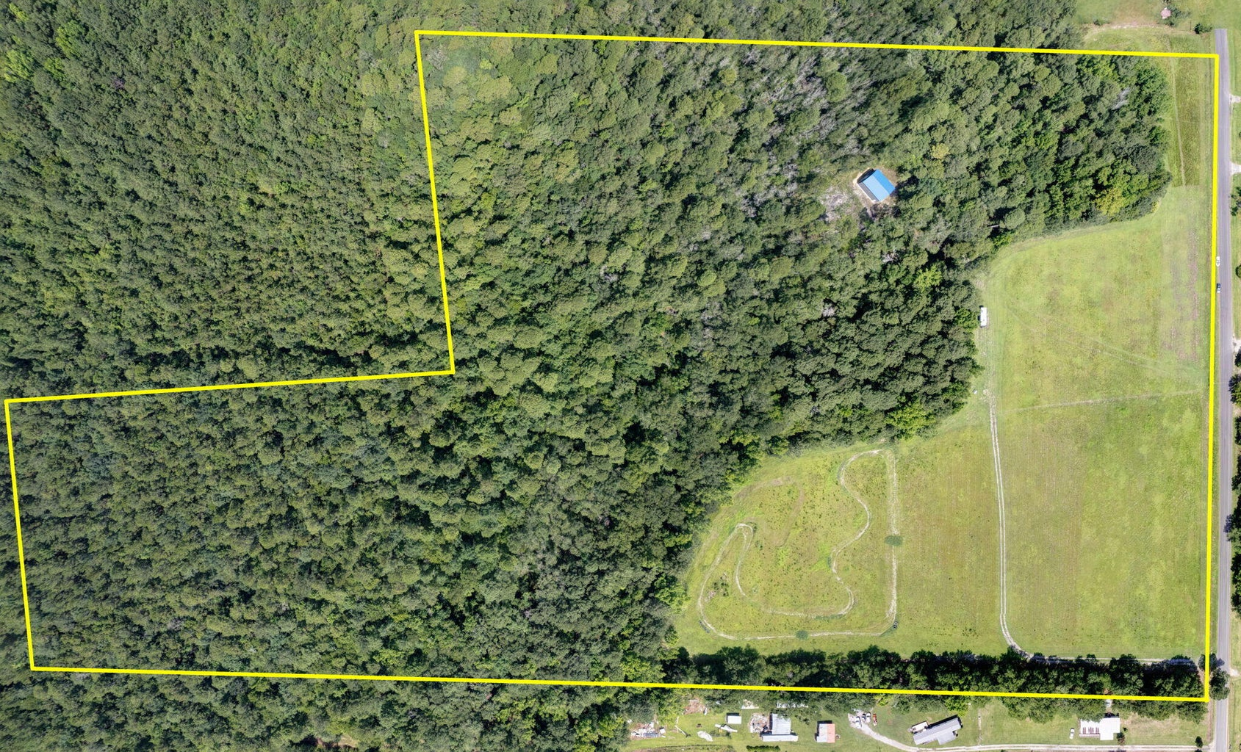
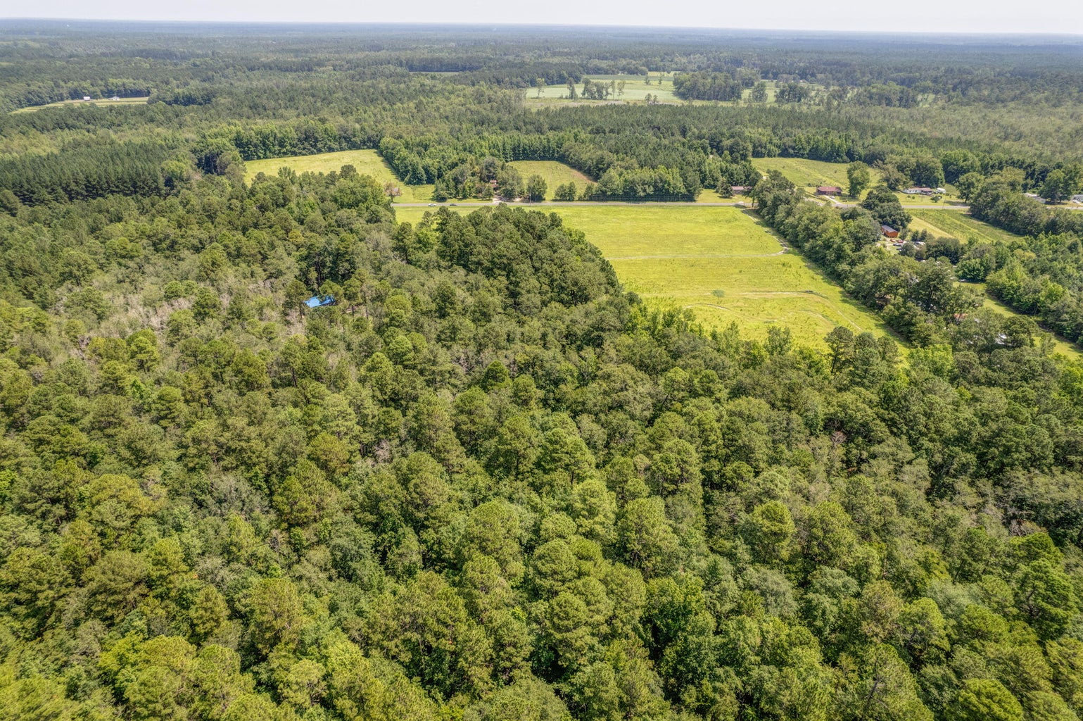
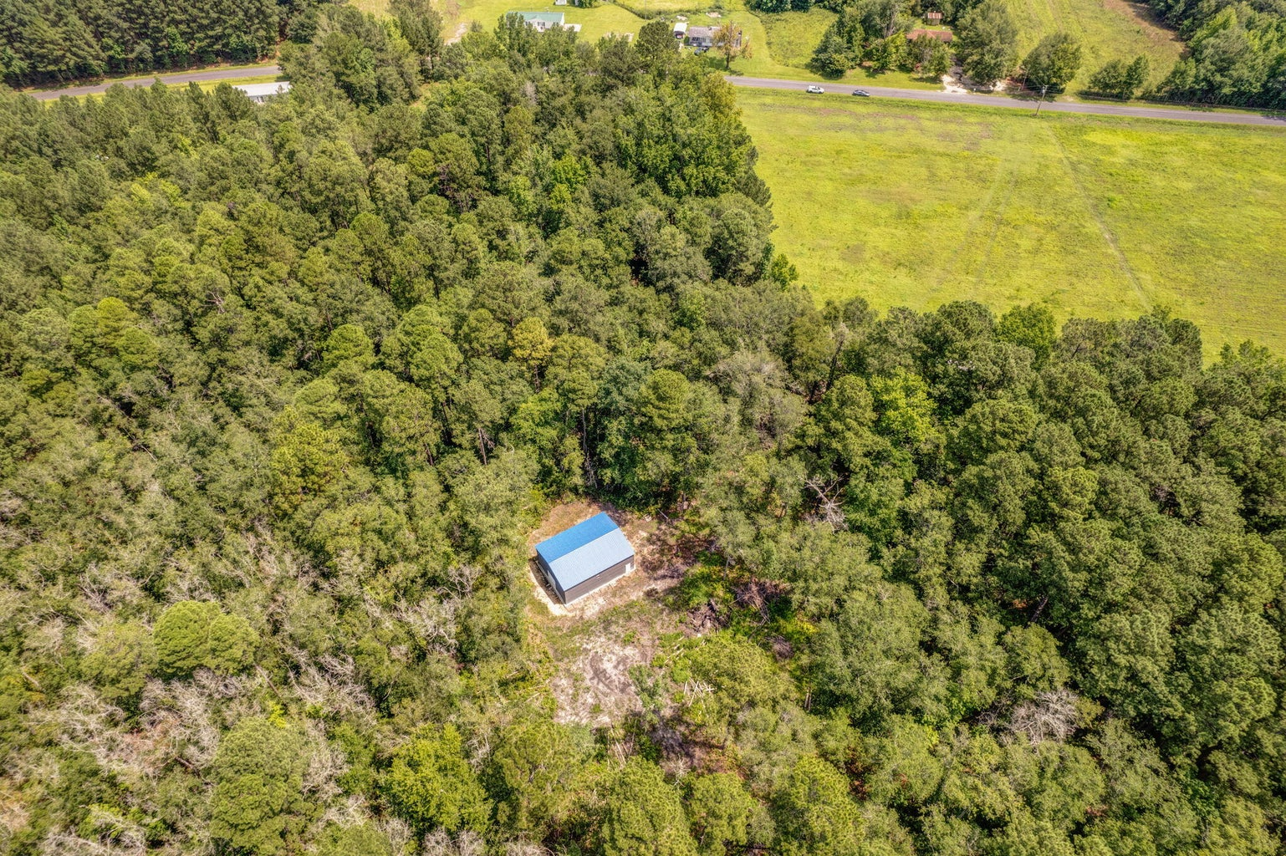
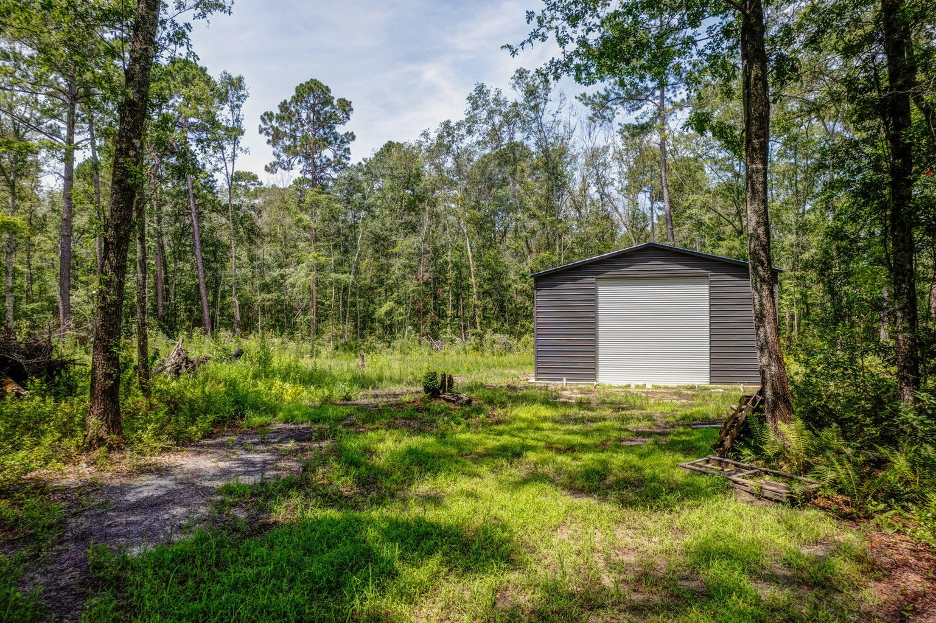



LAKE MOULTRIE RETREAT
2129 Southern Charm Road
Ruffin, SC 29475 | MLS# 23017417 | $289,000
Custom 5br, 4.5ba 4700 Sqft Of Flex Space
10’ Smooth Ceiling
Heart Pine Flooring
Master Bedroom Suite On First Level
Second Master On Upper Level
Two Dens With Gas Fireplaces
Formal Dining Room
Gourmet Kitchen With Second Den/Warming Room And Breakfast Room
Walk-in Pantry
Large Bonus/Game Room Above Oversized Two Car Garage
Screen Porch & Outdoor Firepit
Large Pond Lot With Mature Trees And Irrigation System
3 Separate AC Units
Gas Hot Water Heater
New 35-year Roof
Private Gated Community With Community Pool, Clubhouse, Boat Launch And Dock
Come and see this incredible opportunity to own your personal expanse of land and trails encompassing your 40-plus acre slice of heaven in the Low Country. Within easy access to Walterboro and only a short distance to Charleston, Columbia, Hilton Head Island and Savannah, GA, this centrally located oasis is the perfect place form which to launch an exciting weekend. In addition to a large metal garage, perfect for any hobbyist, this land also boast bike and game trails harboring abundant and varying wildlife. With approximately 9 acres of cleared and flat ground, this property is only requiring your vision to complete your dream. In addition, the travel trailer with toy-hauler can convey, so no worries about where you'll stay while your paradise takes shape around you.
4
3
1,844
Telecia Bilton
843-412-3586
tmbilton@rogcoastal.com
Jeff Baskin
843-934-4220
jeff.baskin@agentownedrealty.com
Realty ONE Group Coastal | 1510 Trolley Rd | Summerville, SC 29485
AgentOwned Realty | 1800 Trolley Rd | Summerville, SC 29485

