Slide 1
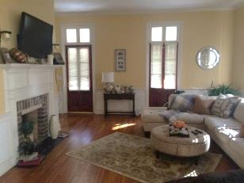
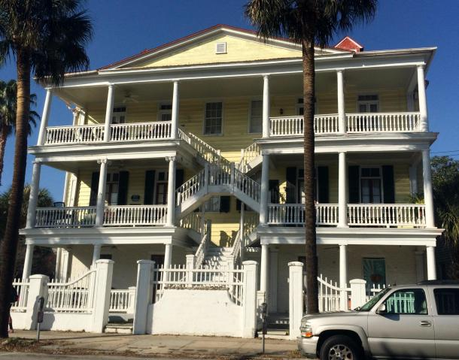
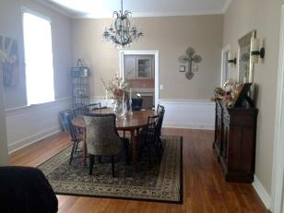
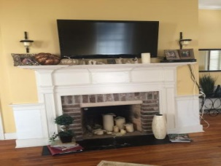
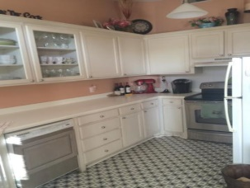
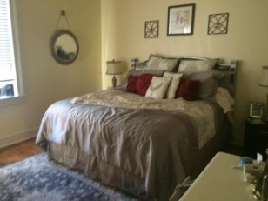
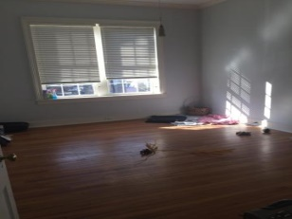



212 Calhoun Street B Radcliffeborough ~ Charleston ~ MLS# 14031456 ~ $434,000
Downtown Condo Reduced $5,000
1 Year Of Regime Fee Paid By Seller With An Acceptable Offer!!!
4 BEDROOMS | 3½ BATHS | 3,600 SQ FT
Great and Historic 2 BR 2 BA condo located in the heart of Charleston in a charming 6 unit building originally built in 1830.
Fantastic location and convenient to the College of Charleston, MUSC, Charleston School of Law, The Citadel, Marion Square, and King Street. Perfect for parent of students, owner occupant or 2nd home.
High ceilings and windows, beautiful hardwood floors throughout and 2 assigned parking spaces. Brick Foundation. Natural gas piping is present in kitchen. There is a fireplace in LR, but Owner has not operated it.
Termite Bond in place. Flood Insurance is included in Regime Fee. Seller offers 1 year regime fee credit with an acceptable offer.
Sunday Lempesis
843-371-1076 M
sunday@carolinaone.com
Daniel Carabus
M 843-793-9265
dcarabus@carolinaone.com
Carolina One Real Estate
195 W Coleman Blvd
Mt Pleasant, SC 29464

