Slide 1
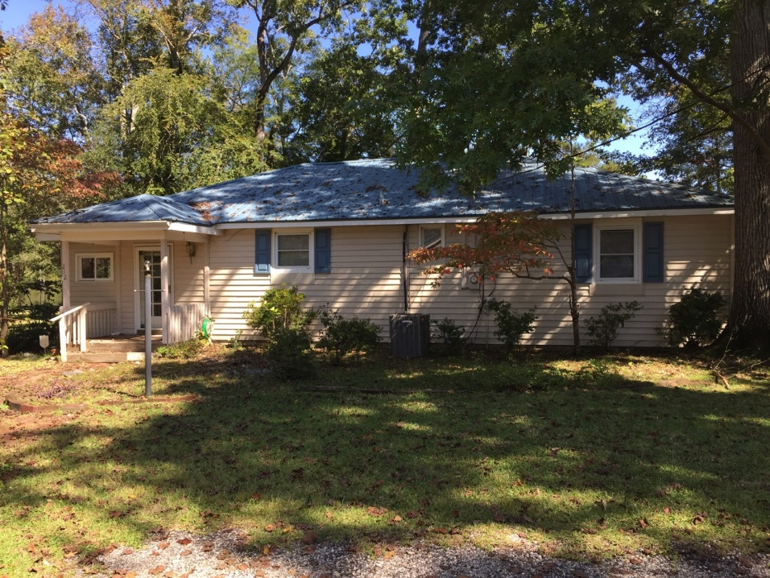
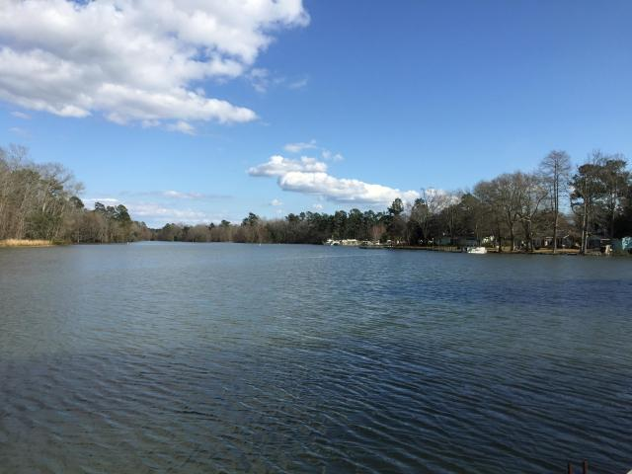
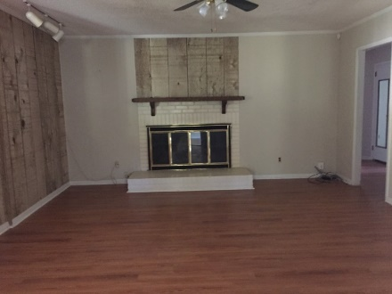
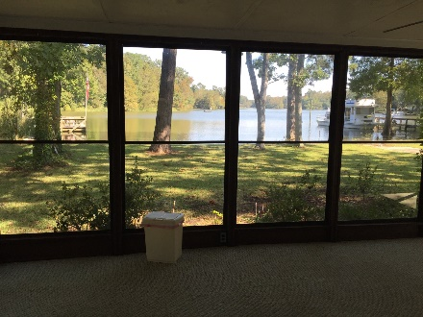
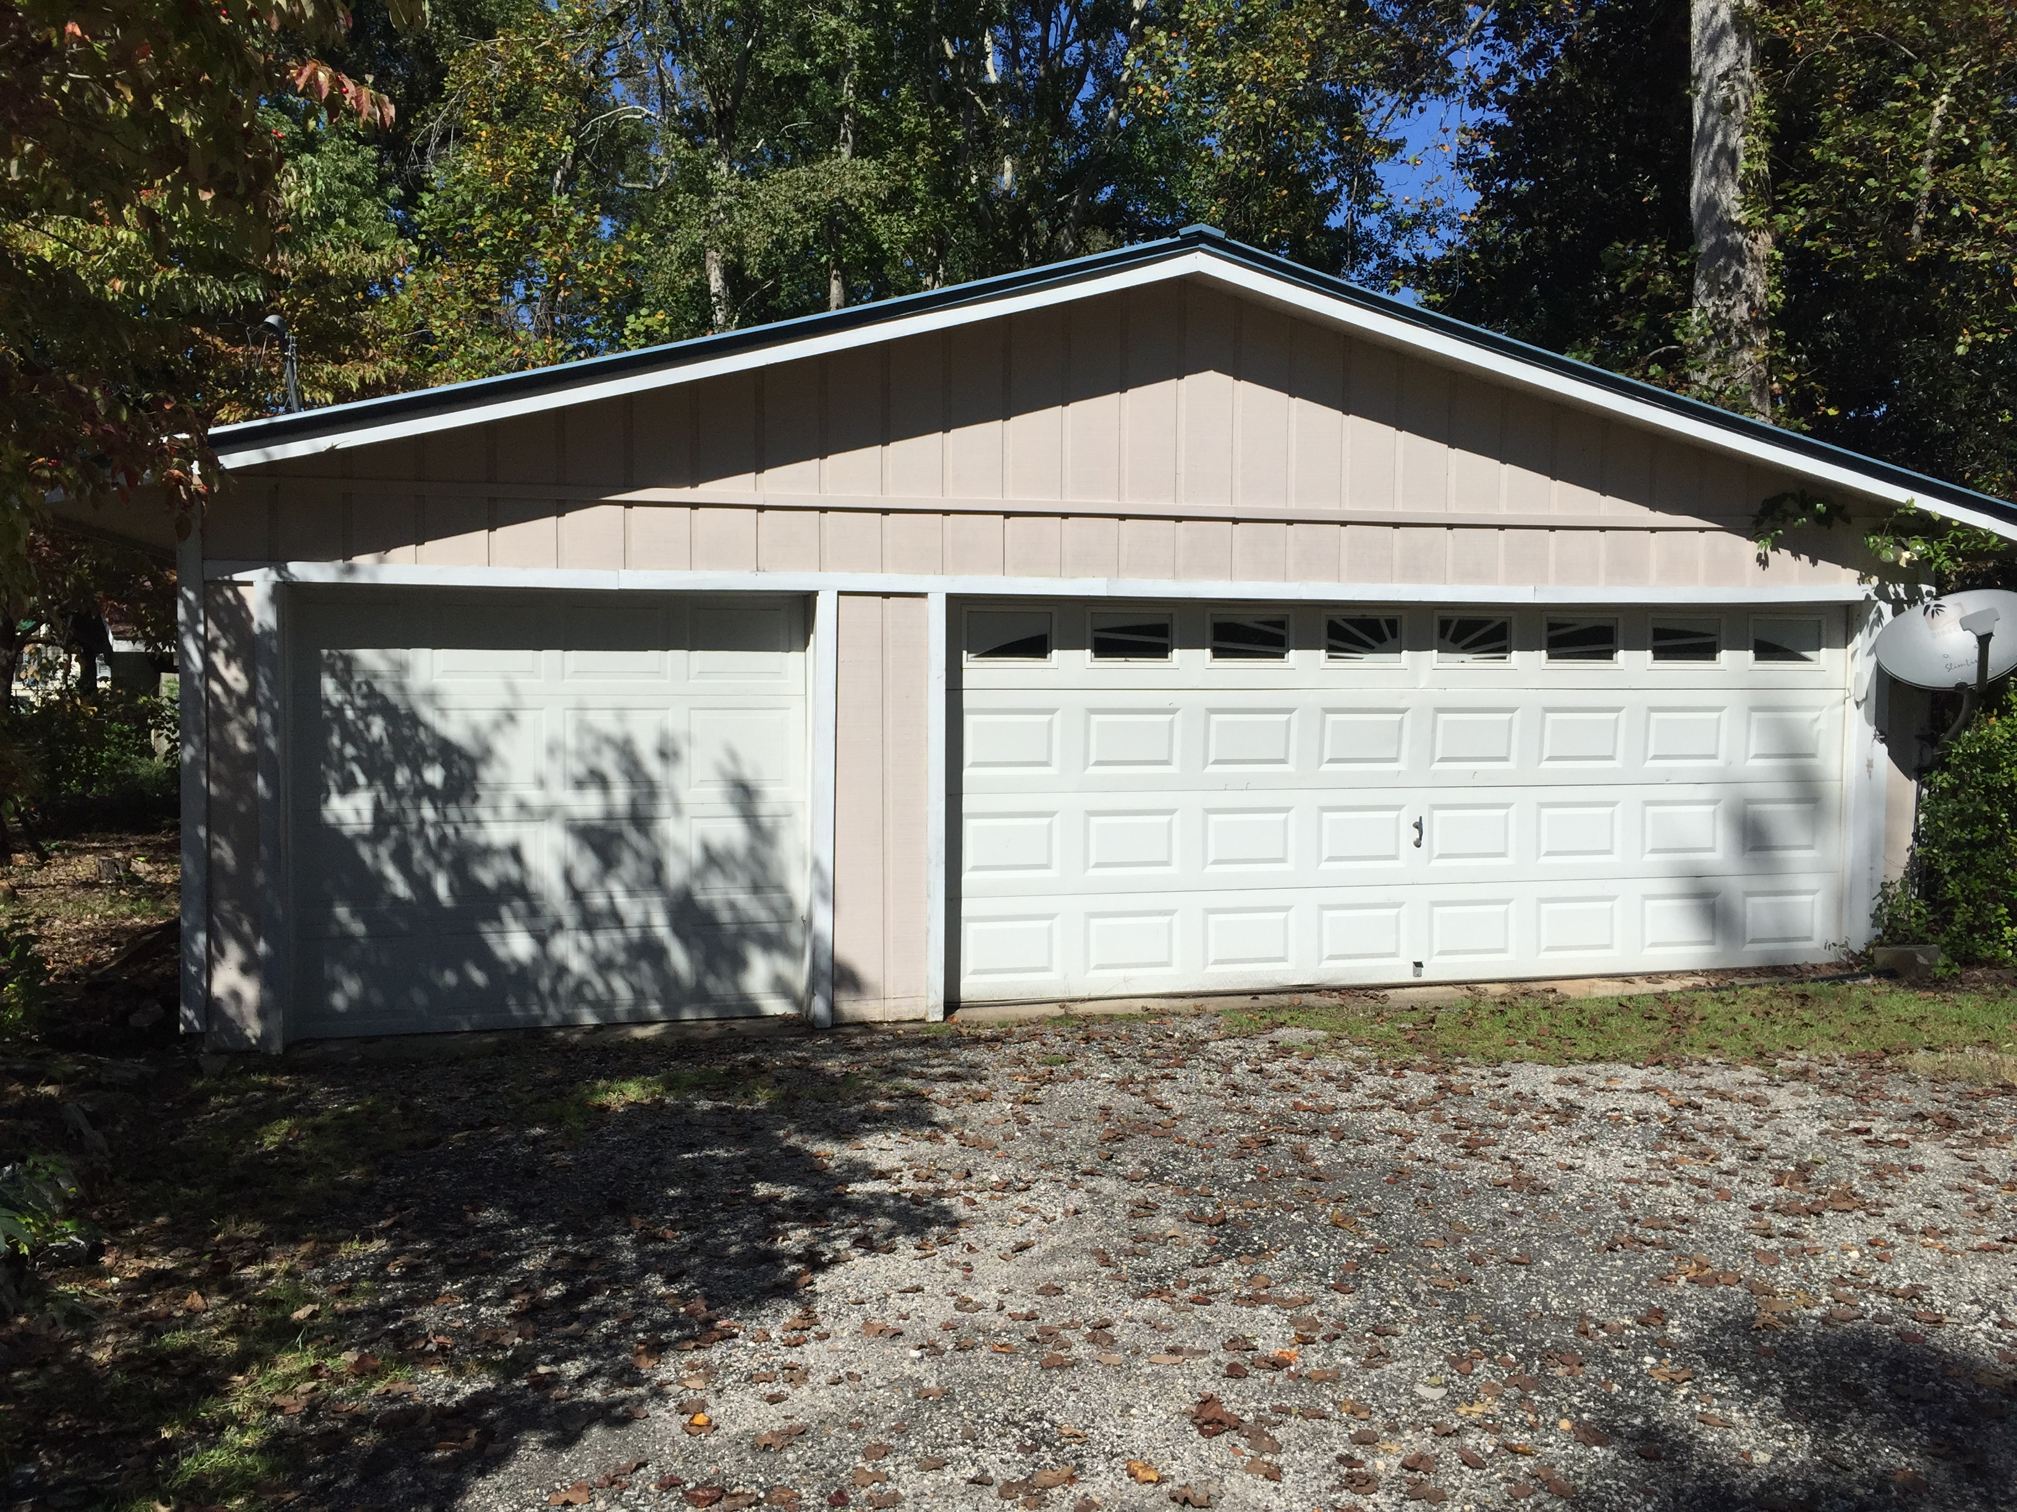
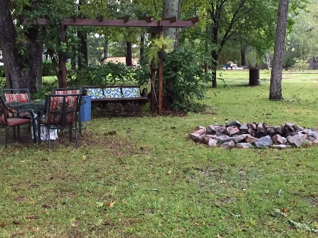

Looking for a lake property?
This is the one for you!
212 Connor Drive
Eutawville, SC 29048 | MLS# 15029345 | $275,000
3 Beds | 3 Baths | 1,850 Square Feet
Waterfront property with a dock in quiet Eutaw Springs!
Property has its own boat ramp, and is across from a wildlife sanctuary!
This 3 bedroom, 3 bathroom house has a new HVAC system, and a metal roof that is less than 10 years old!
Carla C Davis
Mobile - (843) 437-4873
gaweber@tds.net
AgentOwned Premiere Group
141 A N. Main Street
Summerville, SC 29483

