Slide 1


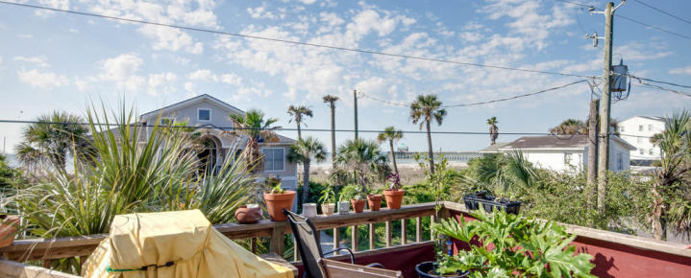
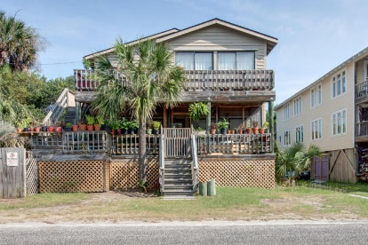
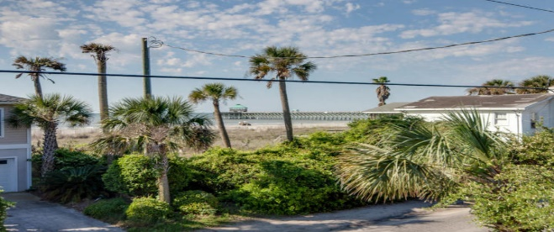
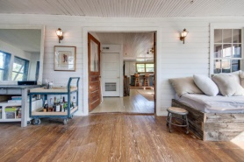
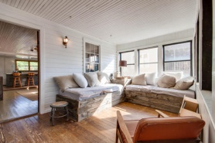
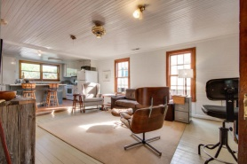
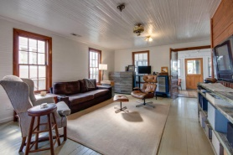
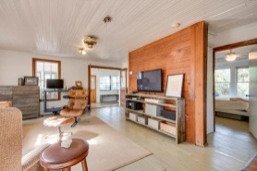
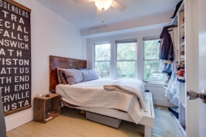
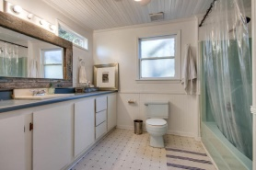
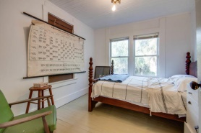
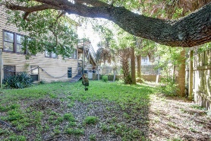
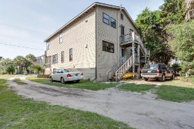



Enjoy Island Time…
212 E Arctic Avenue
Folly Beach, SC 29439
MLS# 15009640 or 15009633
$749,000
~ Great beach access! ~
~ Great investment property! ~
~ Amazing options! ~
~ New roof in April 2015 ~
~ Exterior painted in June 2015 ~
This street-to-street lot can also be a great building opportunity! One block to Folly Beach center and across the street from the beach lies this duplex providing ocean views from the second floor of this older house. Presently generating steady rental income.
This second row lot has street-to-street access, along with a beach access easement on the east side of lot. There is plenty of room to the side and rear of the house (yard is presently privacy fenced) for expansion of the existing house or building a new house.
This is a great location on Folly Beach! On the first level, there are two bedrooms, one bath, a good-sized living area along with a porch and a deck. The second floor residence provides ocean views, three bedrooms, two baths, family room and a deck.
Bob Nitkewicz bob@goldenbearrealty.com
843-819-7754
Lee Lindler leel@goldenbearrealty.com
843-637-0803
Golden Bear Realty | 654 Coleman Blvd, Suite 100 | Mt Pleasant , SC 29464
Cell (843) 637-0803 | Office (855) 725-5890 | Fax (561) 721-3311
www.goldenbearrealty.com

