Slide 1
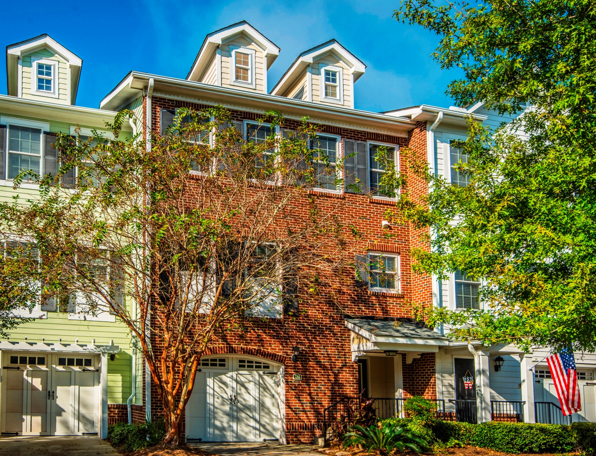
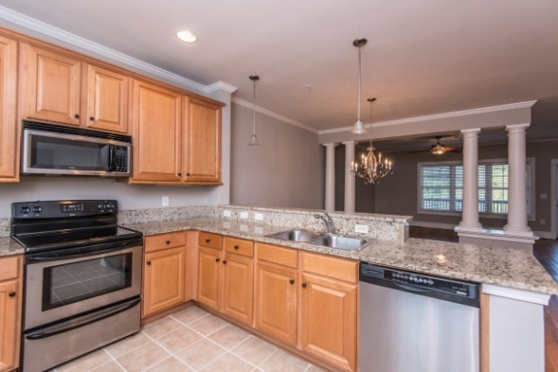
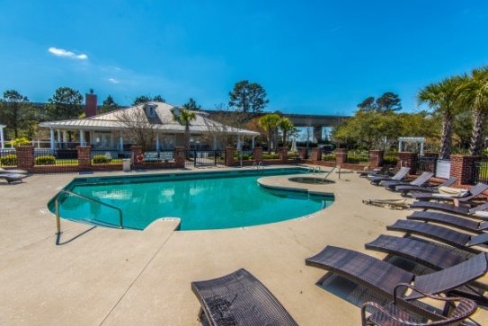
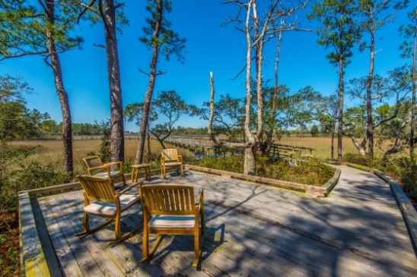
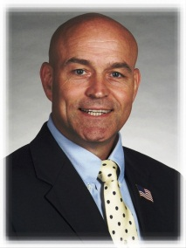

“A ‘best buy’ value for this well-dressed home”
212 Etiwan Pointe Dr
Mt Pleasant, SC 29464
$300K
Best price in Etiwan Pointe!
Come see us during the
Etiwan Pointe - Group Open House
Saturday 19 Jan
11AM-1PM
Superb amenities
Neighborhood deepwater dock + boardwalk
Looks like new
Enjoy this great Mt Pleasant location, close to
much of the best the Lowcountry has to offer.
3BR. 2.5BA, 1851 SF + porch; 2+ car garage; ample storage space
Great for entertaining
Hardwood s & tile in main living spaces
Granite kitchen counters, SS appliances
Fresh neutral paint throughout
New carpet in bedrooms,
Move-in ready, includes fridge
STEVE ROWE
,Realtor®
Retired Military. Active Agent.
(843) 303-7438
srowe@carolinaone.com
www.SteveRoweHomes.com

