Slide 1
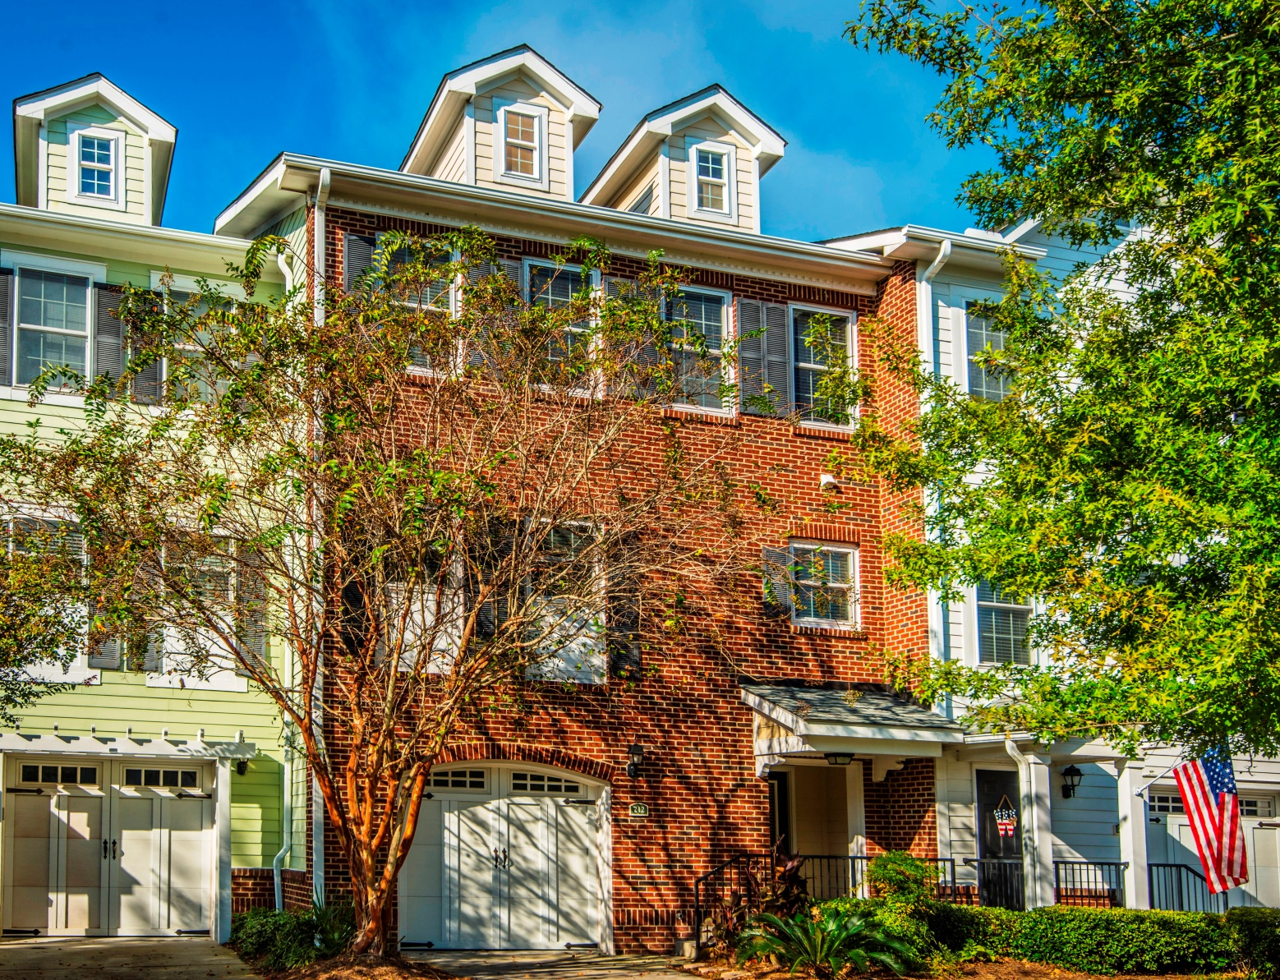
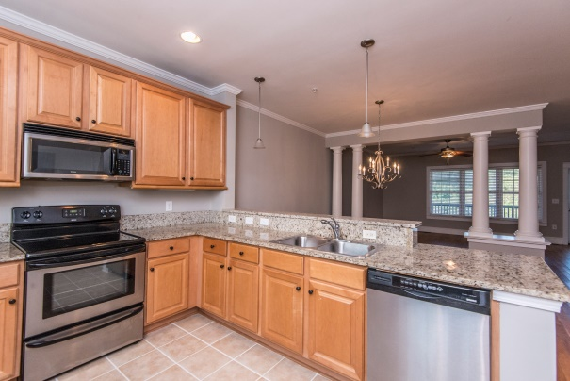
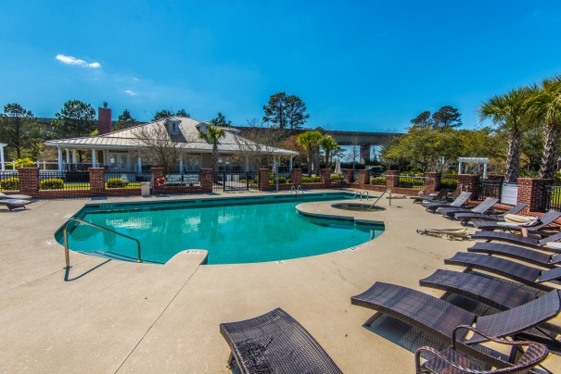
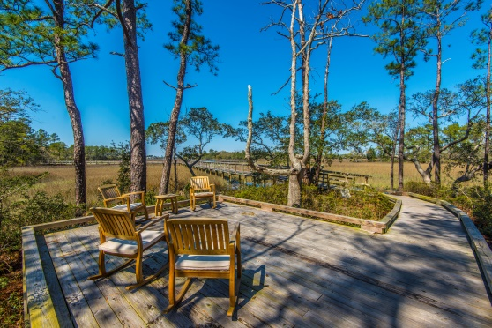


“Best price – BY FAR - for this well-dressed home”
212 Etiwan Pointe Dr
Mt Pleasant, SC 29464
3BR. 2.5BA, 1851 SF heated/cooled space
Additional 176 SF screened porch
Great pool, fitness center, clubhouse
Neighborhood DOCK & Boardwalk – deep water access!
Now Below Market
Value at $289K
Enjoy this Mt Pleasant location, conveniently close to
much of the best the Lowcountry has to offer.
Great for entertaining
Hardwood s & tile in main living spaces
Granite kitchen counters, SS appliances
Fresh neutral paint throughout
New carpet in bedrooms,
Two-plus car garage w/extra storage space
Move-in ready, includes fridge
STEVE ROWE
,Realtor®
Retired Military. Active Agent.
(843) 303-7438
srowe@carolinaone.com
www.SteveRoweHomes.com

