Slide 1
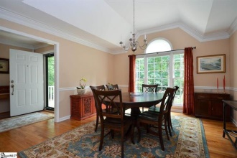
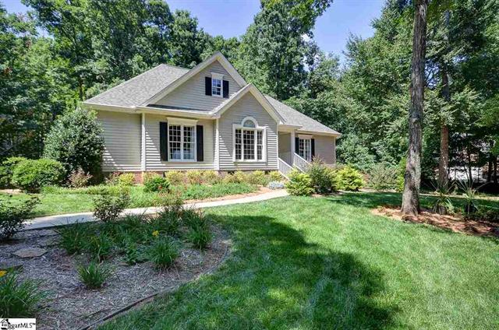
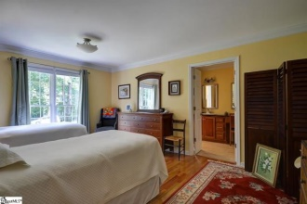
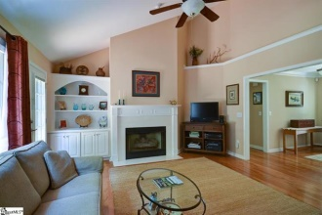
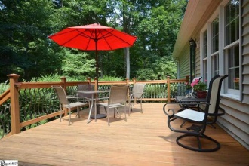
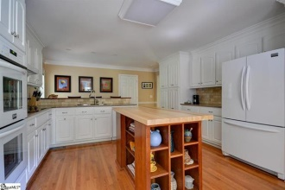
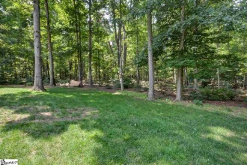
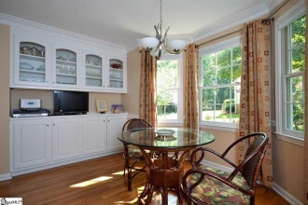
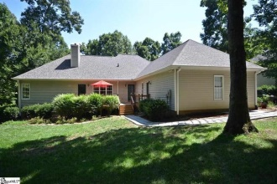



One Level Paradise
212 Kennedy Lane in Powdersville
Lovely one level, well-built custom home with workshop, one step entry from garage. Powdersville area. Two miles to medical clinics, local shopping, new Wal-Mart and schools. Better than new with updates throughout- includes new roof, new hot water heater, new HVAC System. Great curb appeal- nicely landscaped, partially fenced yard-Convenient to I-85. Less than 20 minutes to downtown Greenville. Owners do not smoke nor do they have pets. Enjoy the view of the lovely landscaped front yard as you walk to the sheltered front porch entrance. You are welcomed by the spacious foyer with beautiful hardwood floors throughout the main rooms of the house. The dining room to your left features tray ceiling, gracious front window, chandelier and sconces. The Great room features high vaulted ceiling, accent lighting, down lights, bookcases, gas log fireplace and mantle. Back door from the Great Room leads to an expansive and stunning deck. Magnificent is the only way to describe the kitchen with zero maintenance quartz counter tops, stylish tile back splash, under counter lighting and the refrigerator stays. All appliances are less than three years old. You will appreciate the abundance of cabinets and pantry with pull out drawers. Custom designed island with solid maple top and custom breakfast bar- bar stools stay. All bathrooms and utility room have new tile floors, and hardware, pocket doors in master and shared baths for privacy. Master bathroom has new custom cherry vanity with black granite top, and comfort height commode. Split bedrooms with bath between has a new tile counter top and back splash. The large half bath with comfort height commode is conveniently located between the kitchen and garage across from the laundry room & utility sink. You will notice the abundance of adjustable shelving in the closets Look behind the door going into the back bedroom to see the very nice floor to ceiling bookcase. Cellular shades in all rooms are less than 3 years old, and the upgraded window hardware will remain. Lots of crown molding. The entire interior has been professionally repainted. The garage includes the large workbench on wheels, peg tool board, and wire shelving. The workshop room includes -large red paint storage cabinet- stackable shelving, and small moveable work /tool storage table. The ceiling mounted pull down ladder is located in the garage just above the entry into the house. The attic can be accessed while cars are in the garage. Trane HVAC system, installed by McGee Heating & Air is superior quality heat pump and gas furnace. The gas furnace comes on when outside temperature is below 40 degrees. The enclosed new hot water heater (installed by Corley) is located just outside the access door to the crawl space. The crawl space is very comfortable to access. The light switch is located above the door. Insulation in ceiling to crawl space overhead is new, and the vents are designed to automatically close during cold weather. The house has a complete surge home protection plan installed by Corley. A Duke Energy home repair plan is transferable for inside waterlines and electrical problems. New roof. All appliances and hot water heater have transferable warranties. The wiring in the kitchen and garage has been upgraded by Corley. The wiring in the kitchen was upgraded for the new double convection wall ovens. The garage is attached to the back of the house with a side entry. The wiring in the garage and workshop was up graded for better power when operating several tools at one time. Abundance of electrical outlets ready to serve your tools -15 amps, 20 amps and one 240 volt plug. The owners of the house will be available upon request to explain and demonstrate all systems. A water sensor helps to keep the irrigation system from running when the natural rain is watering your lawn. This is truly a one level paradise within minutes of the city life.
MLS# 1285970 - $238,900
Peggy Wilson
Realtor, Broker, GRI, ABR
864 415-3958
peggy@realtysc.com
www.realtysc.com

