Slide 1
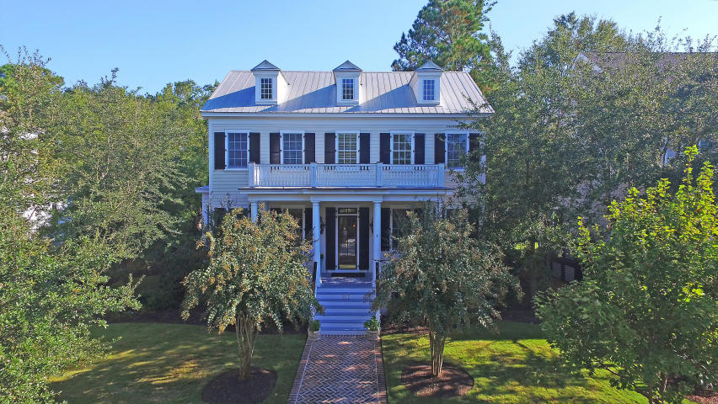
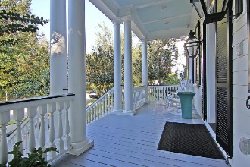
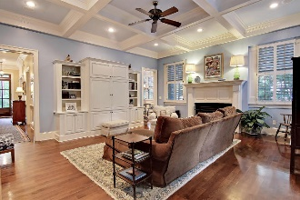
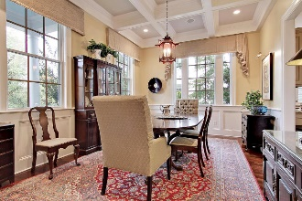
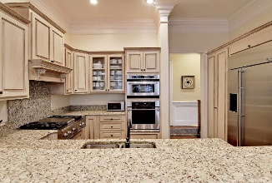
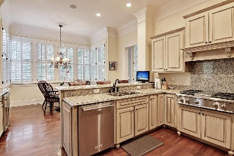
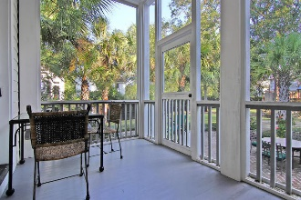
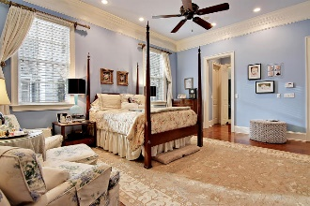
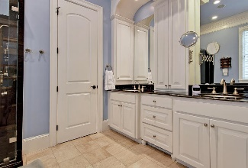

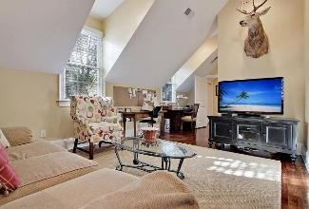
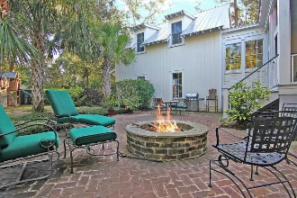
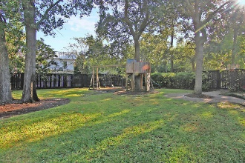

212 King George Street
Daniel Island, SC 29492 ~ MLS# 16031261 ~ $1,190,000
This beautiful estate is located on the Park side in Daniel Island's golf-oriented neighborhood. The moment you step in from the front porch into the elegant entryway you can see the attention to detail. To your right are French Doors leading to an office/living room, across the hall is the formal dining room. As you proceed down the main hallway you come to a gourmet eat-in kitchen with custom cabinetry, granite countertops and stainless steel appliances including a gas cooktop. Adjacent is a large living area/den with plenty of space for spending time with family or visiting with friends. Steps lead from the den to the mother-in-law suite, complete with bedroom, full bath and its own private living space. With the spacious owner's suite downstairs, additional bedrooms complete the upper level. You can also enjoy outdoor living on the screened in back porch or around the custom bricked-in fire pit in the expansive fenced backyard with a full backyard mosquito misting system. This well-appointed home also has an attached two-car garage accessed from a rear alleyway, an enclosed crawlspace with a dehumidifier, and a closed circuit security camera system. This property includes Daniel Island Club social membership privileges, plus the opportunity to upgrade to a transferable, non-recallable golf membership. Daniel Island Resale Addendum, Property Disclosure, Community Fund Disclosure and Club Membership Acknowledgement are attached.
Jonathan Vroon
(843) 514-3114
jvroon@southernlivingre.com
www.southernlivingre.com
Southern Living Real Estate
2249 Salt Wind Way, Mt. Pleasant, SC 29466

