Slide 1
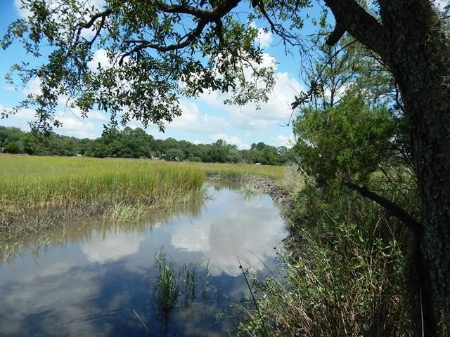
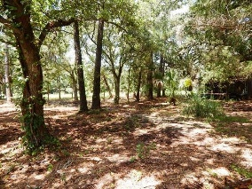
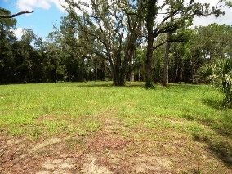
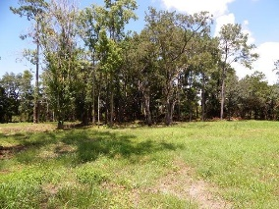
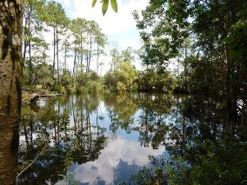
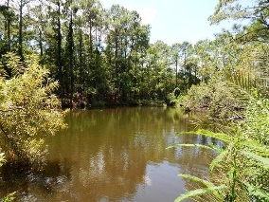

212 Wappoo Road Isle De Nemours Charleston, SC 29407 MLS# 15009156 $249,000 1.5 Acres
Two Amazing Estate Lots
216 Wappoo Road Isle De Nemours
Charleston, SC 29407
MLS# 15009158
$169,000
1.2 Acres
This is a terrific opportunity for a builder or to build your dream home! Access to Pond and Sandy Creek. Lot is being sold ''as is'' and no representation of condition is made. This is a terrific opportunity for a developer, or someone who would like a large estate.
Carolina One Real Estate
2713 Highway 17 North
Mt. Pleasant, SC 29466
Terry Hamlin
(843) 830-3946
terry@thamlinproperties.com

