Slide 1
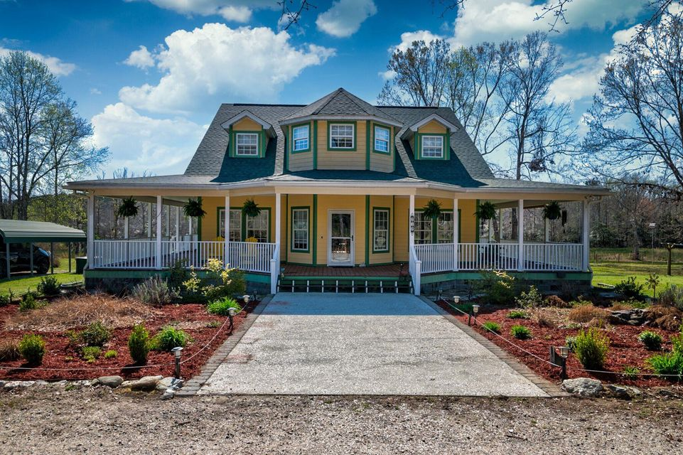
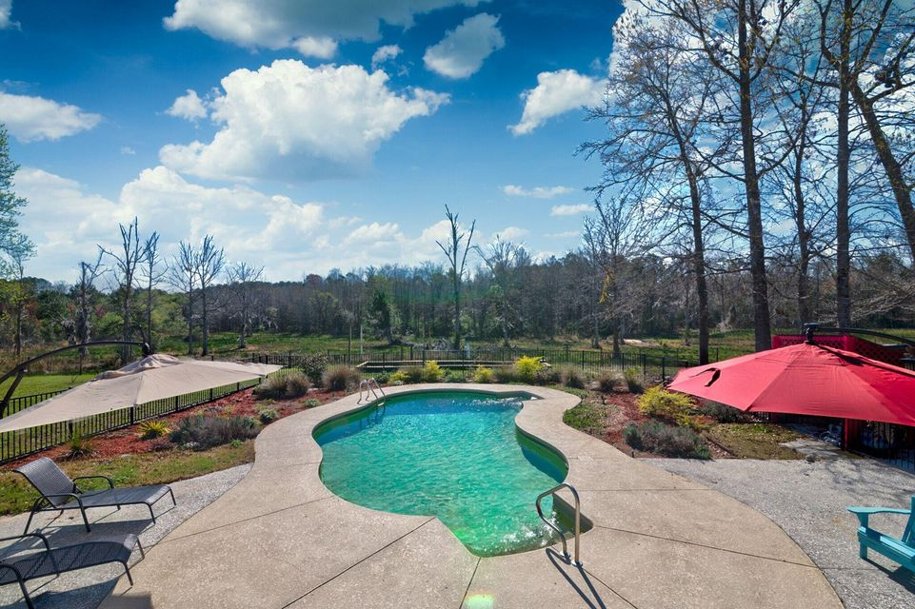
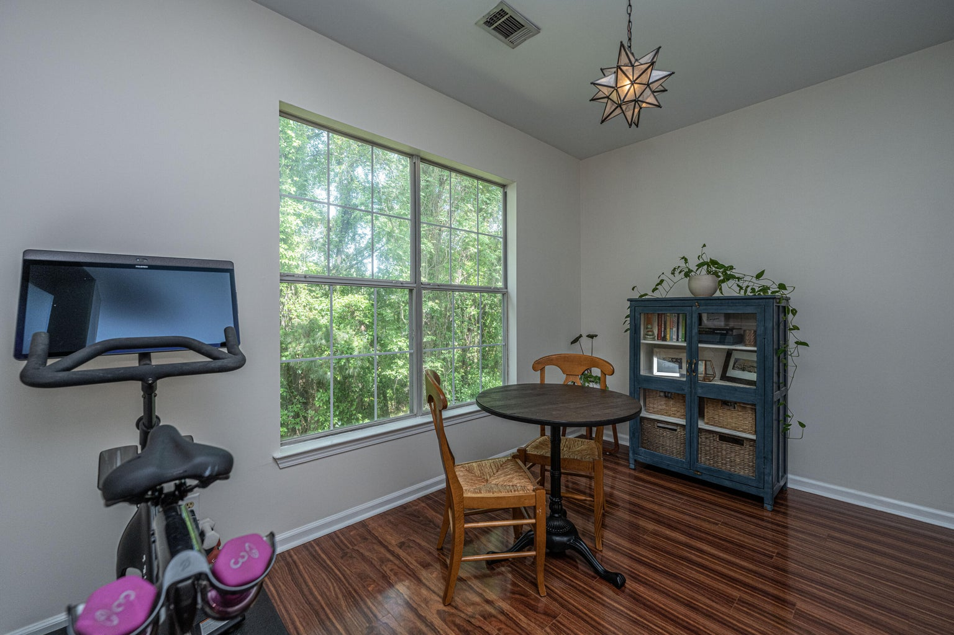
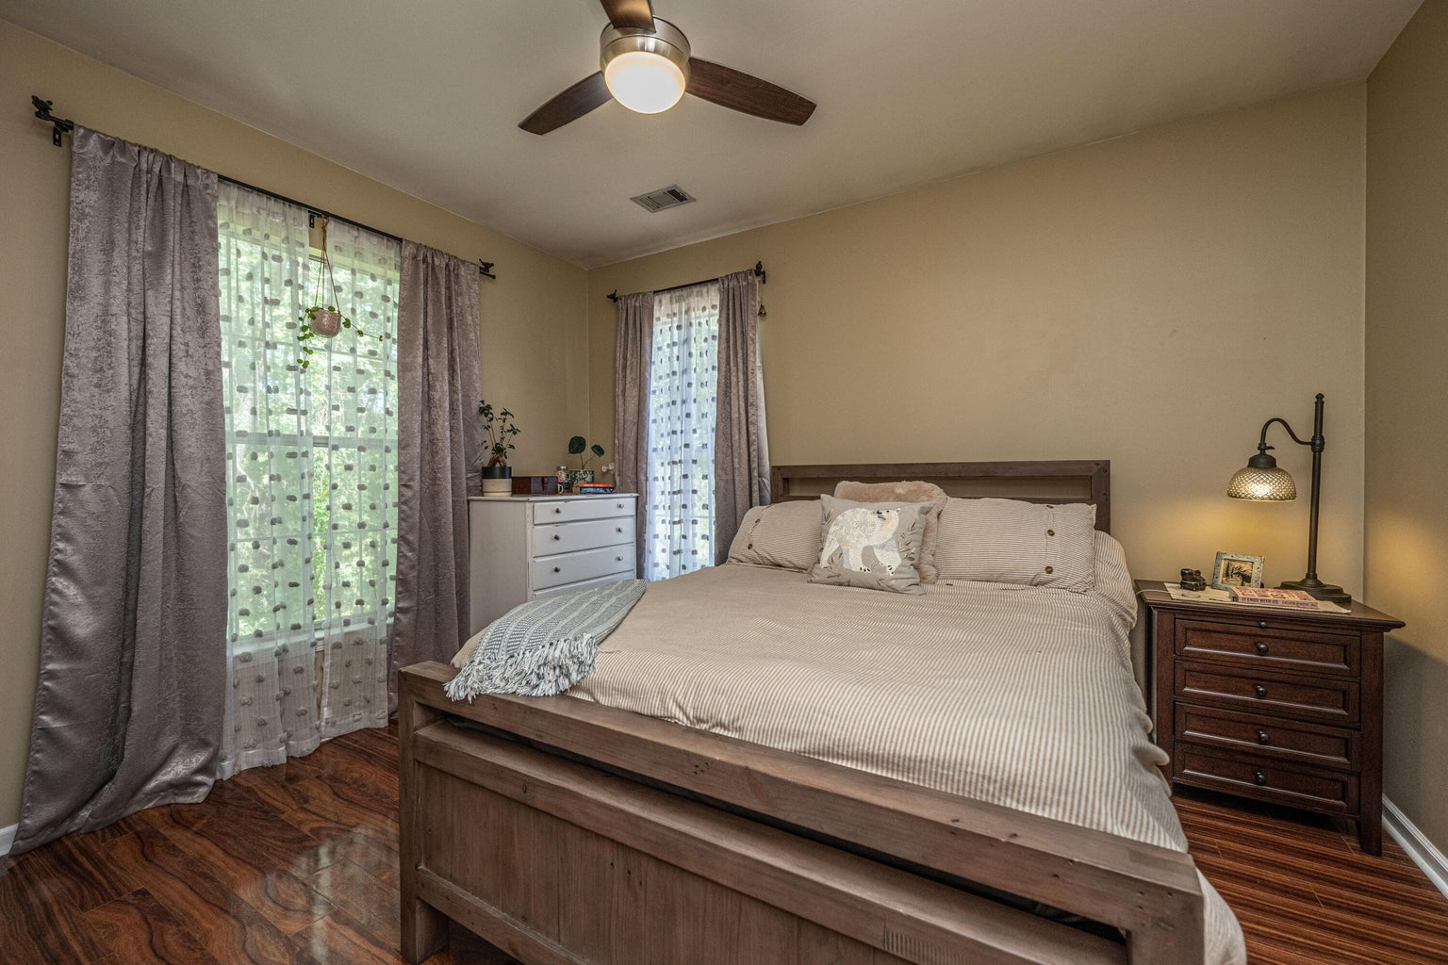



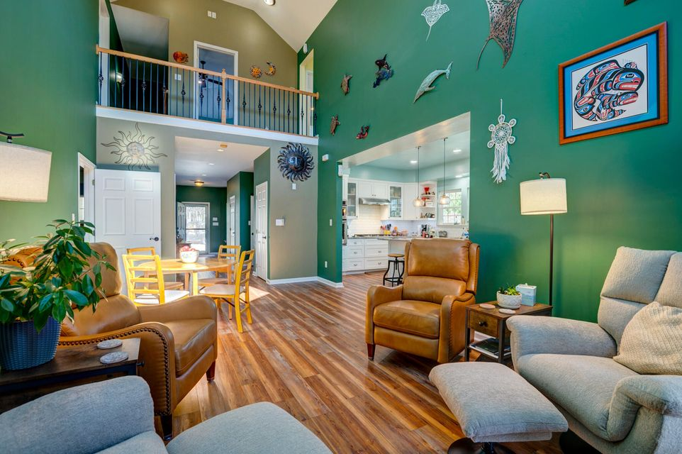
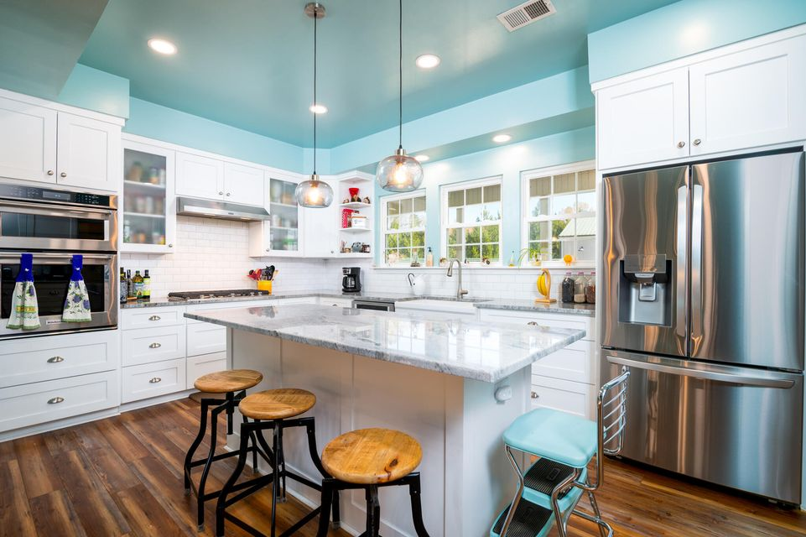
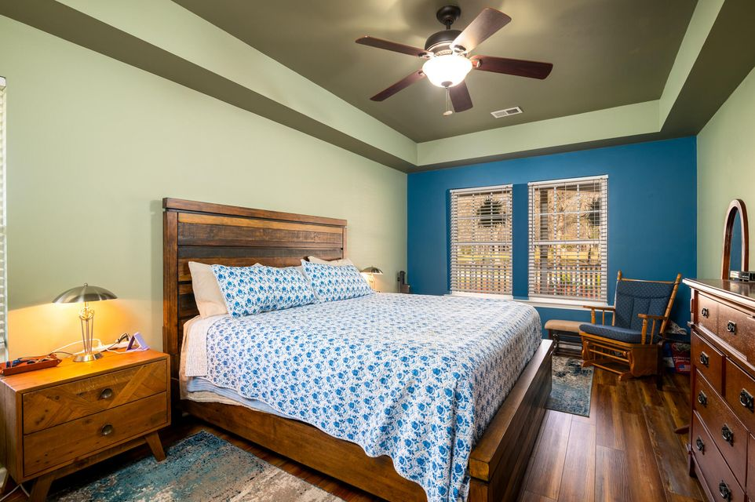
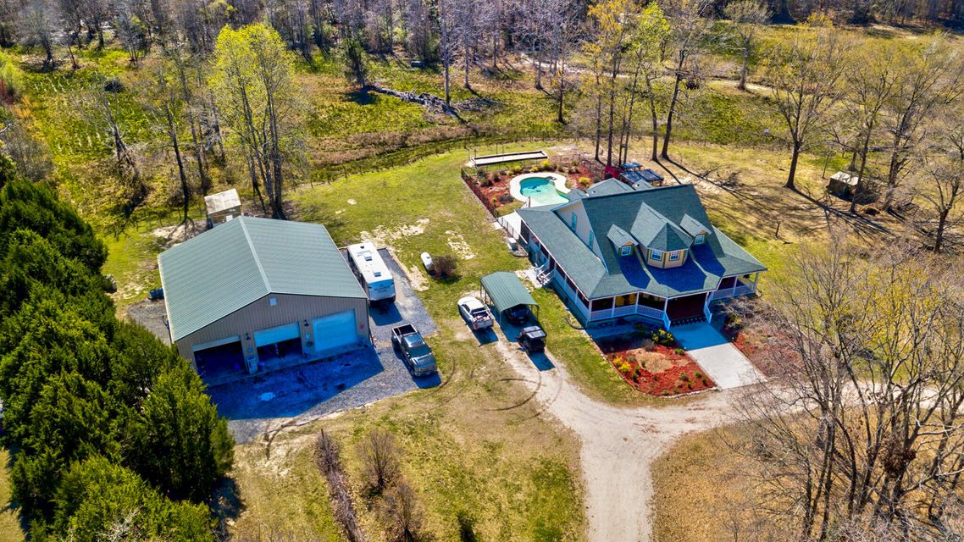

Broker Open Thursday, April 3 from 11-3pm
This stunning 5br, 4.5ba low country custom built home by Simonini Home Builders has been meticulously cared for situated on a .60 acre heavily treed lot on large pond in private gated community of Popular Grove. This spacious , two story, 4721 square foot home features master bedroom suite on the first level, full front porch, beautiful heart pine wood flooring, large entry foyer which separates the private study from formal dining room, open gourmet kitchen with Wolf 6 burner gas stove, built in SubZero refrigerator/freezer, dishwasher, microwave oven and large pantry. Half bath/Powder room under stairway and large utility room for washer and dryer and deep sink and built in cabinets off hallway. The smaller den with gas log fireplace opens to kitchen and breakfast room. The larger fireplace opens to kitchen and breakfast room and offers expansive views of the water year-round. The living room with its second gas log fireplace is great for entertaining away from dining areas. The large master bedroom suite is located on the first level and has travertine tile flooring in the master bath, his and hers walk in closets, separate vanities, soaking tub, and a large separate shower. There is a game room with separate stairs over the two-car garage large enough for a pool table. The second level boasts 4 spacious bedrooms and three bathrooms. On the rear of home is a large screened in porch and open deck overlooking firepit and pond. To reduce maintenance the exposed wood decking has been replaced with Trex decking and exposed rail caps with PVC. Yard has irrigation system and 120-gallon buried propane tank. Sellers just replaced roof with 50 year architectural shingles with transferable warranty. The two electric water heaters have been converted to a single LP gas fired tankless water heater. New epoxy coating on floors and newly finished walls now in two car garage. Neighborhood amenities include Privacy gate, Boat Ramp, Dock facilities, Exercise area, Pool, RV/boat storage and walking/jogging trails. Don't forget the fantastic equestrian center for your horses!
212 Chester Lane
Cottageville, SC 29435 | MLS# 25007805 | $950,000
Country Living at Its Finest - Immaculate Custom Home on 20 Acres! Escape to the serenity of country living with this custom-built, one-owner estate on 20 pristine acres—a rare opportunity offering privacy, space, and endless possibilities. This exceptional property is ideal for those who appreciate open landscapes, outdoor adventure, and a rural lifestyle. A meticulously maintained home welcomes you with an expansive 1,400 sq. ft. wrap-around porch, offering breathtaking 360-degree views of the picturesque countryside—perfect for peaceful mornings and stunning sunsets. A newly built deck extends your outdoor living space, providing the ideal setting for relaxation and entertaining.
Inside, this three-bedroom retreat features a main-floor primary suite, offering a private sanctuary with tranquil views and a walk-in closet by Closets By Design for optimal storage and organization. A spacious media room is also located on the first floor, perfect for entertaining or unwinding in style. Upstairs, you'll find two additional bedrooms with ample storage and a dedicated office - ideal for working from home or creative pursuits.
At the heart of the home, the custom-designed kitchen showcases custom made cabinetry, stunning quartz countertops, and high-end KitchenAid and LG appliances. Thoughtfully crafted for both functionality and elegance, this space is perfect for cooking, gathering, and creating lasting memories.
Step outside to your private saltwater pool, complete with a pergola, outdoor cooking area, and a bocce ball court, creating the ultimate entertainer's paradise. Whether you're soaking in the peaceful surroundings, tending to livestock, or utilizing the expansive garage and workshop space, this estate effortlessly blends luxury, comfort, and practicality.
For hobbyists and enthusiasts, the property features a detached 2,500 sq. ft. garage, spacious enough to accommodate boats, RVs, a car lift, and multiple workshops. The garage also includes 480 sq. ft. of additional storage. Three RV hookups (30/50 amp) are conveniently located on the property, making it perfect for guests, traveling, or extended stays. A carport and greenhouse further enhance the property's impressive functionality.
For those with livestock or equestrian interests, the estate is fully equipped with approximately 11 acres of fenced pastures, designed for efficient animal movement and containment. The working pastures provide ample grazing space for horses and livestock, while a chicken coop adds to the farm-ready appeal.
This is a one-of-a-kind country retreat...schedule your private tour today and experience country living at its finest!
4
3
1,844
Robyn Lane 843-222-5599
robynlane01@icloud.com
Jenny Siggelkow 843-901-3494
jcsiggelkow@gmail.com
ERA Wilder Realty | 537 Folly Road | Charleston, SC 29412

