Slide 1
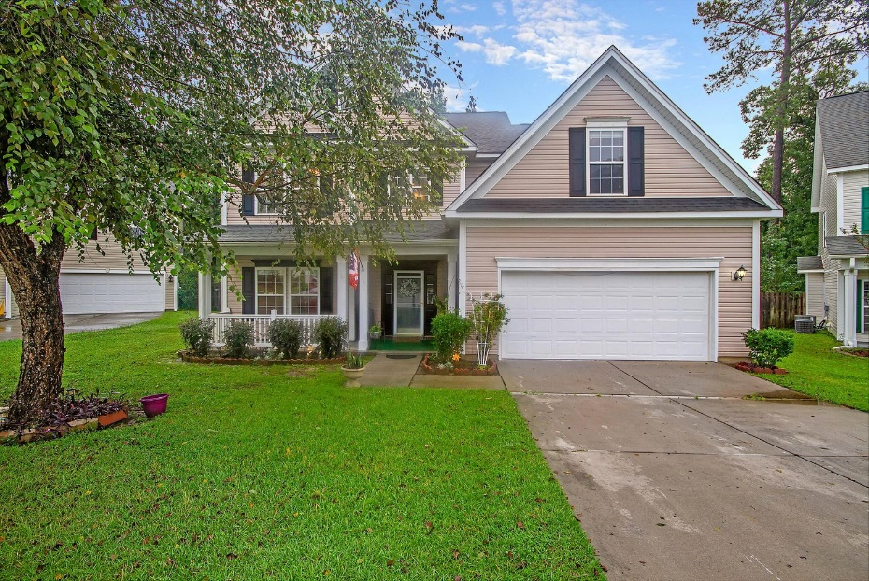
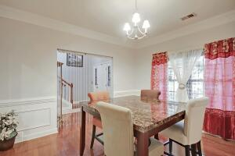
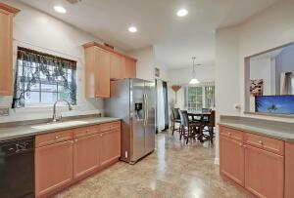
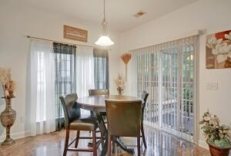
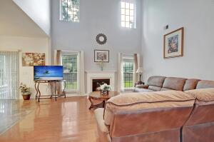
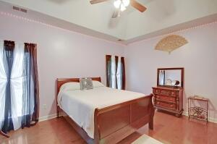
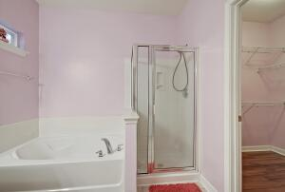
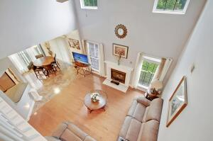
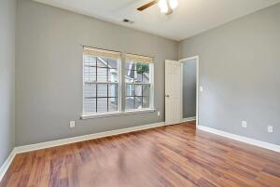
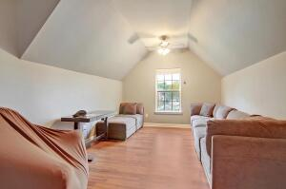
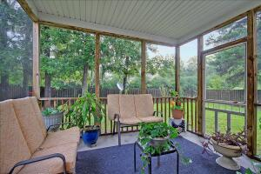
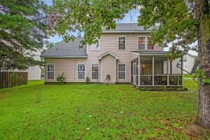
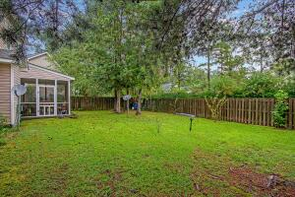


Summerville ~ Cul De Sac ~ Walk to Pool!
212 Curico Lane
Plum Creek
Summerville, SC 29483
MLS# 21025931
$349,900
5 Bedrooms | 2½ Baths | 2,850 sf
Welcome to 212 Curico Lane! This home is ready for you to make it your own! Located in the centrally located neighborhood of Plum Creek, this cul de sac home puts you just steps from the neighborhood pool and a short drive to great local schools, shopping and restaurants. Upon entering, you'll immediately notice the gorgeous wood flooring and natural light. To your left is the large dining room. If you do not have a need for a dining room, this space could easily be a home office. Next is the kitchen, which overlooks the eat in area as well as the family room. This is a great open floor plan with the family room offering a gas fireplace and vaulted ceilings. Down the hall is the first floor large master bedroom and bath. The bathroom has a separate tub and shower and a walk in closet. Upstairs, you'll find three large bedrooms with great closet space, a full bath with dual sinks and a FROG that could be a fifth bedroom if needed. Back downstairs, head out to the screened in porch and enjoy the privacy of your large backyard. This home has it all and is a must see! Dorchester District 2 schools service this home and the HOA fees are low. Come make this home yours today!
Larry & Kathy Mazalatis
Larry Cell 843-693-0529
Kathy Cell 843-693-0159
Office 843-871-9133
AGENTOWNED PREMIERE GROUP | 1800 TROLLEY RD | SUMMERVILLE, SC 29485

